Slide 1
NBA Awareness Workshop

Slide 2
What is Expected from Engineering Activity
Engineering is an activity that is essential to meeting the needs of people, economic development and the provision of services to society
Engineering involves the purposeful application of mathematical and natural sciences and a body of engineering knowledge, technology and techniques.
Engineering must be carried out responsibly and ethically, use available resources efficiently, be economic, safeguard health and safety, be environmentally sound and sustainable and generally manage risks throughout the entire lifecycle of a system
The United Nations Sustainable Development Goals present targets for 2030. Engineers are vital contributors for making progress towards these goals (17 SDGs)

Slide 3
WKs: Knowledge and Attitude Profile
Applying Engineering Knowledge: WK1
Cognitive: Bloom’s Taxonomy
KNOWLEDGE
B
L
O
O
M’
S
H
I
G
H
E
R
level
Problem Solving
Tool Usage
Individual and Collaborative Work
Communication
Project Management and Finance
WK2, WK6
Problem Analysis
Design and Development
Investigation
WK2, WK3, WK4,WK8
S
K
I
L
L
Programme Outcomes
POs
11 POs in New SAR
Psychomotor:
Dave’s Taxonomy
LIFE ACTIVITIES
Affective: Bloom’s Taxonomy
Attitude, Engineer and the World, Ethics, Values, Culture and Life-long learning WK5,WK7, WK9,

Slide 4
POs and WKs
PO1: Engineering Knowledge: Apply knowledge of mathematics, natural science, computing, engineering fundamentals and an engineering specialization as specified in WK1 to WK4 respectively to develop to the solution of complex engineering problems.
PO2: Problem Analysis: Identify, formulate, review research literature and analyze complex engineering problems reaching substantiated conclusions with consideration for sustainable development. (WK1 to WK4)
WK1: A systematic, theory-based understanding of the natural sciences applicable to the discipline and awareness of relevant social sciences. WK2: Conceptually-based mathematics, numerical analysis, data analysis, statistics and formal aspects of computer and information science to support detailed analysis and modelling applicable to the discipline. WK3: A systematic, theory-based formulation of engineering fundamentals required in the engineering discipline. WK4: Engineering specialist knowledge that provides theoretical frameworks and bodies of knowledge for the accepted practice areas in the engineering discipline; much is at the forefront of the discipline.

Slide 5
POs and WKs
PO3: Design/Development of Solutions: Design creative solutions for complex engineering problems and design/develop systems/components/processes to meet identified needs with consideration for the public health and safety, whole-life cost, net zero carbon, culture, society and environment as required. (WK5)
PO4: Conduct Investigations of Complex Problems: Conduct investigations of complex engineering problems using research-based knowledge including design of experiments, modelling, analysis & interpretation of data to provide valid conclusions. (WK8).
WK5: Knowledge, including efficient resource use, environmental impacts, whole-life cost, reuse of resources, net zero carbon, and similar concepts, that supports engineering design and operations in a practice area WK8: Engagement with selected knowledge in the current research literature of the discipline, awareness of the power of critical thinking and creative approaches to evaluate emerging issues

Slide 6
WK1: A systematic, theory-based understanding of the natural sciences applicable to the discipline and awareness of relevant social sciences. WK2: Conceptually-based mathematics, numerical analysis, data analysis, statistics and formal aspects of computer and information science to support detailed analysis and modelling applicable to the discipline. WK3: A systematic, theory-based formulation of engineering fundamentals required in the engineering discipline. WK4: Engineering specialist knowledge that provides theoretical frameworks and bodies of knowledge for the accepted practice areas in the engineering discipline; much is at the forefront of the discipline. WK5: Knowledge, including efficient resource use, environmental impacts, whole-life cost, reuse of resources, net zero carbon, and similar concepts, that supports engineering design and operations in a practice area. WK6: Knowledge of engineering practice (technology) in the practice areas in the engineering discipline. WK7: Knowledge of the role of engineering in society and identified issues in engineering practice in the discipline, such as the professional responsibility of an engineer to public safety and sustainable development.
PO5: Engineering Tool Usage: Create, select and apply appropriate techniques, resources and modern engineering & IT tools, including prediction and modelling recognizing their limitations to solve complex engineering problems. (WK2 and WK6)
PO6: The Engineer and The World: Analyze and evaluate societal and environmental aspects while solving complex engineering problems for its impact on sustainability with reference to economy, health, safety, legal framework, culture and environment. (WK1, WK5, and WK7).

Slide 7
POs and WKs
PO7: Ethics: Apply ethical principles and commit to professional ethics, human values, diversity and inclusion; adhere to national & international laws. (WK9)
PO8: Individual and Collaborative Team work: Function effectively as an individual, and as a member or leader in diverse/multi-disciplinary teams.
PO9: Communication: Communicate effectively and inclusively within the engineering
PO10: Project Management and Finance: Apply knowledge and understanding of engineering management principles and economic decision-making and apply these to one’s own work, as a member and leader in a team, and to manage projects and in multidisciplinary environments.
PO11: Life-Long Learning: Recognize the need for, and have the preparation and ability for i) independent and life-long learning ii) adaptability to new and emerging technologies and iii) critical thinking in the broadest context of technological change. (WK8)
WK8: Engagement with selected knowledge in the current research literature of the discipline, awareness of the power of critical thinking and creative approaches to evaluate emerging issues. WK9: Ethics, inclusive behavior and conduct. Knowledge of professional ethics, responsibilities, and norms of engineering practice. Awareness of the need for diversity by reason of ethnicity, gender, age, physical ability etc. with mutual understanding and respect, and of inclusive attitudes.

Slide 8
PO1: Engineering Knowledge: Apply knowledge of mathematics, natural science, computing, engineering fundamentals and an engineering specialization as specified in WK1 to WK4 respectively to develop to the solution of complex engineering problems.
Breadth, depth and type of knowledge, both theoretical and practical
WK1: A systematic, theory-based understanding of the natural sciences applicable to the discipline and awareness of relevant social sciences.
WK2: Conceptually-based mathematics, numerical analysis, data analysis, statistics and formal aspects of computer and information science to support detailed analysis and modelling applicable to the discipline.
WK3: A systematic, theory-based formulation of engineering fundamentals required in the engineering discipline.
WK4: Engineering specialist knowledge that provides theoretical frameworks and bodies of knowledge for the accepted practice areas in the engineering discipline; much is at the forefront of the discipline.

Slide 9
PO2: Problem Analysis: Identify, formulate, review research literature and analyze complex engineering problems reaching substantiated conclusions with consideration for sustainable development. (WK1 to WK4)
Complexity of analysis
WK1: A systematic, theory-based understanding of the natural sciences applicable to the discipline and awareness of relevant social sciences.
WK2: Conceptually-based mathematics, numerical analysis, data analysis, statistics and formal aspects of computer and information science to support detailed analysis and modelling applicable to the discipline.
WK3: A systematic, theory-based formulation of engineering fundamentals required in the engineering discipline.
WK4: Engineering specialist knowledge that provides theoretical frameworks and bodies of knowledge for the accepted practice areas in the engineering discipline; much is at the forefront of the discipline.

Slide 10
PO3: Design/Development of Solutions: Design creative solutions for complex engineering problems and design/develop systems/components/processes to meet identified needs with consideration for the public health and safety, whole-life cost, net zero carbon, culture, society and environment as required. (WK5)
Breadth and uniqueness of engineering problems i.e. the extent to which problems are original and to which solutions have not previously been identified or codified
WK5: Knowledge, including efficient resource use, environmental impacts, whole-life cost, re- use of resources, net zero carbon, and similar concepts, that supports engineering design and operations in a practice area.

Slide 11
PO4: Conduct Investigations of Complex Problems: Conduct investigations of complex engineering problems using research-based knowledge including design of experiments, modelling, analysis & interpretation of data to provide valid conclusions. (WK8).
Breadth and depth of investigation and experimentation
WK8: Engagement with selected knowledge in the current research literature of the discipline, awareness of the power of critical thinking and creative approaches to evaluate emerging issues

Slide 12
Programme Outcomes
What are the knowledge+Skill+Life Activities and Attitude a graduate is going to inculcate during undergoing the programme and going to practice in the professional career
Generic in nature
Every component is measurable or quantifiable hence, outcomes
In simple language these are the GUNNAs, a graduate is supposed to develop while going through the programme

Slide 13
POs (Outcome) | PSOs (Outcome) | PEOs (Objective)
As per New SAR: 11 Defined by NBA The Graduates to attain during duration of 4 years Attributes or Gunn a students to imbibe/inculcate during the programme Defined for Programme i.e. UG/PG/MBA/MCA etc., Assessed using curriculum, teaching-learning, assessment and evaluation records etc. (09 criteria) | 2 to 3 to be defined for each programme Fill up the gaps to contribute towards POs Attainment before getting the Degree Support specialization or beyond syllabus Defined for a particular programme of a discipline such as UG: Civil or PG: Electrical etc., Assessed using teaching-learning ,assessment records etc. | 4 to 5 to be listed for each programme Expected to achieve after 3 to 4 years or beyond after degree It is like the dream the stakeholders see while establishing the institute/ Launching a programme POs and PSOs are feeder to PEOs Assessed using Alumni data and interacting with employers

Slide 14

PEOs
PEO1:
Globally acclaimed Telecommunication entrepreneur for space industries
PEO2:
Renowned Educationist with extraordinary professional accomplishments
PEO3:
Accomplished Scientist and Keen Investigator of Indian Knowledge System
PEO4:
Technical leaders to spearhead the advancement of telecommunications in the country
Key Interrelationship
Mapping Matrix with Mission: PEOs and Mission Articulation Matrix

Slide 15
OLD Evaluation Criteria NEW
Criteria No. | Criteria | Marks
Program Level Criteria
1. | Vision, Mission and Program Educational Objectives | 50
2. | Program Curriculum and Teaching –Learning Processes | 100
3. | Course Outcomes and Program Outcomes | 175
4. | Students’ Performance | 100
5. | Faculty Information and Contributions | 200
6. | Facilities and Technical Support | 80
7. | Continuous Improvement | 75
Institute Level Criteria
8. | First Year Academics | 50
9. | Student Support Systems | 50
10. | Governance, Institutional Support and Financial Resources | 120
 | Total | 1000
Criterion No. | Criterion Titles | Marks
1 | Outcome based Curriculum | 120
2 | Outcome based Teaching-Learning | 120
3 | Outcome based Assessment | 120
4 | Students’ Performance | 120
5 | Faculty Information | 100
6 | Faculty Contributions | 120
7 | Facilities and Technical Support | 100
8 | Continuous Improvement | 80
9 | Students support and Governance | 120

Slide 16
What and How of OBE
OBE is a measurable quality improvement framework/system
  What do we want our students to achieve or imbibe?
  Captured in PROGRAM OUTCOMES [POs]. Achievement is judged by
  assessment and evaluation of attainment of 11POs:
  How do our students achieve it?
  Launched outcome based curriculum imparted through Teaching-Learning and
  effectiveness is measured by assessment and evaluation.
  Qualitative and quatitative rating is done by asseessment and evaluation
  of Course Outcomes [COs]
  What action is taken to address specialisation of a Programme?
  Defining Programme Specific Outcomes (PSOs)
  How do we close the loop for further improvement (Continuous Quality Improvement (CQI)?
  Make use of the assessment of attainment of COs and POs and taking action on the
  low performing parameters/ criteria

Slide 17
Outcome Based Curriculum
Criterion 1
Maximum Score 120

Slide 18
Outcome Based Curriculum
Multidisciplinary
Interdisciplinary
Scope for critical thinking
Complex problem solving
Ethics and values are integral part
Avenues for emerging technology, tools and experiencing in real environment
Skills and hands-on are distributed and integrated in curriculum spreading over the years
Teaches responsibilities
Contributes to sustainable development
Engaging and challenging leading to Holistic Development
Flexible, Student’s interest driven, diverse and options for student to explore the choices to best of the potential

Slide 19
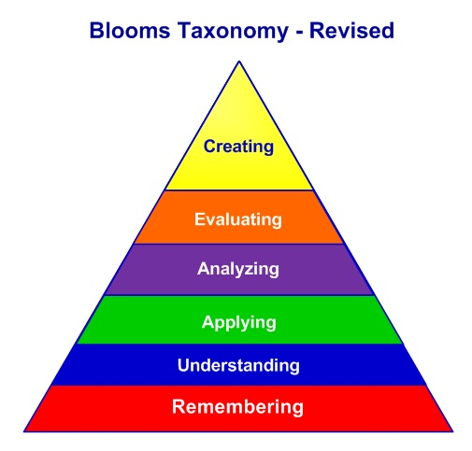
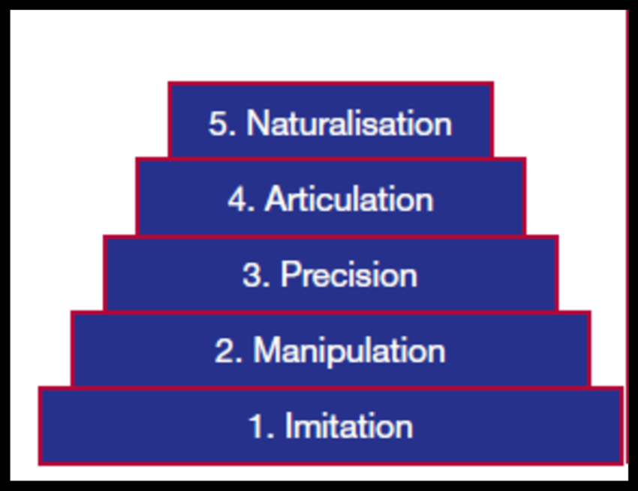
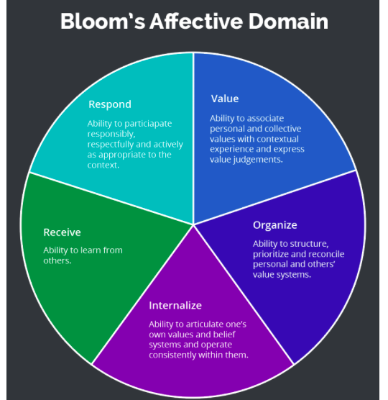
Taxonomy
Dave’s Psychomotor Domain
Respond
Ability to participate responsibly, respectfully and actively
Value
Ability to associate personal and collective values and express value judgement
Receive
Ability to lean from others
Organise
Ability to structure, priotize and reconcile personal and others value systems
Internalise
Ability to articulate one’s values and belief system

Slide 20
Points for Attention in NEW SAR

Slide 21
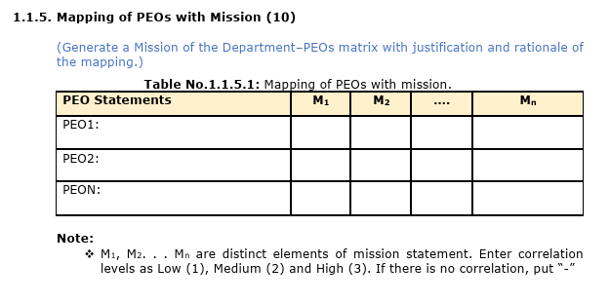


Criterion 1:Outcome based Curriculum: 120

Slide 22
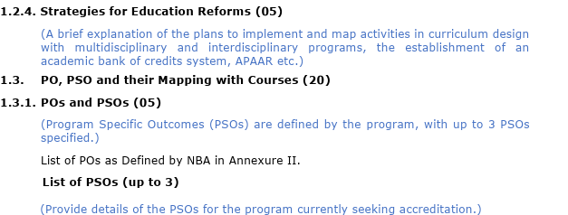




Criterion 1:Outcome based Curriculum: 120

Slide 23
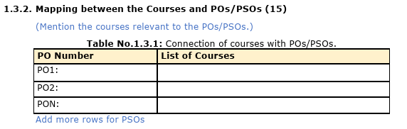
Criterion 1:Outcome based Curriculum: 120

Slide 24
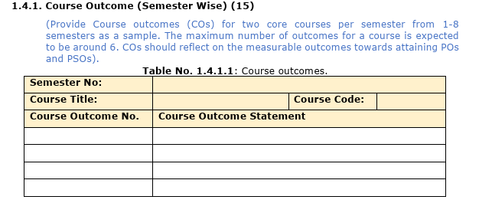
Criterion 1:Outcome based Curriculum: 120

Slide 25
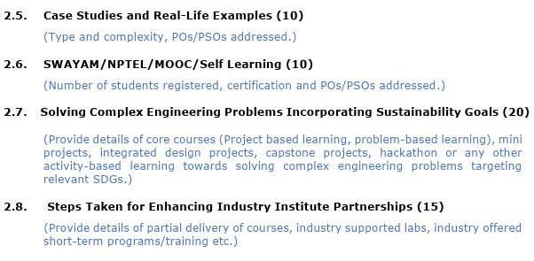




Criterion 2: Outcome based Teaching-Learning: 120

Slide 26
Outcome Based Assessment
Criterion 3
Maximum Score 120

Slide 27
Points for Attention in NEW SAR

Slide 28
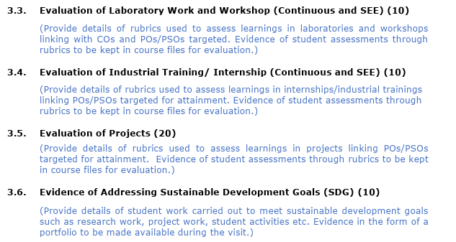







Criterion 3: Outcome based Assessment: 120

Slide 29
Assessment Tools
Mid-Sem and End-Sem Exam
Tutorials
Home Assignment
Laboratory Test
Project Work
Viva, Quiz, Seminar
DIRECT INDIRECT
Result of GATE/CAT/GRE/Any national level test
Professional Society membership and position
Employer’s Feedback
Alumni Feedback
Exit survey
Publications/Patent/
Awards/
Rubrics

Slide 30
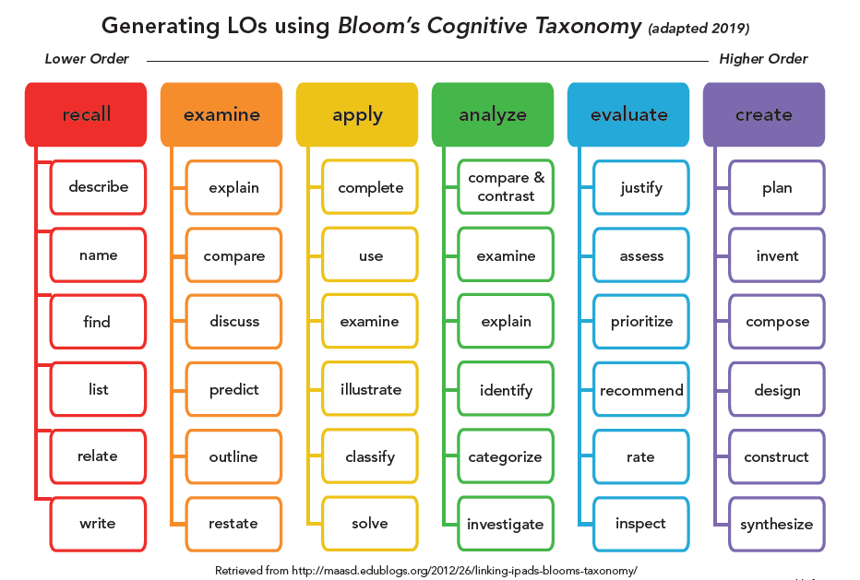
Bloom Verbs

Slide 31
Level | Skill Demonstrated | Question cues / Verbs for tests
2. Understand | understanding information grasp meaning translate knowledge into new context interpret facts, compare, contrast order, group, infer causes predict consequences | describe, explain, paraphrase, restate, associate, contrast, summarize, differentiate interpret, discuss
3. Apply | use information use methods, concepts, laws, theories in new situations solve problems using required skills or knowledge Demonstrating correct usage of a method or procedure | calculate, predict, apply, solve, illustrate, use, demonstrate, determine, model, experiment, show, examine, modify
4. Analyse | break down a complex problem into parts Identify the relationships and interaction between the different parts of a complex problem identify the missing information, sometimes the redundant information and the contradictory information, if any | classify, outline, break down, categorize, analyze, diagram, illustrate, infer, select
Examination Reform Policy
44

Slide 32
Level | Skill Demonstrated | Question cues / Verbs for tests
5. Evaluate | compare and discriminate between ideas assess value of theories, presentations make choices based on reasoned argument verify value of evidence recognize subjectivity use of definite criteria for judgments | assess, decide, choose, rank, grade, test, measure, defend, recommend, convince, select, judge, support, conclude, argue, justify, compare, summarize, evaluate
6. Create | use old ideas to create new ones Combine parts to make (new) whole, generalize from given facts relate knowledge from several areas predict, draw conclusions | design, formulate, build, invent, create, compose, generate, derive, modify, develop, integrate
It may be noted that some of the verbs in the above table are associated with multiple Bloom’s Taxonomy levels. These verbs are actions that could apply to different activities. We need to keep in mind that it’s the skill, action or activity we need students to demonstrate that will determine the contextual meaning of the verb used in the assessment question.
Examination Reform Policy
45

Slide 33
Rubrics and Rubrics based Assessment

Slide 34
Rubrics | Elements of Rubrics
To grade assessment having more than one correct answer in efficient and equitable way Transparency in grading, as well as increase consistency in scoring Understand the purpose of an assignment Provide peer feedback, or to engage in self-assessment | Criteria for assessing Quality Levels Scoring strategy

Slide 35
Example: Analytic Rubrics
Criteria\Quality Level | Needs Improvement (1) | Developing (2) | Sufficient (3) | Above Average (4)
Clarity ( Supported by relevant information and ideas) | Purpose is not well defined Central ideas are not focused Disconnected Relevancy of Information is weak | Purpose is identified Ideas are generally focused to support the ideas Information supports ideas to some extent | Purpose is clear Ideas are focused to support the thesis Relevant information provided to illustrate author’s ideas | Purpose is clear Ideas are always well focused Details are informative and relevant also enrich the work
Organisation ( Sequencing of elements/ ideas) | Ideas and information are poorly sequenced | Presented in an oder | Presented in an order and maintain a logical sequence | Presented in order with logical sequence and connecting very well

Slide 36
Developmental Rubrics
Domain | Initial level (1) | Intermediate Level (2) | Mature Level (3)
Cognitive | Is naïve about cultural practices and values Resists challenges to one’s own belief Views differing cultural prospective as wrong Assumes knowledge is certain | Evolving awareness Acceptance of uncertainty and multiple perspectives Ability to shift from accepting authority’s knowledge claims to personal process for adopting knowledge claims | Ability to shift perspectives and behaviour into an alternative cultural worldview Use multiple cultural frames

Slide 37
Holistic Rubrics
Criterion | Excellent | Good | Adequate | Poor
Site Visit Daily Report | Good and informative thoughtful notes Notes are available for all the sites visited | One day note is missing Efforts on thoughtful notes is less | Every site notes are present Not enough efforts to create thoughtful notes Not more than two days notes are missing | More than two days notes are missing No involvement or thought process
Question-performance | One or two missing | More than two but less than four missing | More than four but less than eight missing | More than eight questions
Reflection on site visit | Site reflection is very good and provided thoughtful input for all sites | Provided reflection action for atleast eight sites | Reflection shown for atleast fours site | Effortless reflection More than two sites

Slide 38
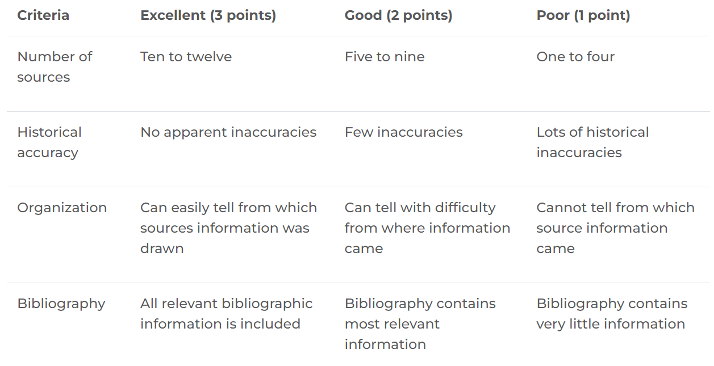
Research Paper

Slide 39
Creating Rubrics | Rubrics Tools
Determine the purpose of the assignment Clearly establish criteria Determine the scoring method Develop the descriptors of the criteria Be sensitive to language used Explore results with hypothetical scoring combinations | Grade scope is a tool that enables efficient and transparent grading. It prompts instructors to grade by question. The Canvas Rubrics Tool can help you grade more quickly by providing an easy way to select the appropriate feedback, or grade by the same criteria for each student. Canvas automatically calculates the total score for you in Speed-grader.

Slide 40
Criteria | Quality Level | Scoring Strategy
Define the distinct elements or competent performance of the tasks central to the assignment. 4 to 6 criteria assess the breadth of knowledge and skill that are most essential to an assignment. Effectively selecting the most important criteria is the first step to designing rubrics | Selecting the number of quality levels is a critical decision As the number of quality levels increases, consistency across graders or reviewers decreases The labeling of quality levels requires careful reflection. Distinguish levels of Knowledge-skill, mastery, or expertise | 1) Setting weights for each criterion, and single scores for each quality level. This approach speeds grading and minimizes discretion that might be a source of bias 2)Weighting criteria and providing a range of scores for each quality level. This approach supports instructors interested in making more fine-grained distinctions. 3)Focusing on the overall combination of quality levels across criteria to assign a grade. This is a simplified grading structure that focuses on the overall grade and holistic judgment of the instructor or grader. For larger course enrollments, this strategy increases the risk of inconsistent or biased grading.

Slide 41
COs And POs Attainment

Slide 42
Procedure for CO attainment calculation
Exam questions CO- PI-BL
CO -attainment
Evaluated Answer scripts
+ Labs, Projects etc., Rubrics

Slide 43
CO attainment calculation
 | Internal Exams |  |  |  |  |  |  |  |  |  |  |  |  |  |  |  |  |  | University Exams
Reg no | Test 1 |  |  |  |  |  | Test 2 |  |  |  |  |  | Project, Assignments, Quiz etc
 | CO1 | CO2 | CO3 | CO4 | CO5 | Total | CO1 | CO2 | CO3 | CO4 | CO5 | Total | CO1 | CO2 | CO3 | CO4 | CO5 | Total | CO1 | CO2 | CO3 | CO4 | CO5 | Internal | Total
24ECE01 | 30 | 40 |  |  |  | 70 |  |  | 20 | 30 | 25 | 75 | 17 | 18 | 15 | 9 | 15 | 74 | 9 | 6 | 20 | 13 | 20 | 24 | 92
24ECE02 | 25 | 37 |  |  |  | 62 |  |  | 25 | 25 | 25 | 75 | 18 | 14 | 8 | 11 | 9 | 60 | 8 | 7 | 15 | 14 | 19 | 23 | 86
24ECE03 | 10 | 30 |  |  |  | 40 |  |  | 14 | 20 | 25 | 59 | 19 | 13 | 11 | 15 | 11 | 69 | 7 | 8 | 20 | 10 | 18 | 21 | 84
24ECE04 | 14 | 20 |  |  |  | 24 |  |  | 10 | 17 | 24 | 51 | 20 | 15 | 17 | 14 | 15 | 81 | 6 | 4 | 11 | 5 | 15 | 17 | 58
No. of Students Attended | 4 | 4 | 4 | 4 | 4 | 4 | 4 | 4 | 4 | 4 | 4 | 4
Max Mark CO wise | 50 | 50 | 0 | 0 | 0 | 100 | 0 | 0 | 30 | 30 | 40 | 100 | 20 | 20 | 20 | 20 | 20 | 100 | 10 | 10 | 20 | 15 | 20 | 25 | 100
Threshold 50% | 25 | 25 |  |  |  | 50 |  |  | 15 | 15 | 20 | 50 | 10 | 10 | 10 | 10 | 10 | 50 | 5 | 5 | 10 | 7.5 | 10 | 12.5 | 50
No. of students above threshold | 2 | 3 |  |  |  | 2 |  |  | 3 | 4 | 4 | 4 | 4 | 4 | 3 | 3 | 3 | 4 | 4 | 3 | 4 | 3 | 4 | 4 | 4
Level | 1 | 3 |  |  |  | 1 |  |  | 3 | 3 | 3 | 3 | 3 | 3 | 3 | 3 | 3 | 3 | 3 | 3 | 3 | 3 | 3 | 3 | 3
 |  |  |  |  |  |  |  | Target
 |  |  |  |  |  |  |  | 50% of students above 50% - 1 (LOW)
 |  |  |  |  |  |  |  | 60% of students above 50% - 2 (MEDIUM)
 |  |  |  |  |  |  |  | 70% of students above 50% - 3 (HIGH)

Slide 44
Setting the Target/ Benchmark
Many methods are available
Method1:
  Same target is identified for all the COs of a course/subject
  Example: the class average mark let say ≥ 70 marks
  In this case all the students are kept in one category and all COs are also kept in same level
  Example:
  Let us consider the case of course title: EM Theory
  Here the students are taught Curl, Divergence, Theorems, Maxwell’s equations, Boundary conditions, Wave equations, Waveguide etc.,. Each unit of the subject has a different difficulty level and so are the tasks to be performed. Hence, does not give the true outcomes but near value of the expected outcomes
  Easy and requires less computation

Slide 45
Method 2:
Targets are the same for all COs and are set in terms of performance levels of different groups of students
Classifies Students into different categories, but does not provide any plan for improvement
15% students below average 60% students at average 25% of students above average
Let us say average score is 65 to 80 marks
Appears to be a good system in heterogeneous case
Computational work is more
Main aim here to make 15% zero
Method 3:
Targets are set for each CO separately
Advantage of finding the difficulty of specific COs
Set based on average i.e. CO1 80%, CO2 65%, CO3 95%, CO4 98%
Computation is more and does not give a distribution of performance

Slide 46
Method 4:
Targets are quantized into certain levels such as Level1, Level 2 and Level 3
Let set Level 3 as 75% students scoring ≥ 80% mark
Level 2: 60% students scoring ≥ 80%
Level 1: 40% Students Scoring ≥ 80%
  Continuous improvement is to attain Level 3
  Generally followed method
  How to fix target whether it is 80 marks or less or more
  For first year 1st Sem: Take average of +2 PCM score or +2 % of Mark
  For rest semesters find the median of formative and summative assessments of at least 3 to 4 batches. Then take average of these medians and ± ø
  Ø is the deviation expected
  Easy create data sheet and also easy to implement
  Difficulty in a heterogeneous system to achieve the set level

Slide 47
PO assessment
Direct 80% | Indirect 20%
• University examination • Internal examination • Tutorials • Class Tests • Direct Assessment Rubrics – Continuous Assessment at laboratory | • Program Exit Survey • Alumni Survey • Employer Survey • External Examiner Feedback • Industrial Visit Evaluation Rubrics • In Plant Training Evaluation Rubrics • Guest Lecture/Workshop/Expert Lecture resource person feedback • Parent Feedback • Students feedback • Co-curricular & Extra Curricular Activities

Slide 48
POs | Exit Survey Question | 0 | 1 | 2 | 3 | 4 | 5 | Total | Weighted Average | % Attainment
PO1 | (i)To what level you could apply science, math and engg. Concept to problem solving (ii) Your ability to support technical problem solving | 0 0 | 0 0 | 2 5 | 3 4 | 14 11 | 6 5 | 25 25 | 3.96 3.64 | 76%
PO2 | Ability to analyse ECE problem | 0 | 0 | 2 | 5 | 14 | 4 | 25 | 3.8 | 76%
PO3 | (i)Capability to design ECE components (ii) Ability to design ECE system | 0 1 | 1 1 | 4 1 | 7 11 | 10 7 | 3 4 | 25 25 | 3.4 3.36 | 68%
PO4 | To what Extent you can analyse and interpret data | 0 | 1 | 1 | 4 | 13 | 6 | 25 | 3.88 | 78%
PO5 | Understanding and ability to use modern tools in ECE problem solving | 0 | 0 | 5 | 5 | 11 | 4 | 25 | 3.56 | 71%
2x2+3x3+14x4+6x5=99/25=3.96 3.96+3.64=7.6=76% 3.8x2=76% and so on

Slide 49
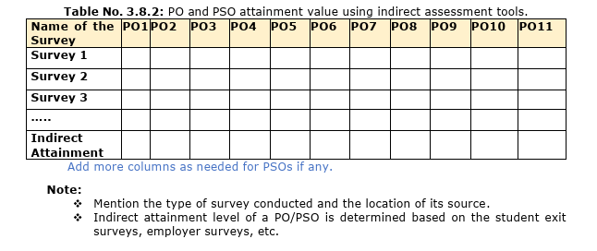




Criterion 3: Outcome based Assessment:120

Slide 50




POs and Assessment
Knowledge-Skill to be attained
KS1.1
COs
POs
KS1.2
KS1.3
Examination Reform Policy
22

Slide 51
ECE: 301 COs | Sub: Electromagnetic Theory Statement of COs: At end of the course the student will be able to do:
C301.1 | Compute the spatial variations in coordinate system by using various coordinate systems
C301.2 | Derive the electric and magnetic force and field intensity for the given charge distributions
C301.3 | Apply the knowledge of electro-magnetic to design waveguides
C301.4 | Relate the volume charge density and electric flux density in a given boundary value problem
C301.5 | Analyze and select a suitable dielectric and magnetic material for cavity resonator application

Slide 52
CO-PO MaTrix for a course : In this case EM Theory
Low: 1 Moderate: 2 High: 3
POs COs | PO1 | PO2 | PO3 | PO4 | PO5 | PO6 | PO7 | PO8 | PO9 | PO 10 | PO 11 | PO 12
C301.1 | 2 |  | 2 | 3 | 2 | 1 | 2 | 1 | 2 | 3 | 1
C301.2 | 3 | 1 | 1 | 2 | 2 | 3 | 2 | 3 | 3 | 3
C301.3 | 2 | 2 |  | 2 | 1 | 3 | 3 | 2 | 2 | 3
C301.4 | 1 | 3 | 3 | 1 | 3 | 2 |  | 2 | 2 | 3 |  | 3
C301.5 | 3 |  | 1 | 2 | 2 | 2 |  |  |  | 1
Avg | 11/5=2.2 | 6/5= 1.2 | 7/5= 1.4 | 10/5= 2 | 10/5= | 11/5=2.2 | 7/5= 1.4 | 8/5= 1.6 | 9/5= 1.8 | 13/5= 2.6 | 1/5= 0.2 | 3/5= 0.6
Rounded Avg. Attainment | 2 | 1 | 1 | 2 | 2 | 2 | 1 | 2 | 2 | 3 | 0 | 1

Slide 53
PO Attainment
Avg. Value of PO from Matrix divide by Highest PO level multiply by CO attainment for the course
(Avg.PO/3) X CO attainment

Slide 54
Attainment of PO
COs | CO Attainment | PO1 2 | PO2 3 | PO3 2 | PO4 2 | PO5 1 | PO6 2 | PO7 3 | PO8 2 | PO9 2 | PO 10 1 | PO 11 1 | PO 12 1
C301.1 | 2.2 | 1.47 | 2,2 | 1.47 |  | .73
C301.2 | 2.8 | 1.87 |  | 1.87 | 1.87 |  |  |  |  |  |  | .93
C301.3 | 1.6 | 1.07 | 1.6 |  |  |  |  | 1.6 |  |  |  |  | .53
C301.4 | 1.4 | .93 | 1.4 | .93 |  | .46
Attainment |  | 1.34 | 1.73 | 1.42 | 1.87 | .59 |  | 1.6 |  |  |  | .93 | .53
( 2.2 x2)/3=1.466=1.47 (2.8 x 2)/3 = 1.866 = 1.87 and so on

Slide 55
Revisiting Key Features for Attention
Extent of gaps identification
Balancing Cognitive, Psychomotor and Affective needs
Internship or Industry component
Stake-holders involvement
Credits through MOOCs
Mapping with COs and POs
Diverse modes of continuous assessment
Quality of questions or tasks
Mapping to COs
Sources of questions and moderation
Rubrics
Distribution Slope of the challenges
Group assessment
  Innovative pedagogy
  Modern Tools
  Industry Experts
  Involvement in Communities
  Industry Labs
  Beyond Syllabus activities
  Complex Problem exercises
  Peers learning
  Diverse Tasks
Efficacy Study
Effectiveness Study
Impact Study
Feedback Analysis
Corrective Actions
Audit both academic and infrastructure
Involvement of third party
Curriculum Design
T-L: Implementation
Assessment and Evaluation
Study Undertaken

Slide 56
Points for Attention in NEW SAR

Slide 57
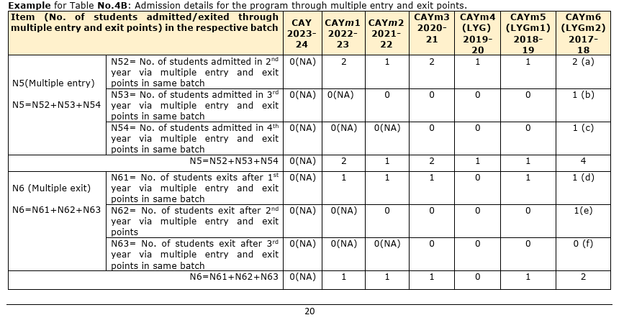
Criterion 4:Students’ Performance: 120

Slide 58
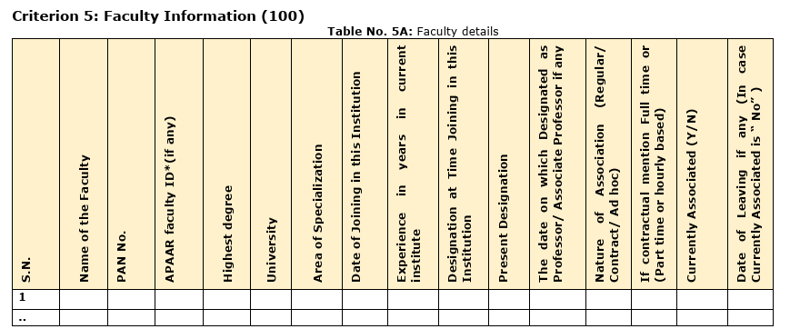

Criterion 5:Faculty Information: 100

Slide 59
Criterion 8: Continuous Improvement: 80
8.2 Academic Audit and Actions thereof during the period of Assessment (15)
Academic audit system/ process and its implementation in relation to continuous improvement

Slide 60
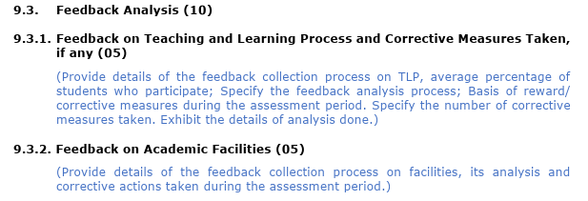

Criterion 9: Students support and Governance: 120

Slide 61
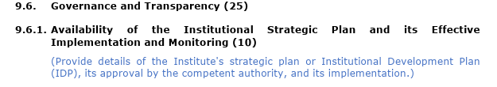


Criterion 9: Students support and Governance: 120

Slide 62
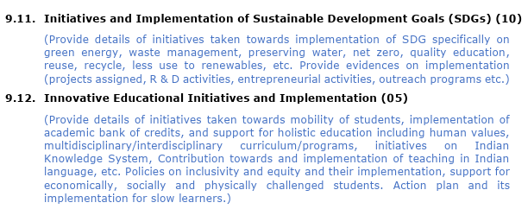






Criterion 9: Students support and Governance:120

Slide 63
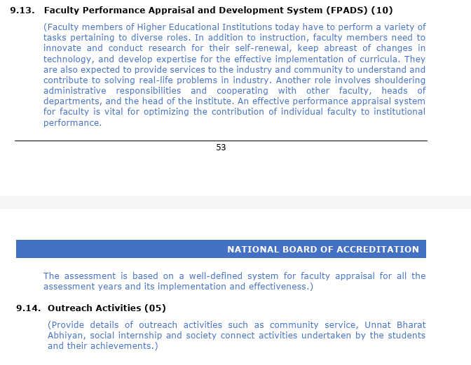

Criterion 9: Students support and Governance:120

Slide 64
OBE Dominant Criteria
Criterion 1
Outcome based Curriculum
Outcome based Teaching Learning
Criterion 2
Criterion 3
Outcome based Assessment
Criterion 6
Faculty Contributions
Criterion 8
Continuous Improvement

Slide 65
Quality of Student Admitted
12
11
1
Entrepreneur
1
POs and PSOs attainment and Records to support
Improvement in Higher Study Admission
10
2
Shortfalls
Continuous
Improvement
Placement and Quality of Hiring
9
3
Plan of Actions
Action Taken on recommendations
8
4
Strategy and Implementation
7
5
Conduct Mechanism
6
Academic Audit
Frequency

Slide 66
Review Activities
Policies and Implementation
Industry Tie-up
Curriculum
Integration of modern tools
Regulatory Requirements
Facilities Upgradation
Students & Faculty Achievements
Instruction and Instructional Resources

Slide 67
Quality Link/Mapping
High POs Attainment------Quality
  Extent of COs contributions to POs: COs and PO→CO mapping
  Contribution of curriculum to COs: Curriculum mapping to COs
  Curriculum Strength for quality support: Curriculum to Taxonomy
  Effective implementation of curriculum: T-L-A → constructive alignment
  Assessment and Evaluation standard: Question mapping to COs
  Feedback and improvement mapping
  Quality and relevance of feedback questions to criteria and Audit

Slide 68
OUTCOMES ANTICIPATED
Enhanced Engagement
Simplification of Complex Concepts
Experiential Learning
Skill Development
Relevant Curriculum
Flexibility in Learning
Knowledge Enhancement
Cultural and Historical Exploration
Effective use of Resource
Professional Development
Quality Assessment Methods
Empowerment and Confidence
Influence Attitude
Increase in Multi-disciplinary Learning
Research Models

Slide 69
More on POs, COs and OBE

Slide 70
PO3: Design/Development of Solutions: Design solutions for complex engineering problems and design system components or processes that meet the specified needs with appropriate consideration for public health and safety, and cultural, societal, and environmental considerations.
Knowledge and Task Levels:
Demonstrate an ability to define a complex, open-ended problem in engineering terms.
Demonstrate an ability to generate a diverse set of alternative design solutions.
Demonstrate an ability to select the optimal design scheme for further development.
Demonstrate an ability to advance an engineering design to the defined end state.
20

Slide 71
(ii) Define Performance Indicators: For each of the task identified, define performance Indicators (PIs) that are explicit statements of expectations of the student learning.
Example:
Demonstrate an ability to generate a diverse set of alternative design solutions
Performance Indicators:
  Apply formal idea generation tools to develop multiple engineering design solutions
  Build models, prototypes, algorithms to develop a diverse set of design solutions
  Identify the functional and non-functional criteria for evaluation of alternate design solutions
21

Slide 72
01
Engineering Knowledge: Does it require knowledge math, physical science, engineering fundamental and specialization: Yes: PO1
02
Problem Analysis: Does it require formulation and survey of research literature: Yes: PO2
Design/Development of Solution: Is it a design problem with consideration for public health: Yes: PO3
03
Design an antenna for mobile phone to radiate in 90 degree with low SAR and with AI support, take a decision on clearance for the company
04
Conduct investigation: Does it require research based knowledge and analysis: Yes: PO4
05
Modern Tool Usage: Is there a need to use ant modern tool : YES: PO5
06
The Engineer and Society: Does it require professional engineering practice to assess societal health and safety: Yes PO6
06
Environment and sustainability: Does it relate to sustainability : NO PO6
07
Ethics: Does it require to apply ethical principle: Yes PO7
Individual and Team Work: Communication: Yes
Project Management and Finance: Life Long Learning : NO
08-09

Slide 73
Example
Course: Chemistry
Students activities
TEST QUESTION
Topic: Salt Preparation
Salt preparation is a process of mixing two or more chemicals through suitable process to make the compound with proper strength, crystallinity and durability as per TATA salt
Here students have the choice of selecting different chemicals, select the different processes to produce the salt matching with that of TATA
State the different processes of chemical mixing techniques for salt preparation
CO1 : Able to explain chemical mixing techniques for salt preparation
PO1: Engineering Knowledge

Slide 74
Example
Observation
questions
Decision
Does not reflect use of math, science and engineering principle and engineering application
It is remembrance only
Test question also does not match PO1
1.Does the test question correlate well with the co1
2.Does this CO1 reflects the intended
measurement from PO 1
Correlation between CO-PO is -----------
a. Strong
b. Moderate
c. Weak
Select the correct one
CO1 : Able to explain chemical mixing techniques for salt preparation
PO1: Engineering Knowledge

Slide 75
Subject/Course CHEM-101
POs COs | PO1 | PO2 | PO3 | PO4 | PO5 | PO6 | PO7 | PO8 | PO9 | PO 10 | PO 11 | Remarks
CO 1
CO 2
CO 3
CO n
3= Strong 2= Moderate 1= Weak

Slide 76
COURSE | COs | PO1 | PO2 | PO3 | PO4 | PO5 | PO6 | PO7 | PO8 | PO9 | PO10 | PO11
Subject1 | CO1 | 3 | 3 | - | - | - | - | - | - | - | - | -
 | CO2 | 3 | 3 | - | - | - | - | - | - | - | - | -
Subject2 | CO1 | 3 | 2 | - | 3 | - | 3 | 3 | - | - | - | -
 | CO2 | 3 | 3 | - | - | - | 3 | 3 | - | - | 3 | -
 | CO3 | - | - | 3 | - | - | - | 3 | 3 | - | 3 | -
Subject3 | CO1 | 3 | 3 | - | - | - | - | - | - | - | - | -
 | CO2 | 3 | 3 | - | - | - | - | - | - | - | - | -
 | CO3 | 3 | 3 | - | - | - | - | - | - | - | - | -
 | CO4 | 3 | 3 | 2 | - | - | 3 | - | - | - | - | -
Subject4 | CO1 | 3 | - | - | - | - | - | - | - | - | - | -
 | CO2 | - | 3 | 3 | - | - | - | - | - | - | - | -
 | CO3 | - | 3 | 3 | - | - | - | - | - | - | - | -
 | CO4 | - | - | - | - | - | - | - | 3 | 3 | - | -
Subject5 | CO1 | 3 | 3 | - | - | - | - | - | - | - | - | -
 | CO2 | 3 | 3 | - | - | - | - | - | - | - | - | -
 | CO3 | 3 | 3 | 3 | - | - | - | - | 3 | - | - | -
Major Project | CO1 | - | - | - | - | - | - | 3 | - | 3 | - | -
 | CO2 | 3 | 3 | 3 | 3 | - | - | - | 3 | 3 | - | -
 | CO3 | - | - | - | - | 3 | - | - | - | 3 | - | -
 | CO4 | - | - | - | - | - | - | - | - | 3 | 3 | 2
CO-PO Matrix for all Subjects and All POs

Slide 77
CO-PO mapping (How to Present)
1: Slight (Low) 2: Moderate (Medium) 3: Substantial (High) : blank: no correlation
 |  |  |  |  |  | PO 1 | PO 2 | PO 3 | PO 4 | PO 5 | PO 6 | PO 7 | PO 8 | PO 9 | PO 10 | PO 11 | PO 12
SEM |  | SUB CODE | Course | COURSE OUTCOMES | COURSE OUTCOMES Statement
III | C203 | BEXX201 | Course name | C203.1 | . | 3 | 3 | 2 | 2 | - | - | 3 | 3 | 2 | 2 | 1 | -
 |  |  |  | C203.2 |  | - | - | - | - | - | - | 3 | 3 | 3 | 2 | 1 | -
 |  |  |  | C203.3 |  | - | - | - | - | - | - | 3 | 2 | 2 | 2 | 1 | -
 |  |  |  | C203.4 |  | - | - | - | - | - | - | 3 | 2 | 2 | 2 | 1 | -
 |  |  |  | C203.5 |  | - | - | - | - | - | - | 2 | 2 | 2 | 2 | 1 | -
 |  |  |  | C203.6 |  | - | - | - | - | - | - | 2 | 2 | 2 | 2 | 1 | -

Slide 78
Model Question Paper
Course: EM Theory (ECE 503)
Maximum Marks :100; Duration: 03 hours
Q.No | Questions | Marks | CO | BL
1(a) | Explain the steps involved in finding curl of a vector. | 08 | CO1 | L2
1(b) | Apply stoke theorem to solve the given problem | 12 | CO2 | L3
2(a) | State Maxwell’s equations. | 08 | CO2 | L1
2b | Design a cylinrical waveguide with the given parameters and analyse the performance using PML boundary condition | 12 | CO3 | L4
3a | Compare rectangular coordinate system with that of cylindical | 08 | CO3 | L2
Appendix
91

Slide 79
Let Us now Define OBE
A process of designing ,revising and restructuring of curriculum and its implementation through innovative T-L and use of continuous assessment and evaluation that reflects the achievement of higher order learning and skill rather than accumulation of credits through rote learning thus, making our students capable of solving complex problems using modern tool with values and ethics while keeping sustainability, society, culture and environment in mind.

Slide 80

Learning Principles
Focused (No ambiguity)
Expanded Opportunity
Knowledge, Skill and Attitude Integration
OBE
High Expectation

Slide 81
Outputs | Outcomes
Activities we do to achieve outcomes Conduct FDP on NBA to train faculty members If the patient having high fever give paracetamol | Results of the activities to be demonstrated All the departments/Programmes of the institute got accredited Has the patient fever comedown

