Slide 1
NBA Awareness Workshop on OBE & Accreditation
Self Assessment Report (SAR) - 2024
Undergraduate Engineering Programs
(GAPC V 4.0)
(TIER-I/II – Institutions)

Slide 2
SAR Context
Provides preparedness status at I/P level for the NBA visit,
Provides the first impression about the I/P to the evaluation team,
Presents crisp program status to the evaluation team and addresses process and the extent to which, a program meets each criterion,
Provides documented evidences, which the evaluation team maps/matches with the visual /oral evidences during the visit.

Slide 3
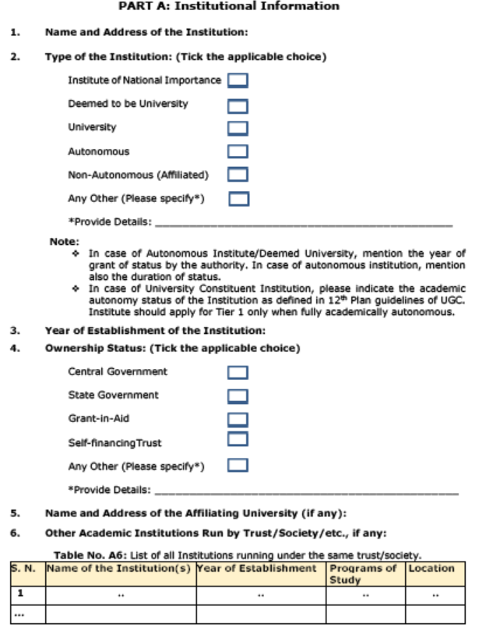

Slide 4
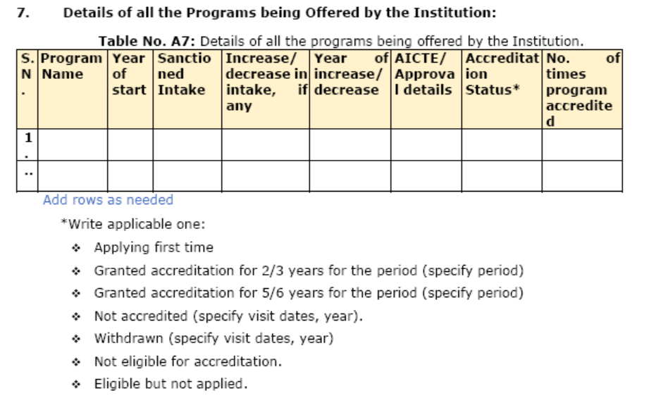

Slide 5
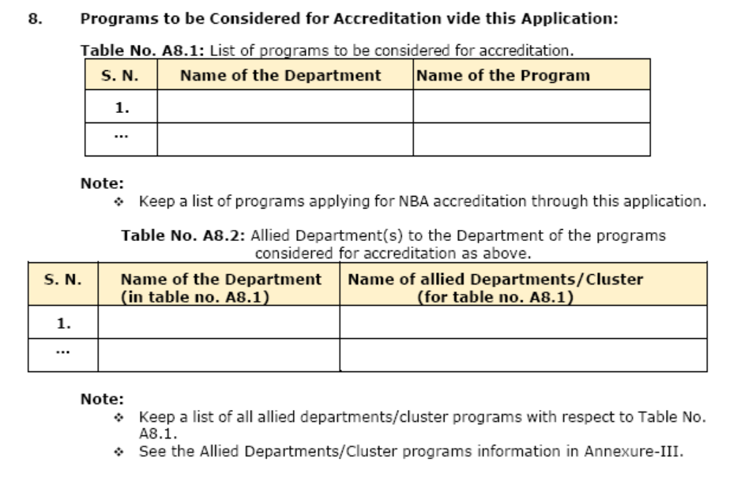

Slide 6
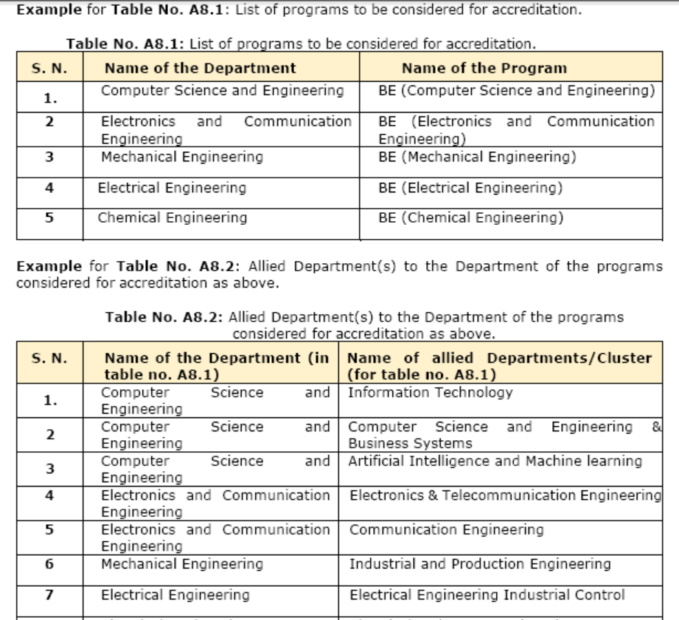

Slide 7
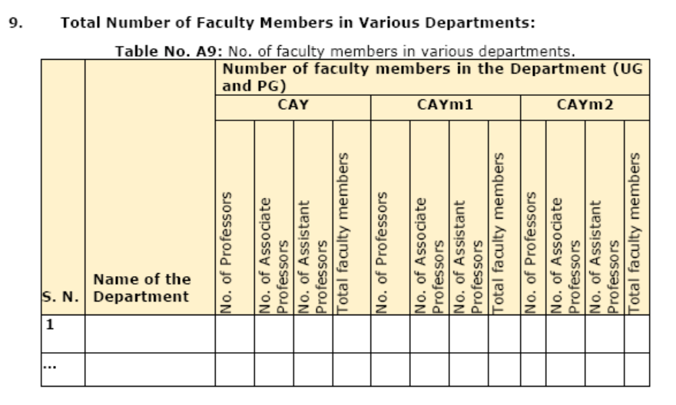

Slide 8
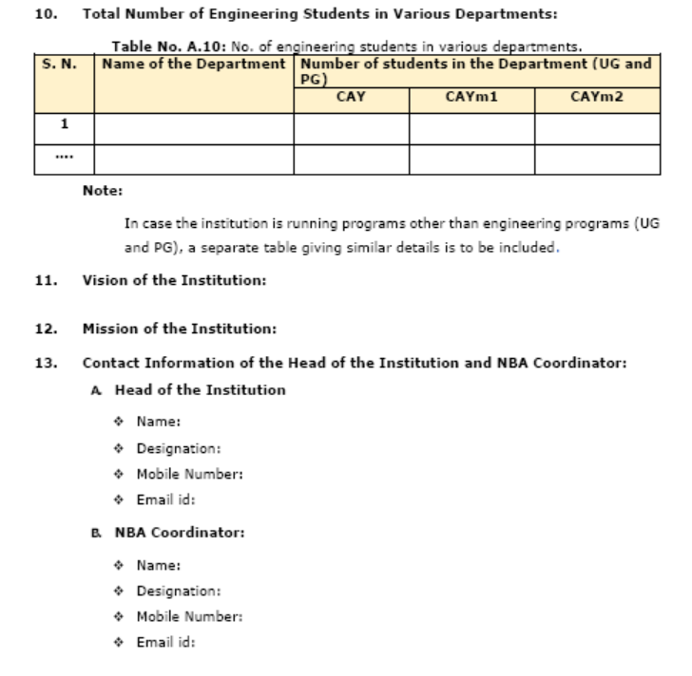

Slide 9
Continuous Quality Improvement
SAY
What you want to
Continuous Quality Improvement
DO
Improve it
What you Say
What you
Proved
Prove it
What you Do

Slide 10
OBE 3 Pillars….
Curriculum
Evaluation
Teaching,Learning
CI

Slide 11
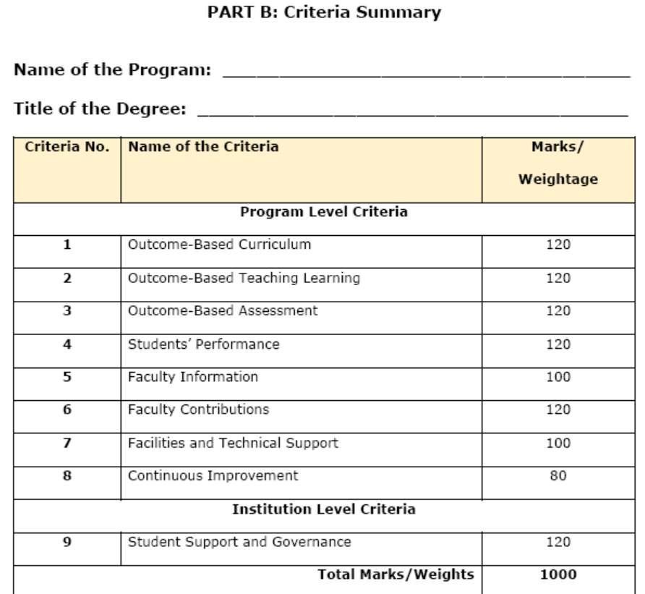

Slide 12
Comparison of Marks/Weightage between Tier-I & Tier-II
Program Level Criteria
Criterion’s |  | Tier-I | Tier-II
Criterion 1 | Outcome-Based Curriculum | 120 | 120
Criterion 2 | Outcome-Based Teaching Learning | 120 | 120
Criterion 3 | Outcome-Based Assessment | 120 | 120
Criterion 4 | Students’ Performance | 120 | 120
Criterion 5 | Faculty Information | 100 | 100
Criterion 6 | Faculty Contributions | 120 | 120
Criterion 7 | Facilities and Technical Support | 100 | 100
Criterion 8 | Continuous Improvement | 80 | 80
Institution Level Criteria
Criterion 9 | Student Support and Governance | 120 | 120

Slide 13
Comparison of Marks/Weightage between Tier-I & Tier-II
Criterion’s |  | Tier-I | Tier-II
Criterion 1 | Outcome-Based Curriculum | 120 | 120 | Outcome-Based Curriculum
1.1 | Vision, Mission and Program Educational Objectives (PEOs) | 35 | 40 | Vision, Mission and Program Educational Objectives (PEOs)
1.1.1. | State the Vision and Mission of the Institute and the Department | 05 | 05 | State the Vision and Mission of the Institute and the Department
1.1.2. | State PEOs of the Program | 05 | 05 | State PEOs of the Program
1.1.3. | Process of Defining Vision, Mission and PEOs | 10 | 15 | Process of Defining Vision, Mission and PEOs
1.1.4. | Dissemination of Vision, Mission and PEOs | 05 | 05 | Dissemination of Vision, Mission and PEOs
1.1.5. | Mapping of PEOs with Mission | 10 | 10 | Mapping of PEOs with Mission

Slide 14
PART B: Program Level Criteria

Slide 15
Criterion 1: Outcome-based Curriculum (120)
1.1. Vision, Mission and Program Educational Objectives (PEOs) (35) (Provide details of vision and mission and program education objectives.)
1.1.1. State the Vision and Mission of the Institute and the Department (05)
(Vision statement typically indicates aspirations and Mission statement states the broad approach to achieve aspirations.)
1.1.2. State PEOs of the Program (05)
(State the PEOs (3 to 5) of program seeking accreditation.)

Slide 16
Vision and Mission Statements
(as per NBA document)
Vision is a futuristic statement that the institution would like to achieve over a long period of time, and Mission is the means by which it proposes to move toward the stated Vision
Example..
Vision:
To emerge as one of the nation’s finest Institutions in the field of Technical Education and Research through focused, effective and sustained monitoring of its programmes and resources.
Mission:
To develop high quality professionals ingrained in ethics, wisdom and creativity for the betterment of the society.
Action verb ?? Verb

Slide 17
Corrected Vision and Mission Statements
Vision:.
To emerge as one of the nation’s finest Institutions of higher learning in the field of Technical Education to develop professionals who are technically competent, ethical, environment friendly for betterment of society.
Mission:
Accomplish stimulating learning environment for students through quality teaching, research and outreach activity by providing state of the art facilities, industry exposure and guidance of dedicated faculty

Slide 18
Department Vision and Mission Statements (Sample)
Vision:
To be an excellent centre for imparting quality higher education in Civil Engineering for a constantly changing societal needs with credibility, integrity and ethical standards.
Mission:
Accomplish excellence in curricular, co-curricular activities with a committed faculty through teaching and research which creates technically competent and dedicated civil engineers to serve their surroundings with pride.

Slide 19
Program Educational Objective-PEO
The educational objectives of an engineering degree program are the statements that describe the expected achievements of graduates in their career, and also in particular, what the graduates are expected to perform and achieve during the first few years after graduation.
The PEOs, may be guided by global and local needs, vision of the Institution, long term goals etc.
For defining the PEOs the faculty members of the program must continuously work with all Stakeholders: Local Employers, Industry, Students and the Alumni

Slide 20
PEOs (Samples)
PEO1:
Graduate will compete on a global platform to pursue their professional career in Electrical Engineering and allied disciplines.
PEO2:
Graduates will pursue higher education and/or engage in continuous up gradation of their professional skills.
PEO3:
Graduate will communicate effectively and will demonstrate professional behaviour while working in diverse team.
PEO4:
Graduates will demonstrate concern for society and environment.

Slide 21
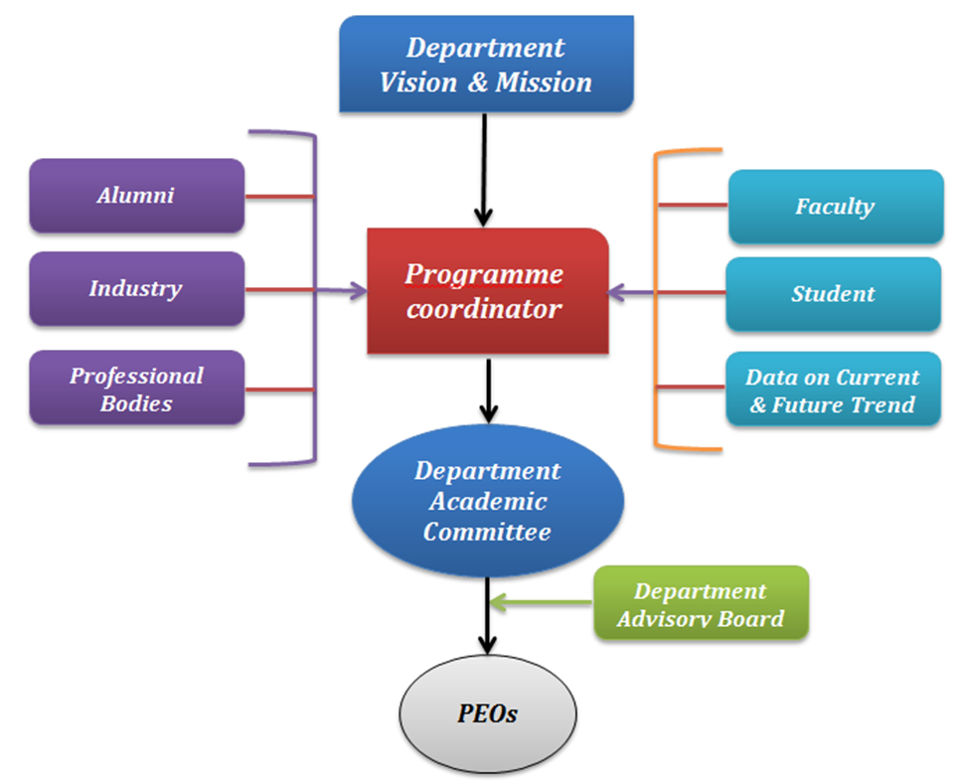
Criterion 1: Outcome-based Curriculum (120)
1.1.3. Process of Defining Vision, Mission and PEOs (10)
(Articulate the process involved in defining the Vision and Mission of the department and PEOs of the program.)
1.1.4. Dissemination of Vision, Mission and PEOs (05)
(Describe where (websites, curricula, posters etc.) the Vision, Mission and PEOs are published and detail the process which ensures awareness among internal and external stakeholders with effective process implementation.

Slide 22
Criterion 1: Outcome-based Curriculum (120)
1.1.5. Mapping of PEOs with Mission (10)
(Generate a Mission of the Department–PEOs matrix with justification and rationale of the mapping.)
Table No.1.1.5.1: Mapping of PEOs with mission
PEO Statements | M₁ | M₂ | …. | M_{n}
PEO1:
PEO2:
PEON:
Note:
❖ M₁, M₂. . . M_{n} are distinct elements of mission statement. Enter correlation levels as Low (1), Medium (2) and High (3). If there is no correlation, put “-”

Slide 23
Mission of the Department:
M1: Make competent Civil Engineers with high level of professional, moral and ethical values
M2:Impart highest standards in theoretical as well as practical knowledge and skill set
M3:Establish Center of Excellence in major areas of Civil Engineering to respond to the current and future needs of the industry
PEO1: Graduates will have successful career in the field of Civil Engineering
PEO2: Graduates will respond to growing demands of society through professional and ethical practices
PEO3: Graduates will pursue lifelong learning including higher studies in the field of Civil Engineering
What is Expected here ?
Establish consistency of PEOs with Mission of the Department (15)
Generate a “Mission of the Department – PEOs matrix” with justification and rationale of the mapping
PEO Statements | M1 | M2 | …… | Mn
PEO 1 | 3/2/1 ? | 3/2/1 ?
PEO 2
PEO 3 | 3/2/1 ?

Slide 24
Criterion 1: Outcome-based Curriculum (120)
1.2. Curriculum Structure and Features (30)
1.2.1. State the Process for Developing/Revising the Program Curriculum (10)
Describe the process that periodically documents and demonstrates how the program curriculum has evolved, considering the Washington Accord Knowledge and Attitude Profile (WKs) and the Program Outcomes (POs) defined by the NBA, as listed in Annexure-II.
    (Describe the process involving both internal and external stakeholders in framing the curriculum.)

Slide 25
Criterion 1: Outcome-based Curriculum (120)
1.2.2. Curriculum Structure (10)
(Provide details of courses in terms of teaching and learning scheme and number of credits in the Program curriculum.)
Table No.1.2.2.1: Details of various courses presented in terms of teaching and learning scheme.
Course Code | Course Title | Teaching & Learning Scheme
 |  | Class room Instruction (CI) (in hours per semester |  | Lab Instruction (LI) (in hours per semester | Team Work (TW) Self Leaning (SL) (TW+SL)(in hours per semester) | Total no. of Hours per semester | Total Credits (C)* (Total Hours/30)
 |  | L | T | P | SL
101 | C++ | 42 | 14 | 28 | 36 | 120 | 120/30=4
102 | Chemistry Lab |  |  | 42 | 18 | 60 | 60/30=2
…
This is as per the new National Credit Framework, which accounts for 30 hrs. of learning as equivalent to 1 credit. Those universities which are still following the LTP will transform them into no. of hours and fill in the above table.

Slide 26

Criterion 1: Outcome-based Curriculum (120)
1.2.3. Components of Curriculum (05)
(Provide details of Curriculum components for all relevant Years.)
Table No.1.3.3.1: Program curriculum grouping based on curriculum components.
Curriculum Component | Curriculum Content (% of total number of credits of the program) | Total number of contact hours | Total number of credits
Basic Sciences
Basic Engineering
Humanities and Social Sciences
Program Core
Program Electives
Open Electives
Project(s)
Internships/Seminars
Any other (Please specify)
Total number of Credits:
Add more rows, if required

Slide 27

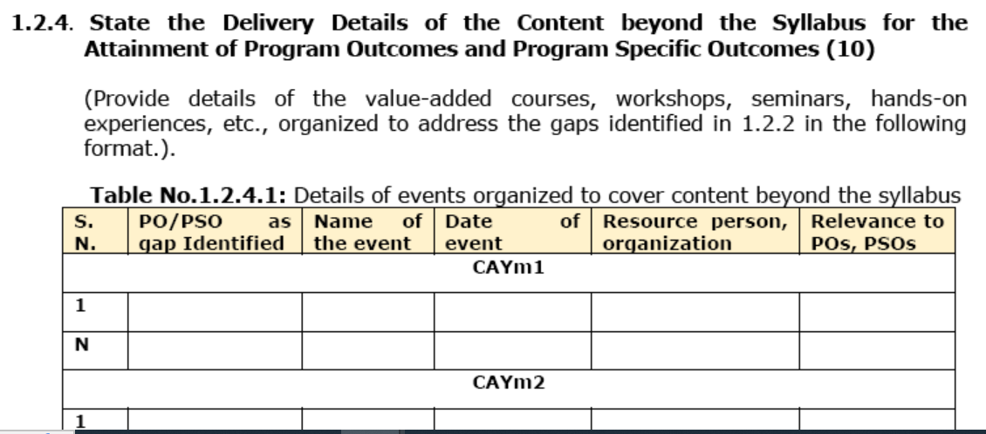
Tier 2

Slide 28
Criterion 1: Outcome-based Curriculum (120)
1.2.4. Strategies for Education Reforms (05)
(A brief explanation of the plans to implement and map activities in curriculum design with multidisciplinary and interdisciplinary programs, the establishment of an academic bank of credits system, APAAR etc.)
1.3. PO, PSO and their Mapping with Courses (20)
1.3.1. POs and PSOs (05)
(Program Specific Outcomes (PSOs) are defined by the program, with up to 3 PSOs specified.)
List of POs as Defined by NBA in Annexure II.
List of PSOs (up to 3)
(Provide details of the PSOs for the program currently seeking accreditation.)

Slide 29
POs (Defined by NBA)
PO1: Engineering Knowledge: Apply knowledge of mathematics, natural science, computing, engineering fundamentals and an engineering specialization as specified in WK1 to WK4 respectively to develop to the solution of complex engineering problems.
PO2: Problem Analysis: Identify, formulate, review research literature and analyze complex engineering problems reaching substantiated conclusions with consideration for sustainable development. (WK1 to WK4)
PO3: Design/Development of Solutions: Design creative solutions for complex engineering problems and design/develop systems/components/processes to meet identified needs with consideration for the public health and safety, whole-life cost, net zero carbon, culture, society and environment as required. (WK5)
PO4: Conduct Investigations of Complex Problems: Conduct investigations of complex engineering problems using research-based knowledge including design of experiments, modelling, analysis & interpretation of data to provide valid conclusions. (WK8).
PO5: Engineering Tool Usage: Create, select and apply appropriate techniques, resources and modern engineering & IT tools, including prediction and modelling recognizing their limitations to solve complex engineering problems. (WK2 and WK6)
PO6: The Engineer and The World: Analyze and evaluate societal and environmental aspects while solving complex engineering problems for its impact on sustainability with reference to economy, health, safety, legal framework, culture and environment. (WK1, WK5, and WK7).

Slide 30
POs (Defined by NBA)
PO7: Ethics: Apply ethical principles and commit to professional ethics, human values, diversity and inclusion; adhere to national & international laws. (WK9)
PO8: Individual and Collaborative Team work: Function effectively as an individual, and as a member or leader in diverse/multi-disciplinary teams.
PO9: Communication: Communicate effectively and inclusively within the engineering community and society at large, such as being able to comprehend and write effective reports and design documentation, make effective presentations considering cultural, language, and learning differences
PO10: Project Management and Finance: Apply knowledge and understanding of engineering management principles and economic decision-making and apply these to one’s own work, as a member and leader in a team, and to manage projects and in multidisciplinary environments.
PO11: Life-Long Learning: Recognize the need for, and have the preparation and ability for i) independent and life-long learning ii) adaptability to new and emerging technologies and iii) critical thinking in the broadest context of technological change. (WK8)
Program Specific Outcomes (PSOs) up to 2-3.

Slide 31
Programme Specific Outcomes
•There should not be any repetition of POs already defined by NBA.
•Specific to the particular program
•2 to 3 in number
•Must have a process for arriving at them

Slide 32
Important things to note from GA V 4
Key Points in GAPC 4:
Knowledge Profiles needs to be ascertained.
Complex Engineering Problems /activities to be met as per definition
Sustainability issues to be addressed while solving CEP

Slide 33
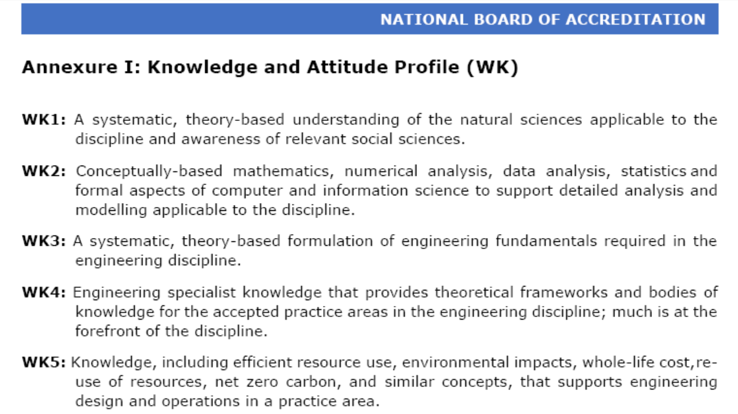
Knowledge Profiles (WKs)

Slide 34
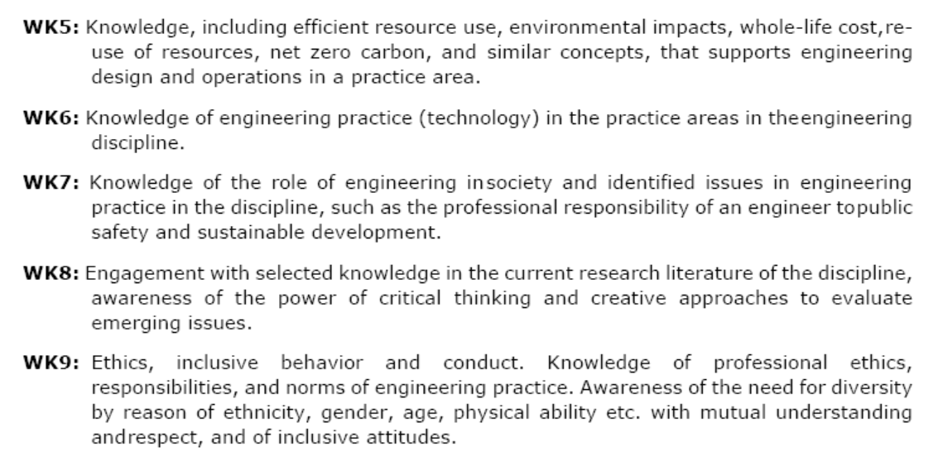
Knowledge Profiles (WKs)

Slide 35
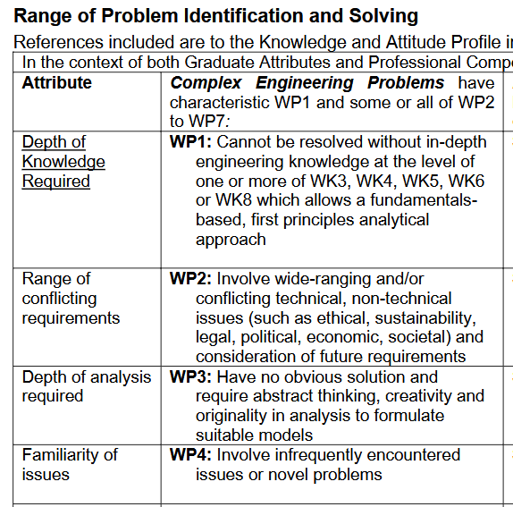
Complex Engineering Problems

Slide 36

3
4
6
7
11
12
13

Slide 37
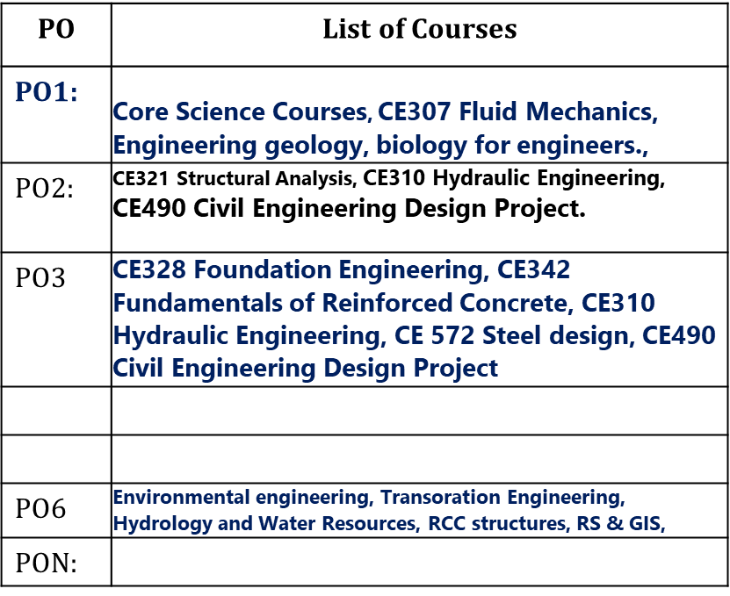
Criterion 1: Outcome-based Curriculum (120)
1.3.2. Mapping between the Courses and POs/PSOs (15)
(Mention the courses relevant to the POs/PSOs.)
Table No.1.3.1: Connection of courses with POs/PSOs.
Add more rows for PSOs
PO Number | List of Courses
PO1:
PO2:
PON:

Slide 38
POs and WKs
PO1: Engineering Knowledge: Apply knowledge of mathematics, natural science, computing, engineering fundamentals and an engineering specialization as specified in WK1 to WK4 respectively to develop to the solution of complex engineering problems.
PO2: Problem Analysis: Identify, formulate, review research literature and analyze complex engineering problems reaching substantiated conclusions with consideration for sustainable development. (WK1 to WK4)
WK1: A systematic, theory-based understanding of the natural sciences applicable to the discipline and awareness of relevant social sciences. WK2: Conceptually-based mathematics, numerical analysis, data analysis, statistics and formal aspects of computer and information science to support detailed analysis and modelling applicable to the discipline. WK3: A systematic, theory-based formulation of engineering fundamentals required in the engineering discipline. WK4: Engineering specialist knowledge that provides theoretical frameworks and bodies of knowledge for the accepted practice areas in the engineering discipline; much is at the forefront of the discipline.

Slide 39
POs and WKs
PO3: Design/Development of Solutions: Design creative solutions for complex engineering problems and design/develop systems/components/processes to meet identified needs with consideration for the public health and safety, whole-life cost, net zero carbon, culture, society and environment as required. (WK5)
PO4: Conduct Investigations of Complex Problems: Conduct investigations of complex engineering problems using research-based knowledge including design of experiments, modelling, analysis & interpretation of data to provide valid conclusions. (WK8).
WK5: Knowledge, including efficient resource use, environmental impacts, whole-life cost, reuse of resources, net zero carbon, and similar concepts, that supports engineering design and operations in a practice area WK8: Engagement with selected knowledge in the current research literature of the discipline, awareness of the power of critical thinking and creative approaches to evaluate emerging issues

Slide 40
PO1:.Engineering Knowledge: Apply knowledge of mathematics, natural science, computing, engineering fundamentals and an engineering specialization as specified in WK1 to WK4 respectively to develop to the solution of complex engineering problems
WK1: A systematic, theory-based understanding of the natural sciences applicable to the discipline and awareness of relevant social sciences.
WK2: Conceptually-based mathematics, numerical analysis, data analysis, statistics and formal aspects of computer and information science to support detailed analysis and modelling applicable to the discipline.
WK3: A systematic, theory-based formulation of engineering fundamentals required in the engineering discipline.
WK4: Engineering specialist knowledge that provides theoretical frameworks and bodies of knowledge for the accepted practice areas in the engineering discipline; much is at the forefront of the discipline.
Courses: | Justification w.r.t WKs
1. Applied Chemistry | WK1 – Theory based learning of alternative fuels, reactions….
2. Data structure | Wk2- Conceptually based analysis for computer and Information sc to support modeling..
3. Fluid Mechanics | WK3- A systematic theory based formulation of engg fundamentals
4. Surveying | Wk4 – Engg specialist knowledge with accepted practice area in civil engg

Slide 41
PO3: Design/Development of Solutions: Design creative solutions for complex engineering problems and design/develop systems/components/processes to meet identified needs with consideration for the public health and safety, whole-life cost, net zero carbon, culture, society and environment as required. (WK5)
WK5: Knowledge, including efficient resource use, environmental impacts, whole-life cost, re- use of resources, net zero carbon, and similar concepts, that supports engineering design and operations in a practice area.
Courses/ Projects/Activities:
1.
2.
3.

Slide 42
Course and Justification
Biotechnology - Example
Courses | WKs justification
3rd semester
Fluid Mechanics | WK3: Theory-based formulation of engineering fundamentals of unit operations like fluid flow, size reduction, etc.
Process Principles and Calculations | WK2: Bioprocess concept-based numerical analysis
Microbiology | WK1: Theory-based understanding of biology
Universal Human Values | WK9: Ethics, inclusive behavior and conduct. Knowledge of professional ethics, responsibilities, and norms of engineering practice
Constitution of India, Professional Ethics and Human Rights | WK9: Ethics, inclusive behavior and conduct. Knowledge of professional ethics, responsibilities, and norms of engineering practice

Slide 43
POs | Courses/Projects | Wks
PO1 | Mathematics, Chemistry, | WK1-WK4
PO2 | Fluid Mechanics, Surveying,
PO3 | Design of RCC structures | WK 5
PO4
PO5
PO6
PO7
PO8
PO9
PO10
PO11

Slide 44
Criterion 1: Outcome-based Curriculum (120)
1.4. Course Outcomes and Course Articulation Matrix (30)
1.4.1. Course Outcome (Semester Wise) (15)
(Provide Course outcomes (COs) for two core courses per semester from 1-8 semesters as a sample. The maximum number of outcomes for a course is expected to be around 6. COs should reflect on the measurable outcomes towards attaining POs and PSOs).
Table No. 1.4.1.1: Course outcomes.
Semester No.:
Course Title: |  | Course Code:
Course Outcome No. | Course Outcome Statement
CO1 | Apply laws of physics (eg..Hook’s law, etc.,) to compute different types of response (stress and deformation) in the given materials.
Course Outcomes: Example
At the end of the course, student is able to:
Apply laws of physics (eg..Hook’s law, etc.,) to compute different types of response (stress and deformation) in the given materials. (PO 1)
Analyse structural elements for different force systems to compute design parameters (BM and SF) (PO2)
Conduct experiments to validate physical behaviour of materials/components.(PO4)
Prepare laboratory reports on interpretation of experimental results (P9)

Slide 45
Criterion 1: Outcome-based Curriculum (120)
1.4.2. Course Articulation Matrix (15)
(Provide course articulation matrices for two core courses per semester from 1-8 semesters which have been provided in the section 1.4.1. Select courses to demonstrate the mapping/correlation with POs and PSOs.)
Table No.1.4.2: Course articulation matrix.
Course Name: Strength of Materials Course Code:
Course Outcomes (COs) code & Statement | Program Outcomes (POs) |  |  |  |  |  |  |  |  |  |  | Program Specific Outcomes (PSOs)
 | PO -1 | PO - 2 | PO - 3 | PO - 4 | PO - 5 | PO - 6 | PO - 7 | PO - 8 | PO - 9 | PO - 10 | PO - 11 | PSO -1 | PSO-2
CO - 1 | 3
CO – 2 |  | 2
CO – 3
CO – 4 |  |  |  | 3
CO - 5 |  |  |  |  |  |  |  |  | 2
Avg | 3 | 2 |  | 3 |  |  |  |  | 2
Add more columns for PSOs if any
Note: ❖ Enter correlation levels 1, 2 or 3 as defined below: ❖ 1: Slight (Low), ❖ 2: Moderate (Medium) ❖ 3: Substantial (High), ❖ If there is no correlation, put “-”

Slide 46
Criterion 1: Outcome-based Curriculum (120)
1.5. Program Articulation Matrix (05) T
able No.1.5.1: Program articulation matrix
Add more columns for PSOs if any
Course Code | Course Name | PO-1 | PO-2 | PO-3 | PO-4 | PO-5 | PO-6 | PO-7 | PO-8 | PO-9 | PO-10 | PO-11
C101
C202
C203 | Strength of Materials | 3 | 2 |  | 3 |  |  |  |  | 2
C 506 | Design project |  | 3 | 3 |  |  | 3 |  |  |  |  | 3
C4…..

Slide 47
Course Outcomes

Slide 48
Course Outcomes (COs)
“Statements of observable student actions that serve as evidence of the Knowledge, Skills and Attitudes acquired in a course”.
Each course is designed to meet (about 6) Course Outcomes
The Course Outcomes are stated in such a way that they can be actually measured.
POs are attained through program specific Core Courses

Slide 49
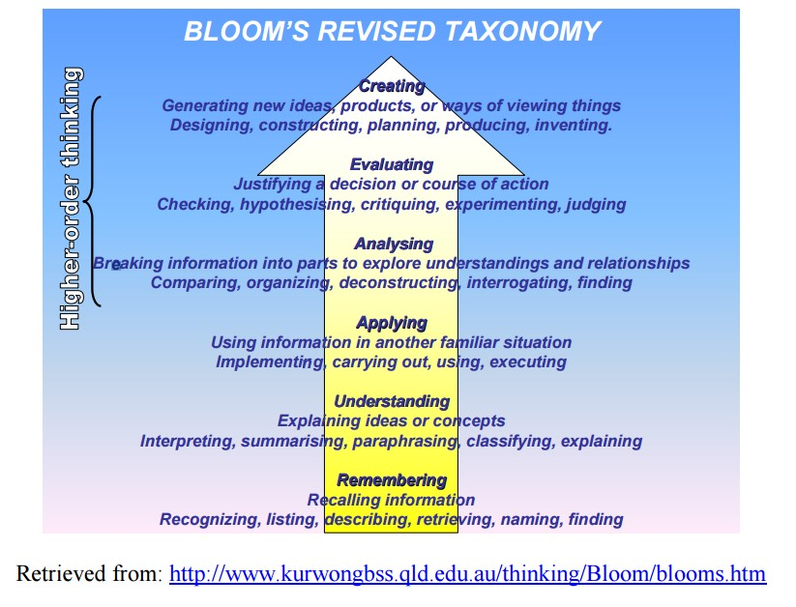

Slide 50


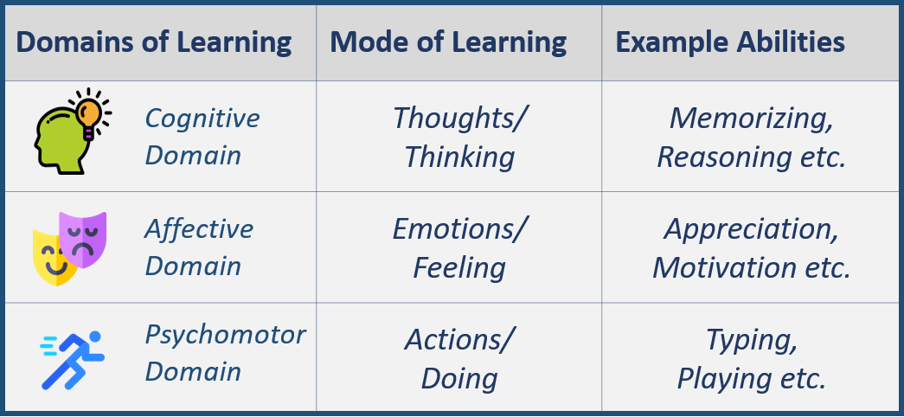

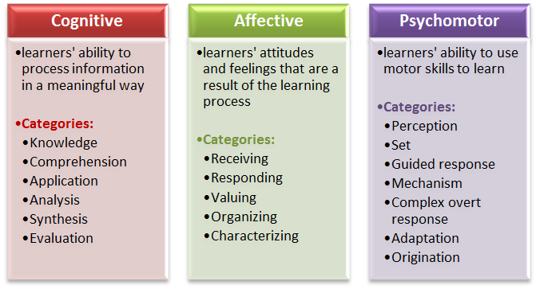
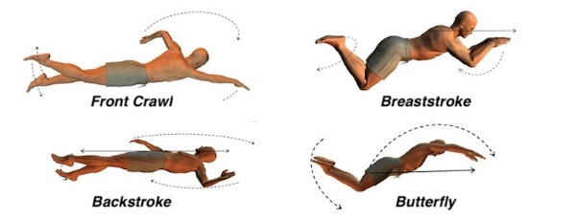

Slide 51
Course Outcomes
Engineering Physics (Not a Good Example)
CO1: Understand the knowledge of basic quantum mechanics, to set up one-dimensional Schrodinger’s wave equations and its application to few physical problems.
CO2: Understand the fundamental aspects of crystallography, able to recognize various planes in a crystal and have knowledge of structure determination using x-rays.
CO3: Understand the role of free electrons in determining the properties of metals, the concept of Fermi energy, and the domain formation in ferromagnetic materials.
CO4: Understand the basic laser physics, working of lasers, holography and principle of propagation of light in optical fibers.
CO5: Understand the theory of free, damped and forced vibrations of a particle and also the concept of resonance and its applications in ESR & NMR.
What level of BLOOM,s Taxonomy you want your students to achieve?

Slide 52
Structure of Course Outcomes:
Course Outcome statement may be broken down into two main components:
An action word that identifies the performance to be demonstrated;
Learning statement that specifies what learning will be demonstrated in the performance;
Examples of good action words to include in course outcome statements:
Compile, identify, create, plan, revise, analyze, design, select, utilize, apply, demonstrate, prepare, use, compute, discuss, predict, assess, compare, rate, critique, outline, or evaluate

Slide 53
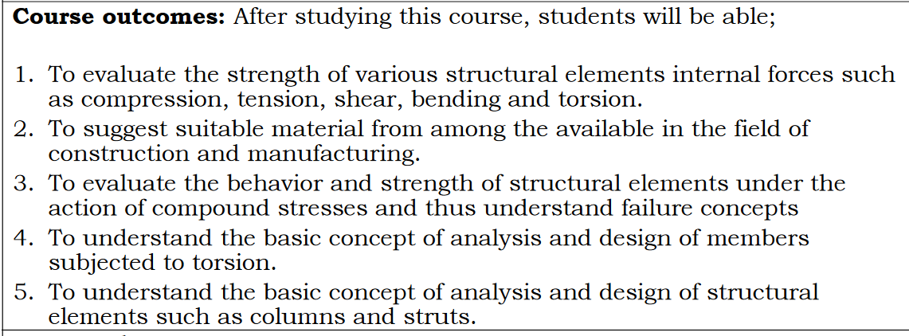
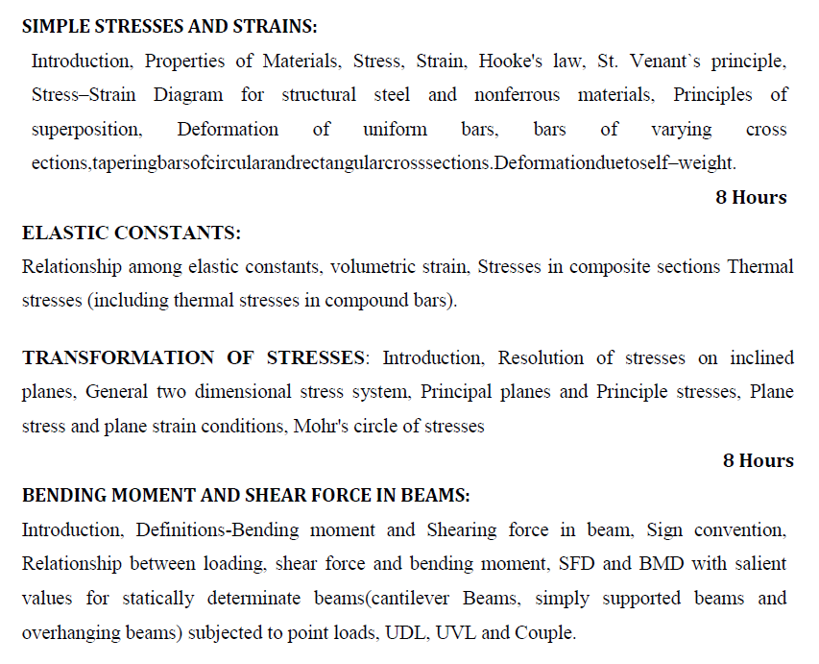
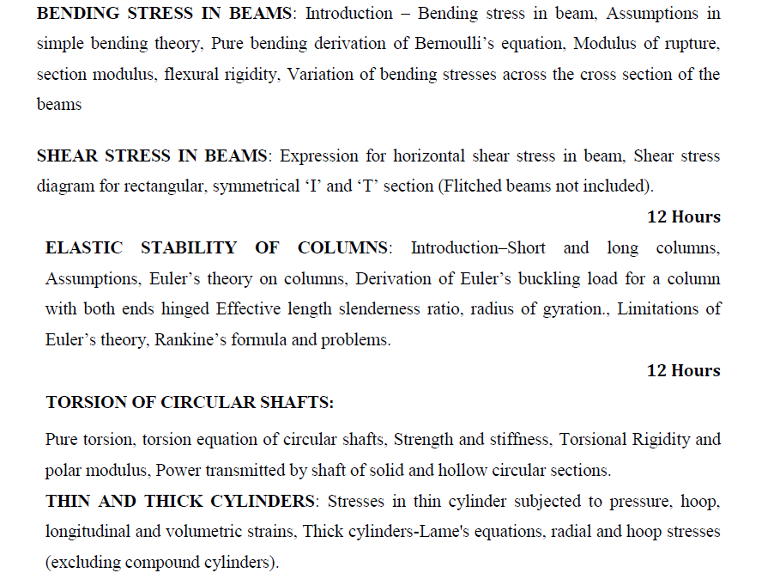
Strength of Materials
Which POs are targeted ??
Do we want to do all of them ?
How many POs this course can give ?

Slide 54
Course Title: Strength of Materials
Course Outcomes: Example
At the end of the course, student is able to:
Apply laws of physics (eg..Hook’s law, etc.,) to compute different types of response (stress and deformation) in the given materials. (PO 1)
Analyse structural elements for different force systems to compute design parameters (BM and SF) (PO2)
Conduct experiments to validate physical behaviour of materials/components.(PO4)
Prepare laboratory reports on interpretation of experimental results (P10)
Action Verb
Learning Statement

Slide 55
CO-PO Relationship
Each CO can be identified to address a subset of POs
Based on the intended measurement of COs and the evidence of learning to be obtained, it is possible to identify the strength of mapping (1, 2 or 3) to POs
Based on these strengths of selected POs a CO–PO matrix can be established

Slide 56
Constructive Alignment
How do we arrive at mapping based on constructive alignment ?
Correlation depends on relevance.
Strength of correlation depends on constructive alignment of the assessment.
We will see an Example…

Slide 57
Alignment of Assessment to COs and hence to POs…Example.

Slide 58
Course:- Concrete Technology Example-1
Topic: Mix Proportioning
Mix proportioning is a process of arriving at suitable proportions of concrete ingredients based on their characteristics to achieve desired strength and durability characteristics of concrete. Here, students will have the freedom of selecting different types of cements, aggregates, admixtures to arrive at a given grade of concrete say M40.

Slide 59
Contd.,
To introduce complexity, students can be asked to provide solutions for the same M40 grade concrete but to be used in different field conditions such as Hot weather concreting, Underwater concreting, Mass concreting, High early strength requirement in say 3 days.

Slide 60
PO1: Engineering Knowledge: Apply the knowledge of mathematics, science, engineering fundamentals, and an engineering specialization to the solution of complex engineering problems
Example Situation 1: CO3: Able to understand mix proportioning techniques for field applications.
Assessment for CO3: (Question in Tests) Briefly explain the various methods of mix proportioning techniques.
Does this CO reflects the intended measurement from PO1? Does the assessment correlates well with the CO? | Mapping: CO3- PO1.

Slide 61
In this case, CO does not reflect the intention of measuring application of either science, maths or engineering principles. It can measure only remembrance in this topic.
Further, the assessment, does not test the requirement of application of engineering principles used in mix proportioning as per PO1. Hence, the correlation between CO-PO is weak.

Slide 62
PO2:Problem Analysis: Identify, formulate, review research literature, and analyze complex engineering problems reaching substantiated conclusions using first principles of mathematics, natural sciences, and engineering sciences.
Example Situation 2: CO3: Able to apply mix proportion principles to design a concrete mix for field applications.
Assessment for CO3: (Question in Tests) Proportion a concrete mix for M40 grade concrete by IS method. Given data: maximum nominal size of aggregate: 20mm; minimum cement content: 340kg/cum; maximum w/c ratio: 0.45; workability: 75mm slump; exposure: very severe; concreting type: pumping mode; quality at site: good; aggregate type: sub-angular; sp. gr of cement – 3.15, aggregate – 2.68, flyash – 2.08, SP 1.08, Design using IS 10026 – 2009.
Is CO reflects the intended measurement from PO2? Does the assessment correlates well with the CO? | Mapping: CO3 - PO2

Slide 63
In this case, the assessment does not test the students ability to identify, formulate and do some research for arriving at a suitable concrete mix for a given situation since many variables of the design have already been identified in the problem and hence the strength of mapping of CO3 for PO2 in the above example can not be considered good. At best it can map well for PO1 as it involves application of engineering fundamentals.

Slide 64
PO3: Design/Development of Solutions: Design solutions for complex engineering problems and design system components or processes that meet the specified needs with appropriate consideration for the public health and safety, and the cultural, societal, and environmental considerations.
Example Situation 3: CO3: Design concrete mix for field applications using characteristics of mix constituents and relevant IS codes.
Assessment:/ASIGNMENT/ ABC Construction Company is entrusted with manufacturing of precast elements for elevated express way. The precast elements are required to attain 40 MPa in 7 days. Design a mix for least cost. The mix should comply with the requirements of IS 10262 and IS 456.
Is CO reflects the intended measurement from PO3 ? Does the assessment correlates well with the CO? | Remarks: CO3 –PO3

Slide 65
Contd…
In this case, students are expected design mix using various parameters such as type of cement which can be used for early strength gain, water content (W/C), workability required to manufacture such precast elements. They are also required to look for specifications as per the codal provisions and then apply engineering principles to arrive at mix proportions for a least cost.
The assessment correlates well with the CO and hence maps strongly PO3.

Slide 66
COs (Summary)
Example Situation 1:
Able to understand mix proportioning techniques for field applications.
Example Situation 2:
Able to apply mix proportion principles to proportion a concrete mix for field applications.
Example Situation 3:
Design concrete mix for field applications using characteristics of mix constituents and relevant IS codes.
(Choice of writing an appropriate CO and choosing the right assessment to map corresponding PO remains with the course instructor)

Slide 67
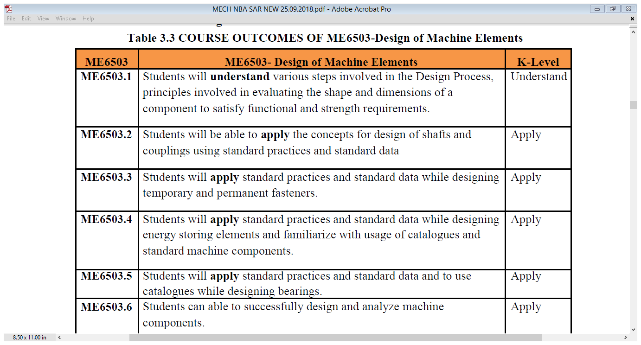
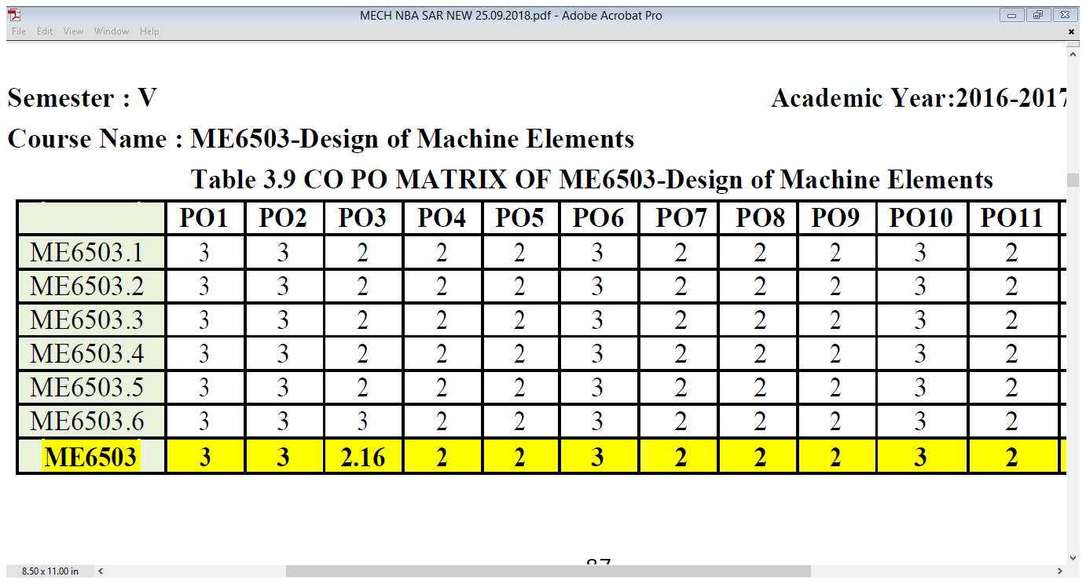
Communication

Slide 68
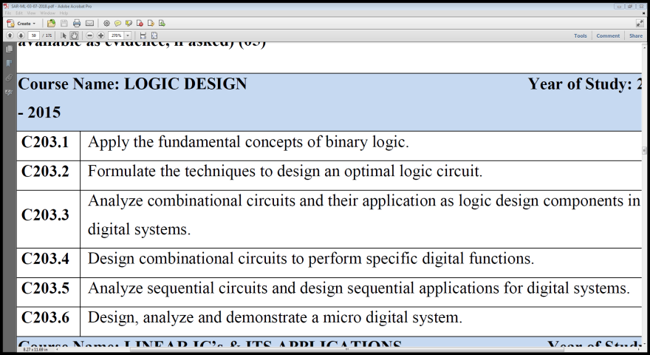
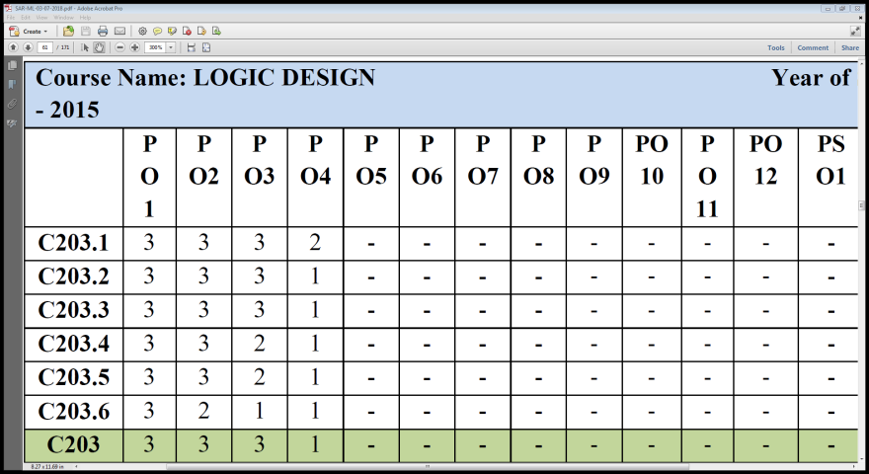
CO-PO mapping ??
Design
Apply

Slide 69
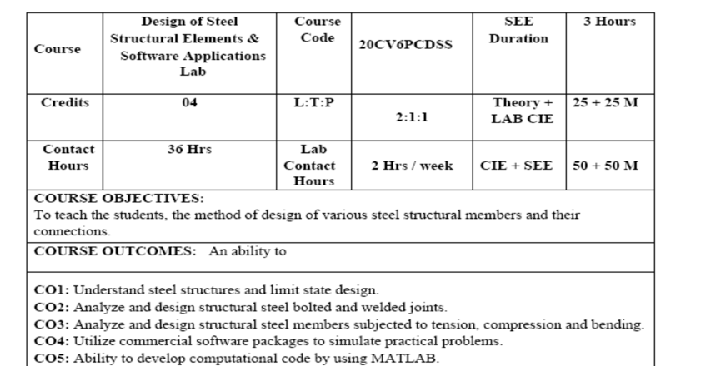
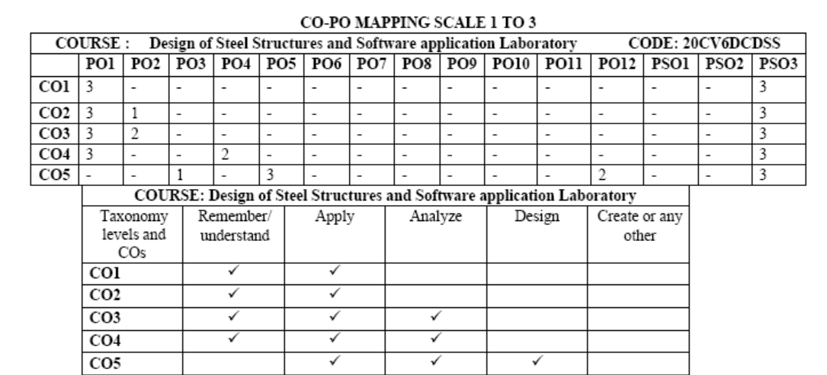

Slide 70
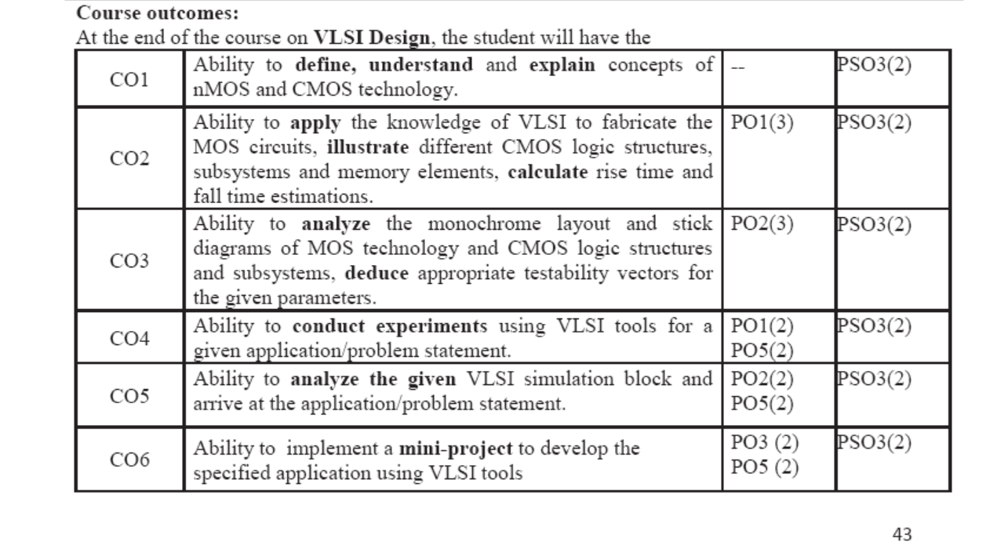

Slide 71
CO-PO Relationship
COURSE | COs | PO1 | PO2 | PO3 | PO4 | PO5 | PO6 | PO7 | PO8 | PO9 | PO10 | PO11
Analysis of structures II | CO1 | 3 | 3 | - | - | - | - | - | - | - | - | -
 | CO2 | 3 | 3 | - | - | - | - | - | - | - | - | -
Environmental Engineering I | CO1 | 3 | 2 | - | 3 | - | 3 | 3 | - | - | - | -
 | CO2 | 3 | 3 | - | - | - | 3 | 3 | - | - | 3 | -
 | CO3 | - | - | 3 | - | - | - | 3 | 3 | - | 3 | -
Geotechnical Engineering II | CO1 | 3 | 3 | - | - | - | - | - | - | - | - | -
 | CO2 | 3 | 3 | - | - | - | - | - | - | - | - | -
 | CO3 | 3 | 3 | - | - | - | - | - | - | - | - | -
 | CO4 | 3 | 3 | 2 | - | - | 3 | - | - | - | - | -
Concrete Technology | CO1 | 3 | - | - | - | - | - | - | - | - | - | -
 | CO2 | - | 3 | 3 | - | - | - | - | - | - | - | -
 | CO3 | - | 3 | 3 | - | - | - | - | - | - | - | -
 | CO4 | - | - | - | - | - | - | - | 3 | 3 | - | -
Hydrology and water resources | CO1 | 3 | 3 | - | - | - | - | - | - | - | - | -
 | CO2 | 3 | 3 | - | - | - | - | - | - | - | - | -
 | CO3 | 3 | 3 | 3 | - | - | - | - | 3 | - | - | -
Quantity Surveying and Costing | CO1 | 3 | 3 | - | 1 | - | - | - | - | - | - | -
 | CO2 | 3 | 3 | - | - | 2 | 2 | - | - | - | - | -
 | CO3 | 3 | 3 | - | - | - | - | - | - | - | - | -
 | CO4 | 2 | 3 | 2 | - | - | 3 | - | - | - | - | -
Alternate Building Material & Technology | CO1 | 3 | - | - | - | - | - | 3 |  | - | - | -
 | CO2 |  | 3 | - |  | - | - | 3 |  | - | - | -
 | CO3 |  | - | - | - |  | - | 3 |  | - | - | -
 | CO4 |  |  | 3 | - | 2 | - | 2 | 3 | - | - | -
Major Project Phase II | CO1 | - | - | - | - | - | - | 3 | - | 3 | - | -
 | CO2 | 3 | 3 | 3 | 3 | - | - | - | 3 | 3 | - | -
 | CO3 | - | - | - | - | 3 | - | - | - | 3 | - | -
 | CO4 | - | - | - | - | - | - | - | - | 3 | 3 | 2

Slide 72

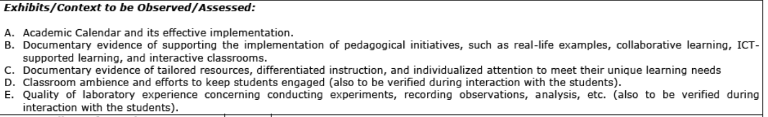
Criterion 2: Outcome-Based Teaching Learning (120)
2.1. Describe Processes Followed to Ensure Quality of Teaching & Learning (20)
(Processes may include adherence to academic calendar and instruction methods using pedagogical initiatives such as real-world examples, collaborative learning, quality of laboratory experience with regard to conducting experiments, recording observations, analysis of data etc. encouraging fast learners, assisting slow learners etc. The implementation details and impact analysis need to be documented.)

Slide 73
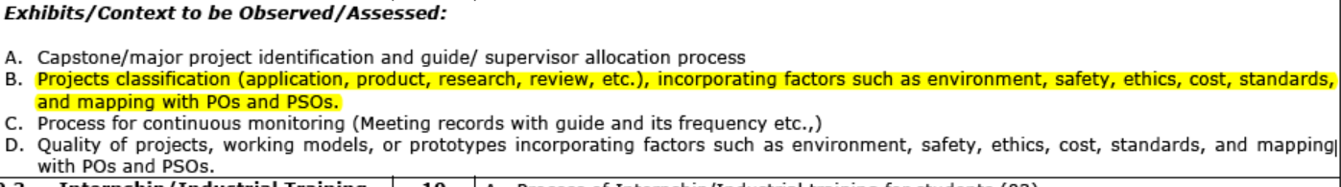
Criterion 2: Outcome-Based Teaching Learning (120)
2.2. Quality of Student Capstone Project (25)
(Quality of the capstone/major project is measured in terms of consideration to factors including, but not limited to, environment, sustainability, safety, ethics, cost, type (application, product, research, review etc.) and standards. Processes related to project identification, allotment, continuous monitoring, evaluation including demonstration of working prototypes and enhancing the relevance of projects. Mention implementation details including details of POs and PSOs addressed through the projects with justification.)

Slide 74
Criterion 2: Outcome-Based Teaching Learning (120)
2.3. Internship/Industrial Training (10)
(Describe process, duration, POs/PSOs addressed.)
2.4. Seminar and Mini/Micro Projects (10)
(Describe process, POs/PSOs addressed.)
2.5. Case Studies and Real-Life Examples (10)
(Type and complexity, POs/PSOs addressed.)
2.6. SWAYAM/NPTEL/MOOC/Self Learning (10)
(Number of students registered, certification and POs/PSOs addressed.)
Rubrics for measurement

Slide 75

Criterion 2: Outcome-Based Teaching Learning (120)
2.7. Solving Complex Engineering Problems Incorporating Sustainability Goals (20)
(Provide details of core courses (Project based learning, problem-based learning), mini projects, integrated design projects, capstone projects, hackathon or any other activity-based learning towards solving complex engineering problems targeting relevant SDGs.)
(Documentary evidences of solving complex engineering problems targeting SDGs )
2.8. Steps Taken for Enhancing Industry Institute Partnerships (15)
(Provide details of partial delivery of courses, industry supported labs, industry offered short-term programs/training etc.)

Slide 76



Problem-Based Learning
2.7. Solving Complex Engineering Problems Incorporating Sustainability Goals (20)
(Provide details of core courses (Project based learning, problem-based learning), mini projects, integrated design projects, capstone projects, hackathon or any other activity-based learning towards solving complex engineering problems targeting relevant SDGs.)

Slide 77

What’s the Difference?
Project-Based Learning
Individual or group
Teacher defines the problem
Teacher identifies action steps
Create a product
Both
Teacher as guide
Students at centre
Real-world connections
Active learning
Self and peer assessment
Problem-Based Learning
Groups
Students define the problem
Students identify action steps
Create a solution
Metacognition
Bottom Line:
In Problem-Based Learning, students have more control over their own learning and the processes involved.

Slide 78
Advantages of Problem Based Learning
Can be incorporated in any course
Learner-centred
Students acquire content knowledge, skills and attitudes
Facilitates measurement of skill based Programme Out comes namely, Team work, Communication, Life long learning…

Slide 79
Sample Problem
XYZ Construction Company has been in the forefront of concrete construction in India. It specializes in construction of Infrastructure and Buildings. The company wants to hire construction engineers who can take proactive role in the future projects of the company and build their career along with the company.
Following are the requirements of the concrete engineer who will be responsible for the sourcing of materials, quality control of materials, proportioning of concrete mixes using locally available materials for different applications, evaluation of its properties (fresh, hardened and durability) pertaining to appropriate codes.

Slide 80
Expected Out Comes
The candidate should be well versed with the current trends of materials innovation, quality assurance practices, concrete production and testing methods and standards. Further, candidate is required to apply/demonstrate skills for communication, social concern and capacity to learn independently and reflect and implement new concreting requirement for the projects.

Slide 81

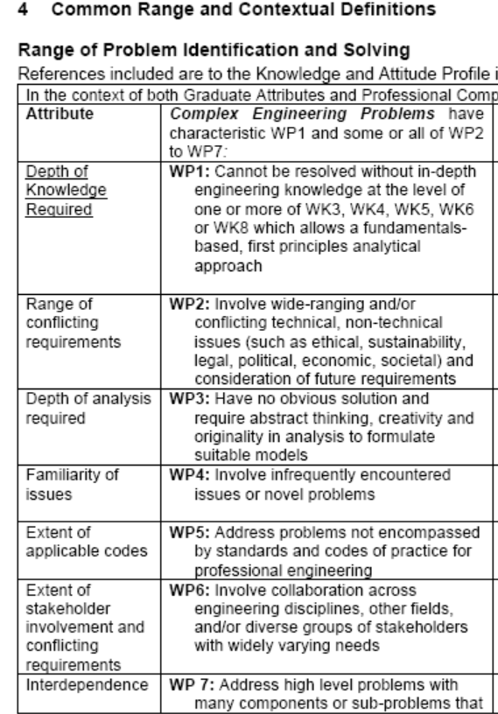
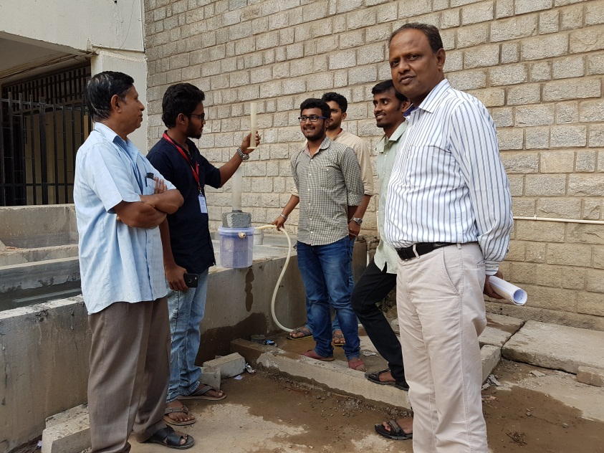
PBL - Example
Problem:
Development of Pervious concrete for pavements
WP1 and WP5
SDG 11
WK 3, WK4, WK5 WK6 and WK8
POs ??
PO1, PO2 , PO4, PO6, PO11

Slide 82
Assessment strategy
Rubric for Evaluating Self Study
Course: - Advances in Construction Materials
Problem – Develop a concrete mix for field applications
Batch No: Title :
Performance Indicators ↓ | Unsatisfactory (2) | Developing (6) | Satisfactory (8) | Exemplary (10) | Score
Identifying Problem & Materials characteristics for possible solutions (PO1)
Choice of complexities of field requirement and identification of material characteristics |  |  |  | Identified problem is complex and relevant to field application. All the characterization of material is carried out.
Research Analysis & Mix proportioning (PO2)
Identifying research gaps and Proportioning of mixes using new methods (PO2)
Design of experiments (PO4)
Choice of Experiments to arrive at solutions. ( PO4)
Communication and Life long learning (PO9, PO11)
Presentation and Reporting of work (PO9, PO11)
Total Score(Maximum, 40)

Slide 83
PO2 : PBL, Can it help?
PO2: Problem Analysis: Identify, formulate, review research literature and analyze complex engineering problems reaching substantiated conclusions with consideration for sustainable development. (WK1 to WK4)
PO6: The Engineer and The World: Analyze and evaluate societal and environmental aspects while solving complex engineering problems for its impact on sustainability with reference to economy, health, safety, legal framework, culture and environment. (WK1, WK5, and WK7).

Slide 84
Complex Engineering Problems. (Definition)
may require a system approach.

Slide 85
Annexure I: Knowledge and Attitude Profile (WK)
WK1: A systematic, theory-based understanding of the natural sciences applicable to the discipline and awareness of relevant social sciences.
WK2: Conceptually-based mathematics, numerical analysis, data analysis, statistics and formal aspects of computer and information science to support detailed analysis and modelling applicable to the discipline.
WK3: A systematic, theory-based formulation of engineering fundamentals required in the engineering discipline.
WK4: Engineering specialist knowledge that provides theoretical frameworks and bodies of knowledge for the accepted practice areas in the engineering discipline; much is at the forefront of the discipline.
WK5: Knowledge, including efficient resource use, environmental impacts, whole-life cost, re-use of resources, net zero carbon, and similar concepts, that supports engineering design and operations in a practice area.
WK6: Knowledge of engineering practice (technology) in the practice areas in the engineering discipline.
WK7: Knowledge of the role of engineering in society and identified issues in engineering practice in the discipline, such as the professional responsibility of an engineer to public safety and sustainable development.
WK8: Engagement with selected knowledge in the current research literature of the discipline, awareness of the power of critical thinking and creative approaches to evaluate emerging issues.
WK9: Ethics, inclusive behavior and conduct. Knowledge of professional ethics, responsibilities, and norms of engineering practice. Awareness of the need for diversity by reason of ethnicity, gender, age, physical ability etc. with mutual understanding and respect, and of inclusive attitudes.

Slide 86
Problem statement
Agricultural byproducts are a sustainable and easily accessible material. Biochar production from such waste is an eco-friendly method that follows the rules of the circular economy and conserves resources. Biochar may be made from agricultural byproducts such as rice husks, maize cobs, and coconut shells. This helps with waste management by lowering the amount of agricultural wastes that would otherwise be burnt or allowed to degrade, which might lead to pollution. A biochar water filter solves two environmental problems: agricultural waste management and clean drinking water. This initiative decreases pollution, promotes sustainable resource use, and improves water availability by turning agricultural leftovers into filter media. The initiative promotes sustainable development and public health via environmental engineering, sustainability, and community participation.
Design and Testing of a Biochar Water Filter
Description: Develop an environmentally friendly water filter that uses biochar, made from agricultural waste, to remove harmful contaminants from drinking water.
Scope of the Project
Create a Biochar Water Filter:
Make a water filtration system using biochar from agricultural waste to eliminate pollutants.
Encourage Sustainable Waste Management:
Show that agricultural wastes may be used to make biochar, minimizing waste and pollution.
Improve Clean Water Access: Improve rural and underserved water quality at low cost and sustainability.
Reference: Dr. Prathima, CV, BMSCE.

Slide 87
Justification as complex engineering problem and its mapping to WK’s
WP | Justification | Targeted WK’s
 |  | WK1 | WK5 | WK7
WP1 – Depth of Knowledge required | Requires in-depth knowledge of chemical engineering (pyrolysis and adsorption), environmental science (contaminant behavior), and materials science (properties of biochar). | The project requires an understanding of chemistry (e.g., chemical reactions involved in pyrolysis), and environmental science (e.g., contaminant behavior and environmental impact). | Efficient resource reuse Pollution reduction Water quality improvement Sustainable practices Circular economy principles | The project addresses ethical considerations in providing clean water, managing agricultural waste, and ensuring environmental sustainability. It emphasizes the professional responsibility of engineers to protect public health and the environment.
WP2 – Range of conflicting requirements | Conflicts arise in balancing the efficiency of contaminant removal, the sustainability of biochar production, and the economic feasibility of the solution.
PO6: The Engineer and The World: Analyze and evaluate societal and environmental aspects while solving complex engineering problems for its impact on sustainability with reference to economy, health, safety, legal framework, culture and environment. (WK1, WK5, and WK7).

Slide 88
Rubrics (Indicative Example)
WK | Excellent (4) | Good (3) | Satisfactory (2) | Needs Improvement (1)
PO1 | Comprehensive understanding and application of chemistry, and environmental science. | Strong grasp with minor gaps. | Basic understanding with some application struggles. | Insufficient understanding of natural science concepts.
PO2 | Optimisation of resource use, Analysis of environmental impacts, whole-life cost, and re-use concepts,. | Strong application with minor gaps. | Basic understanding with application struggles. | Insufficient understanding of key concepts.
PO6 | Comprehensive understanding of societal role, ethics, and sustainability. | Strong awareness with minor gaps. | Basic understanding with lack of depth. | Insufficient understanding of societal role and ethics.

Slide 89

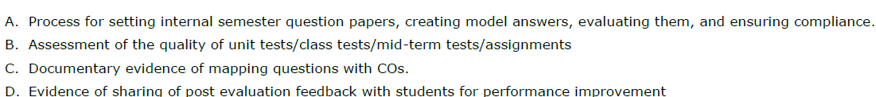

Criterion 3: Outcome-Based Assessment (120)
3.1. Evaluation of Continuous Assessment: Assignments, Unit Tests, Mid-Term, etc. (10)
(Describe the process of evaluation followed during continuous assessment to maintain quality of assessment; constructive alignment of questions with COs and hence POs/ PSOs. Details to be kept in course files for evaluation.)
3.2. Evaluation of the Semester End Exam (SEE) Question Paper (10)
(Describe the process of setting of SEE papers & their evaluation to maintain quality of assessment, constructive alignment of questions with COs and POs/PSOs. Details to be kept in course files for evaluation.)

Slide 90
Criterion 3: Outcome-Based Assessment (120)
3.3. Evaluation of Laboratory Work and Workshop (Continuous and SEE) (10)
(Provide details of rubrics used to assess learnings in laboratories and workshops linking with COs and POs/PSOs targeted. Evidence of student assessments through rubrics to be kept in course files for evaluation.)
  (Evidence of Rubrics developed and used for assessing student performance during workshops/laboratories. )
3.4. Evaluation of Industrial Training/Internship (Continuous and SEE) (10)
(Provide details of rubrics used to assess learnings in internships/industrial trainings linking POs/PSOs targeted for attainment. Evidence of student assessments through rubrics to be kept in course files for evaluation.)
(Evidence of Rubrics developed and used for assessing student performance during workshops/laboratories. )

Slide 91
Criterion 3: Outcome-Based Assessment (120)
3.5. Evaluation of Projects (20)
(Provide details of rubrics used to assess learnings in projects linking POs/PSOs targeted for attainment. Evidence of student assessments through rubrics to be kept in course files for evaluation.)
(Rubrics used for assessing complexity, cost, relevance to the environment, and sustainability (10)
Rubrics used for assessing team work, communication, and use of project management concepts (10))
3.6. Evidence of Addressing Sustainable Development Goals (SDG) (10)
(Provide details of student work carried out to meet sustainable development goals such as research work, project work, student activities etc. Evidence in the form of a portfolio to be made available during the visit.)
(Student Portfolio’s)

Slide 92
Criterion 3: Outcome-Based Assessment (120)
3.7. Attainment of Course Outcomes (25)
3.7.1. Describe the Assessment Tools and Processes Used to Gather the Data for the Evaluation of Course Outcome (05)
(Describe different assessment tools (semester end examinations, mid-semester tests, laboratory examinations, student portfolios etc.,) to measure the student learning and hence attainment of course outcomes.)
3.7.2. Record the Attainment of Course Outcomes of all Courses with Respect to Set Attainment Levels (20)
(Program shall set course outcome attainment levels for each course. Measuring CO attainment through Continuous Internal Examinations (CIE) and Semester End Examination (SEE) needs to be detailed.

Slide 93
Criterion 3: Outcome-Based Assessment (120)
Target may be stated in terms of percentage of students getting more than class average marks or set by the program in each of the associated COs in the assessment instruments (midterm tests, assignments, mini projects, reports and presentations etc. as mapped with the COs.))
3.8. Attainment of Program Outcomes and Program Specific Outcomes (25)
(The attainment of POs and PSOs by direct assessment based on student performance and indirect assessment based on surveys are to be presented through program level Course-PO&PSO matrices as indicated.)

Slide 94
Criterion 3: Outcome-Based Assessment (120)
PO and PSO Attainment:
Table No.3.8.1: PO and PSO attainment value using direct assessment tools.
Add more columns as needed for PSOs if any.
Note:
C101, C102 are indicative courses in the first year. Similarly, C409 is final year course. First numeric digit indicates year of study and remaining two digits indicate course nos. in the respective year of study.
Direct attainment of a PO/PSO is determined by taking average across all courses addressing that PO/PSO.
Course | PO1 | PO2 | PO3 | PO4 | PO5 | PO6 | PO7 | PO8 | PO9 | PO10 | PO11
C101
C102
…….
C409
Direct Attainment

Slide 95
Criterion 3: Outcome-Based Assessment (120)
Table No. 3.8.2: PO and PSO attainment value using indirect assessment tools.
Add more columns as needed for PSOs if any.
Note:
  Mention the type of survey conducted and the location of its source.
  Indirect attainment level of a PO/PSO is determined based on the student exit surveys, employer surveys, etc.
Name of the Survey | PO1 | PO2 | PO3 | PO4 | PO5 | PO6 | PO7 | PO8 | PO9 | PO10 | PO11
Survey-1
Survey-2
Survey-3
……..
Indirect Attainment

Slide 96
Criterion 3: Outcome-Based Assessment (120)
Table No. 3.8.3: Overall PO and PSO attainment value.
Add more columns as needed for PSOs if any.
Assessment | PO1 | PO2 | PO3 | PO4 | PO5 | PO6 | PO7 | PO8 | PO9 | PO10 | PO11
Direct Attainment
Indirect Attainment
Overall Attainment

Slide 97
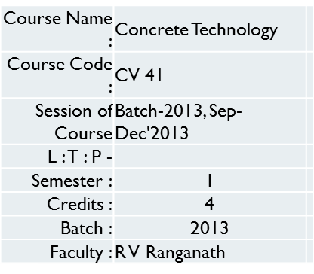
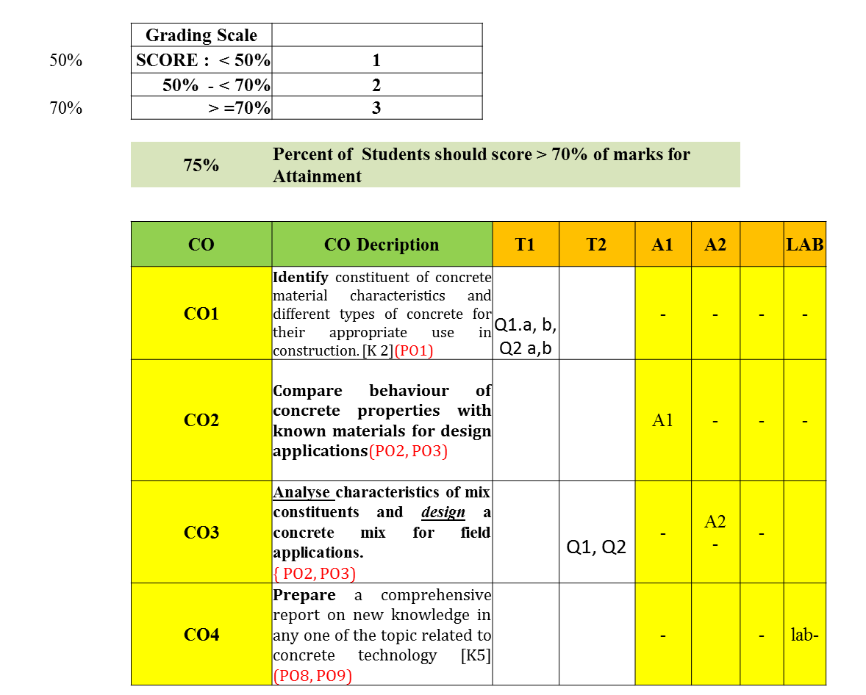
Example of CO-attainment for a course

Slide 98
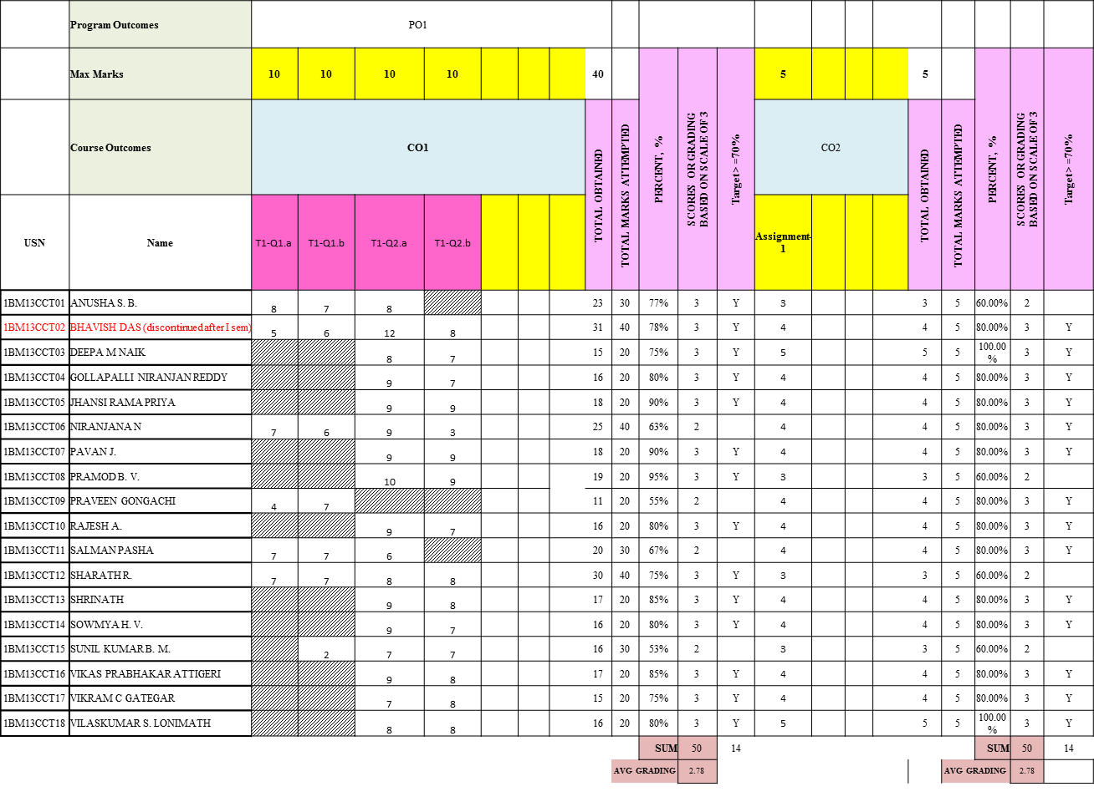
Example of CO-attainment for a course

Slide 99
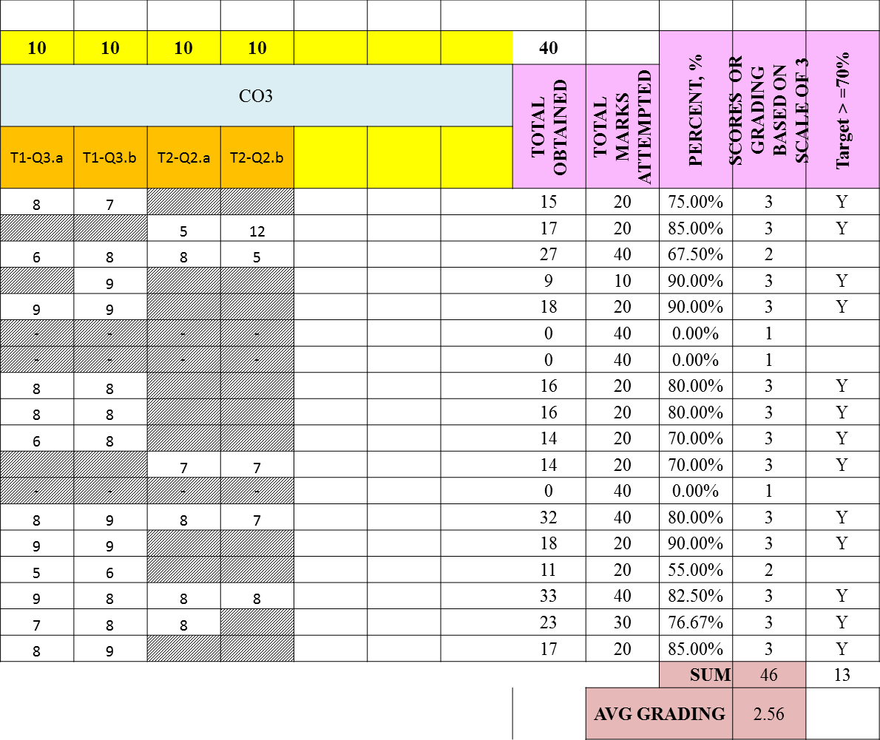
Example of CO-attainment for a course

Slide 100
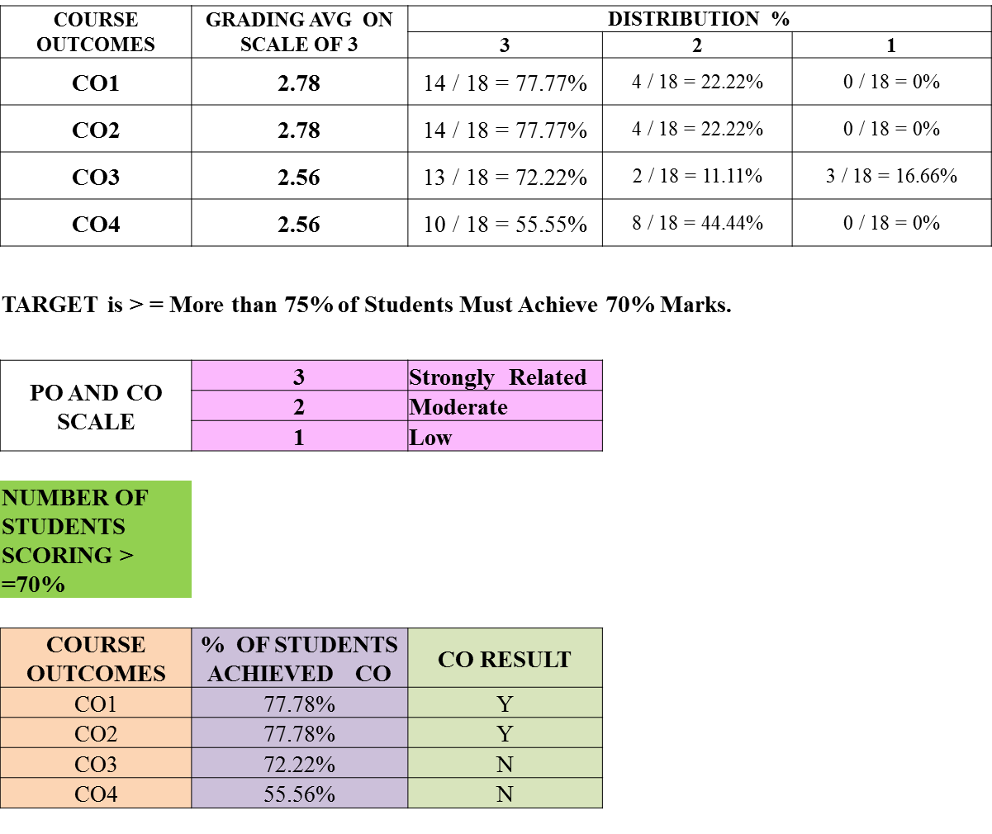
Example of CO-attainment for a course

Slide 101
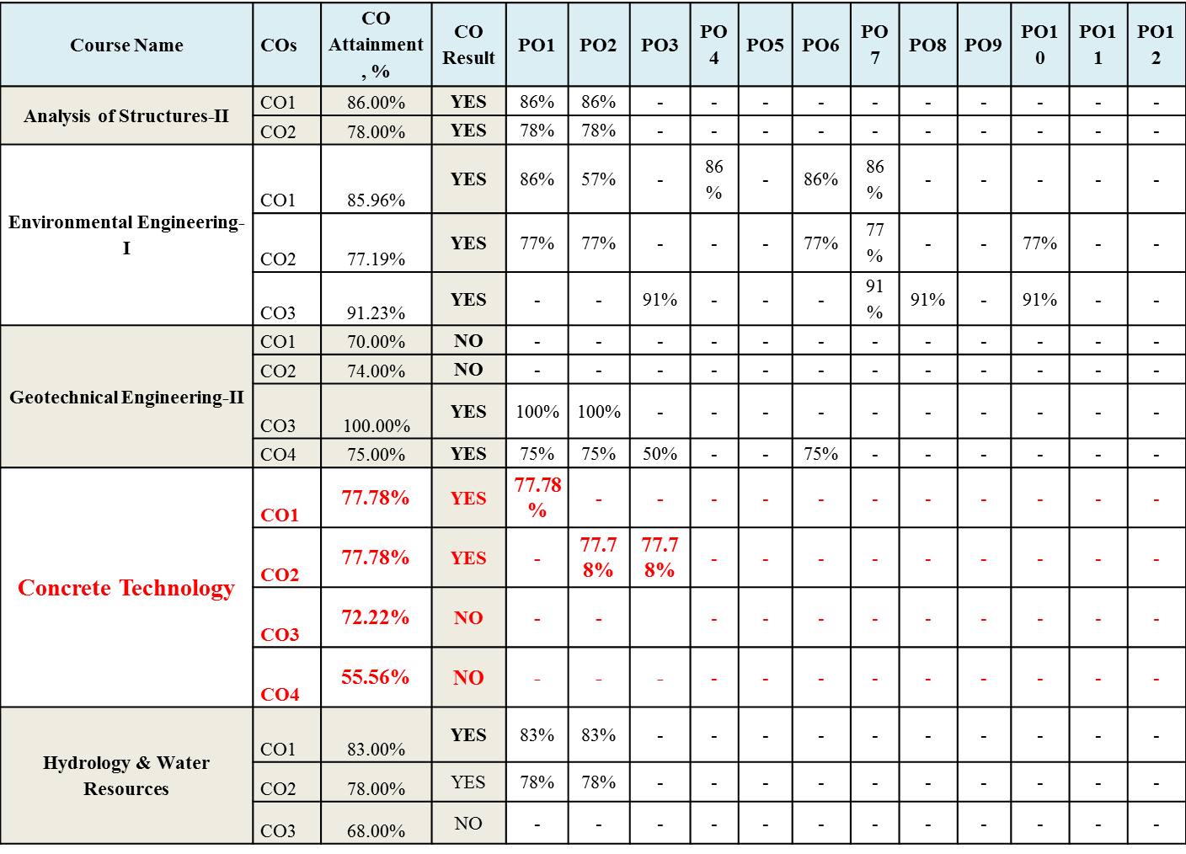
Attainment of Pos:

Slide 102
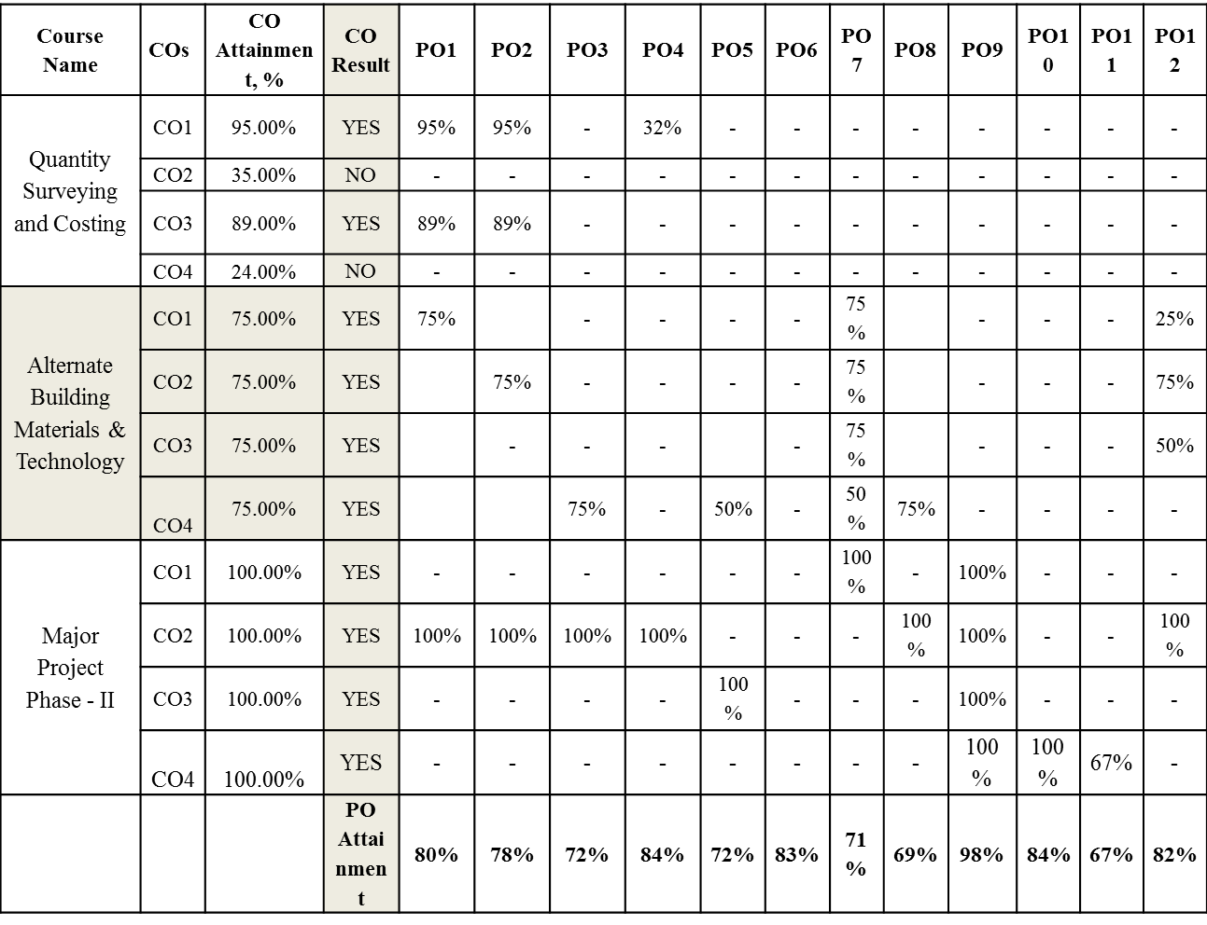
Contd…

Slide 103
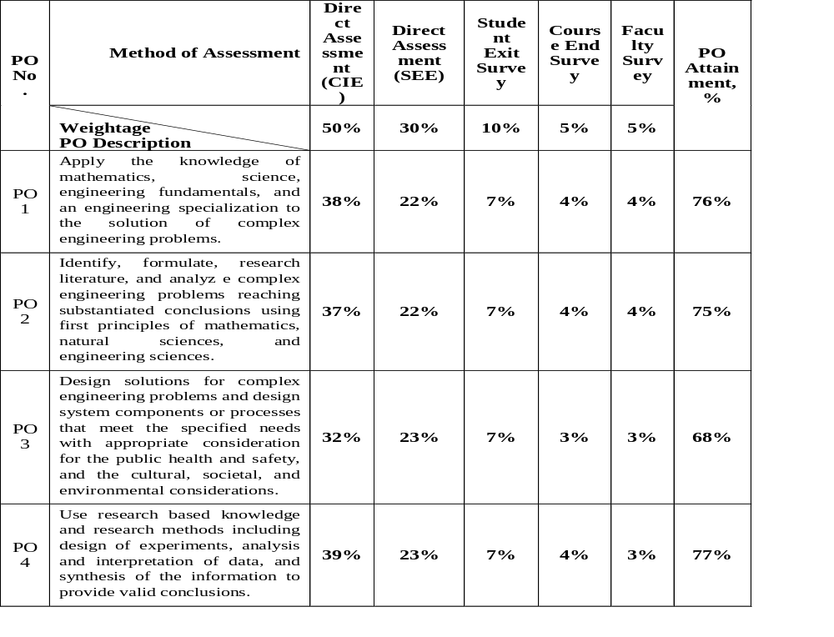
Example Weightages for PO Attainment
40
5

Slide 104
PO Attainment
All POs can be adequately addressed through the selection of core courses and their COs
Attainable targets can be selected for each of the CO.
If assessment is in alignment with COs the performance of the students indicates the CO attainment and hence PO attainment.
These measurements provide the basis for continuous improvement in the quality of learning.

Slide 105
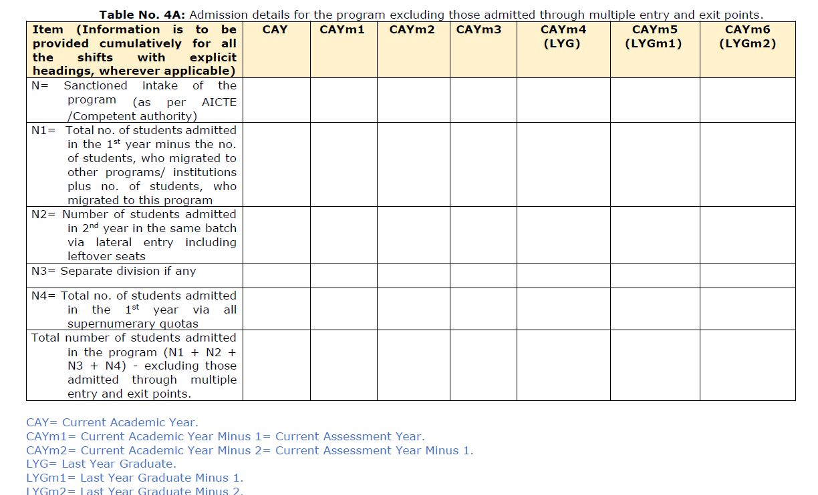
Criterion 4: Students’ Performance (120)

Slide 106
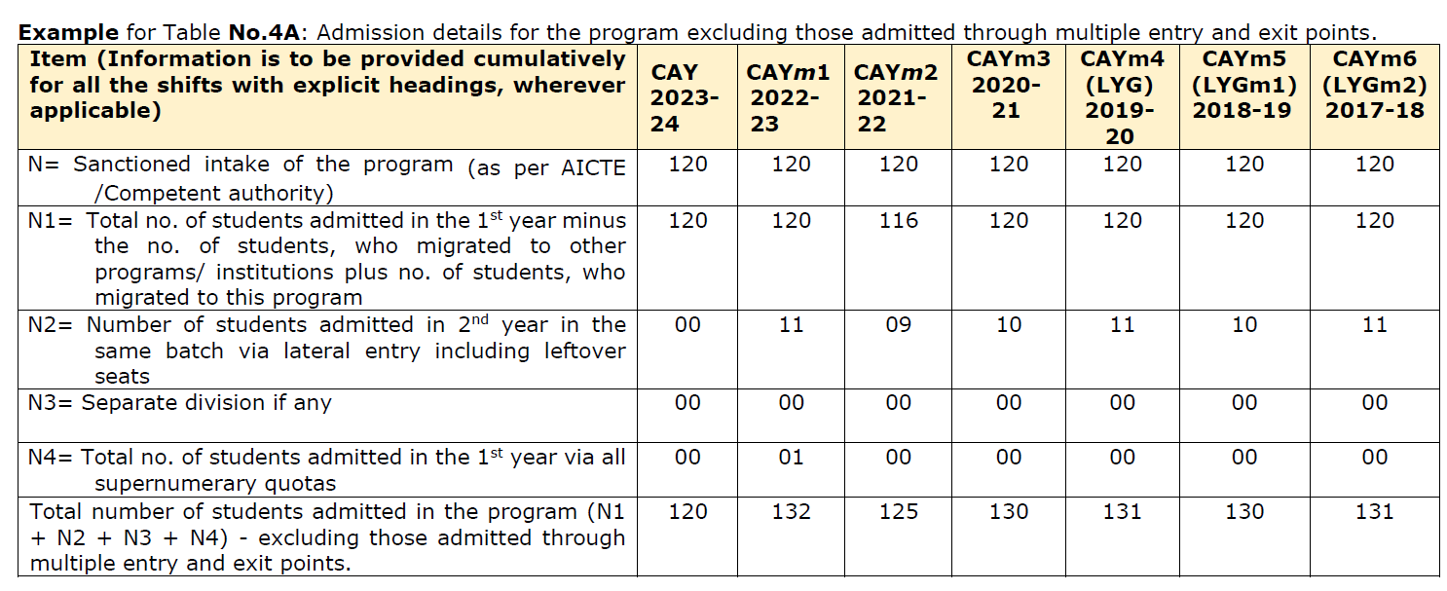
Example:

Slide 107
Criterion 4: Students’ Performance (120)
Example for Table No.4B: Admission details for the program
through multiple entry and exit points.
.
Item (No. of students admitted / exited through multiple entry and exit points) in the respective batch |  | CAY 2023-24 | CAYm1 2022-23 | CAY m2 2021 -22 | CAY m3 2020 -21 | CAYm4 (LYG) 2019 -20 | CAYm5 (LYGm1) 2018 -19 | CAYm6 (LYGm2) 2017 -18
N5(Multiple entry) N5=N52+N53+N54 | N52= No. of students admitted in 2nd year via multiple entry and exit points in same batch | 0 (NA) | 2 | 1 | 2 | 1 | 1 | 2 (a)
 | N53= No. of students admitted in 3rd year via multiple entry and exit points in same batch | 0 (NA) | 0 (NA) | 0 | 0 | 0 | 0 | 1 (b)
 | N54= No. of students admitted in 4th year via multiple entry and exit points in same batch | 0 (NA) | 0 (NA) | 0 (NA) | 0 | 0 | 0 | 1 (c)
N5=N52+N53+N54 | N5=N52+N53+N54 | 0 (NA) | 2 | 1 | 2 | 1 | 1 | 4

Slide 108
Criterion 4: Students’ Performance (120)
Example for Table No.4B: Admission details for the program
through multiple entry and exit points.
.
Item (No. of students admitted / exited through multiple entry and exit points) in the respective batch |  | CAY 2023 -24 | CAY m1 2022-23 | CAY m2 2021 -22 | CAY m3 2020 -21 | CAYm4 (LYG) 2019 -20 | CAYm5 (LYGm1) 2018 -19 | CAYm6 (LYGm2) 2017 -18
N6 (Multiple exit) N6=N61+N62+N63 | N61= No. of students exits after 1st year via multiple entry and exit points in same batch | 0 (NA) | 1 | 1 | 1 | 0 | 1 | 1 (d)
 | N62= No. of students exit after 2nd year via multiple entry and exit points | 0 (NA) | 0 (NA) | 0 | 0 | 0 | 0 | 1 (e)
 | N63= No. of students exit after 3rd year via multiple entry and exit points in same batch | 0 (NA) | 0 (NA) | 0 (NA) | 0 | 0 | 0 | 0 (f)
N6=N61+N62+N63 | N5=N52+N53+N54 | 0 (NA) | 1 | 1 | 1 | 0 | 1 | 2

Slide 109
Criterion 4: Students’ Performance (120)
1. Example: Multiple entry for Batch LYG m2 (2017-18):
No. of students admitted through multiple entry: 4
Breakdown: 1(a) + 1(b) + 2(c), where:
  a = no. of students admitted in 2nd year
  b = no. of students admitted in 3rd year
  c = no. of students admitted in 4th year
  Therefore, for batch LYG m2 (2017-18):
  2 students were admitted in the 2nd year.
  1 student was admitted each in the 3rd and 4th years.

Slide 110
Criterion 4: Students’ Performance (120)
Example: Multiple exit for Batch LYG m2 (2017-18):
No. of students exiting/dropped through multiple exit: 2
Breakdown: 1(d) + 1(e) + 0(f)), where:
d = no. of students exiting after 1st year
e = no. of students exiting after 2nd year
f = no. of students exiting after 3rd year
Therefore, for batch LYG m2 (2017-18):
1 student exited after the 1st year.
1 student exited after the 2nd year.
No students exited after the 3rd year.

Slide 111
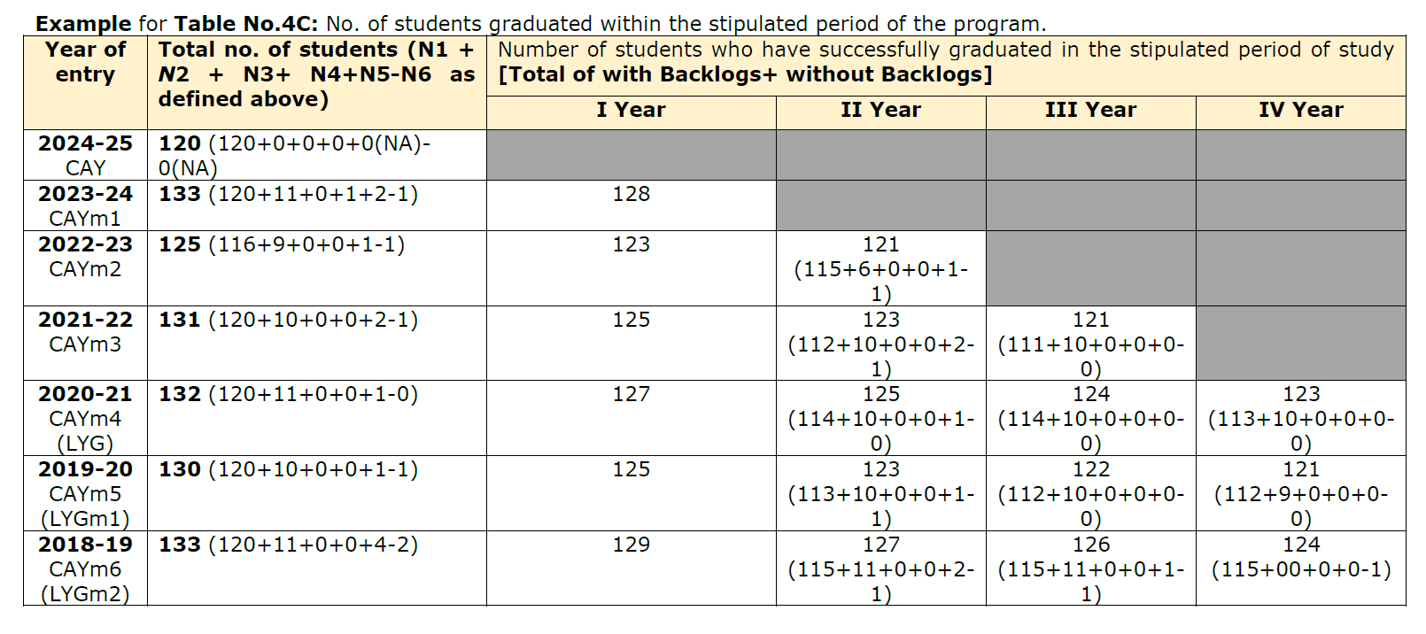
Criterion 4: Students’ Performance (120)
Table No. 4C: No. of students graduated within the stipulated period of the program.

Slide 112
Criterion 4: Students’ Performance (120)
4.1. Enrolment Ratio in the First Year (20) : ER Points= 20 * (Average ER/100)
Example for Table No.4.1.1: Student enrolment ratio in the 1st year.
Item (Students enrolled in the First Year on average over 3 academic years (CAY, CAYm1 and CAYm2)) | CAY 2023-24 | CAYm1 2022-23 | CAYm2 2021-22
N= Sanctioned intake of the program in the 1st year (as per AICTE/Competent authority) | 120 | 120 | 120
N1= Total no. of students admitted in the 1st year minus the no. of students, who migrated to other programs/ institutions plus no. of students, who migrated to this program | 120 | 120 | 116
N4= Total no. of students admitted in the 1st year via all supernumerary quotas | 00 | 01 | 00
Enrolment Ratio (ER)= (N1+N4)/N | 100 | 100.83 | 96.67
Average ER= (ER_1+ ER_2+ ER_3)/3 | 99.17%

Slide 113
Criterion 4: Students’ Performance (120)
Table No. 4.1.2: The marks distribution for enrolment ratio in the 1st year.
Item (Students enrolled in the First Year on average over 3 academic years (CAY, CAYm1 and CAYm2)) | Marks
>= 90% students enrolled in the First Year on average over 3 academic years (CAY, CAYm1 and CAYm2) | 20
>= 80% students enrolled in the First Year on average over 3 academic years (CAY, CAYm1 and CAYm2) | 17
>= 70% students enrolled in the First Year on average over 3 academic years (CAY, CAYm1 and CAYm2) | 14
>= 60% students enrolled in the First Year on average over 3 academic years (CAY, CAYm1 and CAYm2) | 11
>= 50% students enrolled in the First Year on average over 3 academic years (CAY, CAYm1 and CAYm2) | 08
>= 40% students enrolled in the First Year on average over 3 academic years (CAY, CAYm1 and CAYm2) | 05

Slide 114

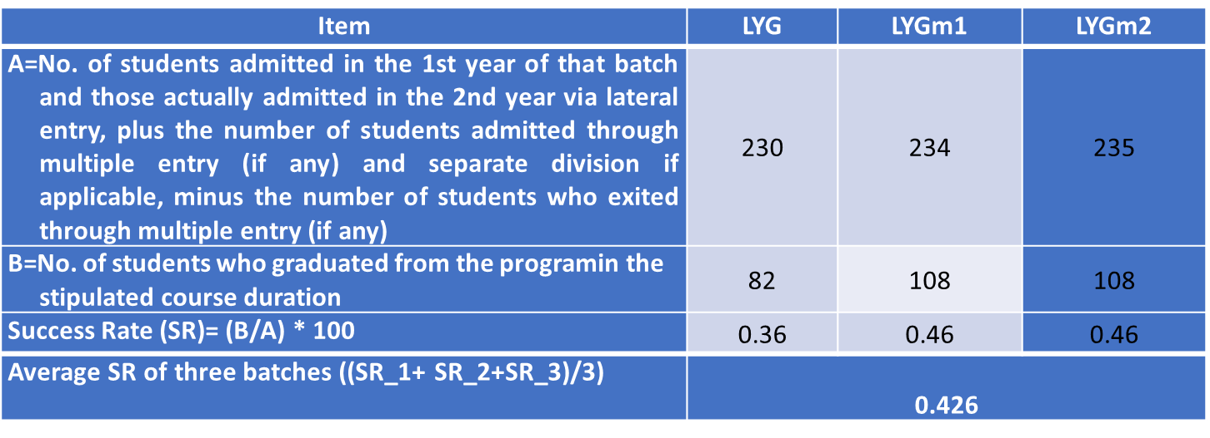
Criterion 4: Students’ Performance (120)
4.2. Success Rate of the Students in the Stipulated Period of the Program (15)
Success Rate (SR) = (No. of students who graduated from the program in the stipulated course duration) /(No. of students admitted in the 1st year of that batch and those actually admitted in the 2nd year via lateral entry, plus the number of students admitted through multiple entry (if any) and separate division if applicable, minus the number of students who exited through multiple entry (if any).
Average SR = Mean of SR for the past three batches.
SR Points = 1.5 * Average SR/10.
Note *: If the value of A in Table No. 4.2.1 is less than the sum of the sanctioned intake (N) and the lateral entry including leftover seats (N2), then the value of A in Table No. 4.2.1 should be the sum of the sanctioned intake (N) and the lateral entry including leftover seats (N2).

Slide 115
Criterion 4: Students’ Performance (120)
4.3. Academic Performance of the First-Year Students of the Program (10)
Academic Performance = Average Academic Performance Index (API), where API = ((Mean of 1st Year Grade Point Average of all successful students on a 10-point scale) or (Mean of the percentage of marks of all successful students in 1st year/10)) * (Number of successful students/number of students appeared in the examination)
Successful students are those who have to proceeded to the 2nd year.
Academic Performance | CAYm1 | CAYm2 | CAYm3
X= (Mean of 1st year grade point average of all successful students on a 10-point scale) or (Mean of the percentage of marks of all successful students in 1st year/10)
Y= Total no. of successful students
Z = Total no. of students appeared in the examination
API = X* (Y/Z) | AP1 | AP2 | AP3
Average API = (AP1 + AP2 + AP3)/3

Slide 116

Criterion 4: Students’ Performance (120)
4.4 Academic Performance of the Second Year Students of the Program (10)
Academic Performance = Average Academic Performance Index (API), where, API = ((Mean of 2nd Year Grade Point Average of all successful students on a 10-point scale) or (Mean of the percentage of marks of all successful students in 2nd Year/10)) * (Number of successful students/number of students appeared in the examination).
Successful students are those who have proceeded to the 3rd year.
Academic Performance | CAYm1 | CAYm2 | CAYm3
X= (Mean of 2nd year grade point average of all successful students on a 10-point scale) or (Mean of the percentage of marks of all successful students in 2nd year/10) | 5.91 | 7.70 | 7.06
Y= Total no. of successful students | 189 | 177 | 187
Z = Total no. of students appeared in the examination | 193 | 177 | 211
API = X* (Y/Z) | AP1 =5.79 | AP2 = 7.70 | AP3 = 6.26
Average API = (AP1 + AP2 + AP3)/3 | 6.58

Slide 117
Criterion 4: Students’ Performance (120)
4.5 Academic Performance of the Third Year Students of the Program (10)
Academic Performance = Average Academic Performance Index (API), where, API = ((Mean of 3rd Year Grade Point Average of all successful students on a 10-point scale) or (Mean of the percentage of marks of all successful students in 3rd Year/10)) * (Number of successful students/number of students appeared in the examination).
Successful students are those who have proceeded to the 4th year
Academic Performance | CAYm1 | CAYm2 | CAYm3
X= (Mean of 3rd year grade point average of all successful students on a 10-point scale) or (Mean of the percentage of marks of all successful students in 3rd year/10)
Y= Total no. of successful students
Z = Total no. of students appeared in the examination
API = X* (Y/Z) | AP1 | AP2 | AP3
Average API = (AP1 + AP2 + AP3)/3

Slide 118
Criterion 4: Students’ Performance (120)
4.6 Placement, Higher Studies and Entrepreneurship (30)
Placement index points= 0.3 * Average placement index (P),
Table No. 4.6.1: Placement, higher studies, and entrepreneurship details.
Item | LYG | LYGm1 | LYGm2
FS*=Total no. of final year students
X= No. of students placed
Y= No. of students admitted to higher studies
Z= No. of students taking up entrepreneurship
X + Y + Z = | P_1 | P_2 | P-3
Placement Index (P) = (((X + Y + Z)/FS) * 100)
Average placement index = (P_1 + P_2 + P_3)/3
Note *: If the value of FS in Table No. 4.6.1 is less than the sum of the sanctioned intake (N) and the lateral entry including leftover seats (N2), then the value of FS in Table No. 4.6.1 should be the sum of the sanctioned intake (N) and the lateral entry including leftover seats (N2).

Slide 119
Criterion 4: Students’ Performance (120)
4.7 Professional Activities (25)
4.7.1 Professional Societies/ Bodies, Chapters, Clubs, and Professional Engineering Events Organized (05)
(Provide a list of active professional societies/bodies, chapters, and clubs that exist at the departmental/cluster level in the past 3 years, and also provide a list of events organized by the professional societies, chapters, and clubs over the past 3 years.)
4.7.2 Student’s Participations in Professional Events (10)
(Provide details of students, who have participated at other institutes in various professional events, such as hackathons, codeathons, ideathons, etc., over the past 3 years.)

Slide 120
Criterion 4: Students’ Performance (120)
4.7.3 Publication of Journals, Magazines, Newsletters, etc. in the Department (05)
(Provide details of journals, magazines, newsletters, etc., published by the department, along with the names of the editors, issue numbers, volume numbers, and a list of students involved for the past 3 years.)
Table No. 4.7.3.1: List of students involved in publication of journals, magazines,
and newsletters, etc. in the Department.
.
S.N. | Name of the Journal, Magazine, Newsletter | Name of the Editor | Name of the Student & Semester | No. of Issues | Hard copy/ Soft copy
CAYm1
1.
….
CAYm2
1.
…
CAYm3
1.
…

Slide 121
Criterion 4: Students’ Performance (120)
4.7.4 Student Publications (05)
(Provide details of student publications in journals, conferences, etc., for the past 3 years.)
Table No. 4.7.4.1: List of student publications.
S.N. | Name of the Student & Semester | Name of the Publisher | Name of the Journal/ Conference, etc. | Volume No. & Issue No. | Volume No. & Issue No. | Name of the Award if any
CAYm1
1.
….
CAYm2
1.
…
CAYm3
1.
…

Slide 122
Criterion 5: Faculty Information (100)
Table No. 5A: Faculty details
S.N. | Name of the Faculty | PAN No. | APAAR faculty ID*(if any) | Highest degree | University | Area of Specialization | Date of Joining in this Institution | Experience in years in current institute | Designation at Time Joining in this Institution Present Designation The date on which Designated as Professor/ Associate Professor if any |  |  | Nature of Association (Regular/ Contract/ Ad hoc) If contractual mention Full time or (Part time or hourly based) Currently Associated (Y/N) Date of Leaving if any (In case Currently Associated is “No”)
1.
….

Slide 123
Criterion 5: Faculty Information (100)
Note 1: Please provide details of the faculty in the Department and allied Departments, including cumulative information for all three academic years starting from the current academic year (CAY) in the specified format. Programs such as MCA, BCA, and other non-engineering programs running in the Department or allied Departments need to have sufficient faculty members to support those programs. Note that these faculty members should not be included in the above said Table no. 5A.
Note 2: All the faculty whether regular or contractual (except part-time or hourly based), will be considered. All regular faculty members shall meet the AICTE qualifications and experience requirements. The contractual faculty appointed with any terminology whatsoever, who have taught for 2 consecutive semesters with or without break between the 2 semesters in corresponding academic year on full-time basis shall be considered for the purpose of calculation in the faculty student ratio. However, following will be ensured in case of contractual faculty.

Slide 124
Criterion 5: Faculty Information (100)
A. Shall have the AICTE prescribed qualifications and experience.
B. Shall be appointed on full time basis and worked for consecutive two semesters with or without break between the 2 semesters during the particular academic year under consideration.
C. Should have gone through an appropriate process of selection and the records of the same shall be made available to the visiting team during NBA visit.
Note 3:
Faculty members in the Department who do not have teaching, or practical loads, will not be counted.
Director/ Principal/ Dean/ other academic/administrative posts, who has teaching/ practical load in the Department will be counted.
Visiting faculty/adjunct faculty, who are working on hourly based faculty will not be counted

Slide 125
Criterion 5: Faculty Information (100)
5.1. Student-Faculty Ratio (30)
(SFR to be calculated at Department level considering all UG and PG engineering programs in the Department; include allied department programs/clusters as well.)
No. of UG (Engineering) programs in Department including allied departments/clusters (UG_{n}):
UG₁=1st UG program
UG_{n}= n^{th} UG program
B= No. of Students in UG 2nd year (ST)
C= No. of Students in UG 3rd year (ST)
D= No. of Students in UG 4th year (ST)

Slide 126
Criterion 5: Faculty Information (100)
No. of PG (Engineering) programs in Department including allied departments/ clusters (PG_{m}):
PG₁=1st PG program.
PG_{m}=m^{th} PG program
A= No. of Students in PG 1st year
B= No. of Students in PG 2nd year
Student Faculty Ratio (SFR) = S/F
S=No. of students of all programs in the Department including all students of allied departments / clusters.
No. of students (ST)=Sanctioned Intake (SA) + Actual admitted students via lateral entry including leftover seats (L) if any (limited to 10 % of SA)
Students who admitted under supernumerary quotas (SNQ, EWS, etc) will not be considered in calculating SFR value. Those students are exempted.
F= Total no. of regular or contractual faculty members (Full Time) in the Department, including allied departments/clusters (excluding first year faculty (The faculty members who have a 100% teaching load in the first-year courses)).

Slide 127
Criterion 5: Faculty Information (100)
Example: Table No. 5.1.1: Calculation of no. of students admitted in the program though lateral entry or left-over seats.
Let assume that sanctioned intake of the program (SA)=120
Example case | No. of students admitted in 1st year | Leftover seats/ Unfilled seats in 1st year | No. of actually students admitted in 2nd year, L= a+ b; a=Lateral entry admission (maximum 10% of SA) b=Leftover seats admitted in 2nd year | No. of students in the program to be considered for SFR calculation (ST) = (SA + L) limited to 110 % of SA
Case 1 | 120 | 00 | 00 | 120 (120+00)
Case 2 | 120 | 00 | 12 | 132 (120+12)
Case 3 | 120 | 00 | 06 | 126 (120+06)
Case 4 | 60 | 60 | 00 | 120 (120+00)
Case 5 | 75 | 45 | 06 | 126 (120+06)
Case 6 | 82 | 38 | 12 | 132 (120+12)
Case 7 | 88 | 32 | 44* | 132 (120+12)
Case 8 | 60 | 60 | 42* | 132 (120+12)
*Note: If the number of students admitted in 2nd year via lateral entry including left over seats (L) is more than 10% of the sanctioned intake in the respective program, then the total number of students considered to be admitted in the program (ST) should be the sanctioned intake program plus 10% of the sanctioned intake program. Additionally, the (ST) value cannot exceed 132 in the given example.

Slide 128
Criterion 5: Faculty Information (100)
Example1: Computer Science and Engineering Department (Cluster Programs)/ (See Annexure-III):
If the College offers a cluster of Undergraduate(UG) engineering programs & Postgraduate (PG) Engineering Programs in for example Computer Science and Engineering (CSE), such as UG-Engineering-CSE, UG-Engineering-CSE (Artificial Intelligence), UG-Engineering-CSE (Artificial Intelligence and Machine Learning), UG-Engineering-CSE (Cyber Security), UG-Engineering-CSE (Data Science), UG-Engineering-Information Technology, PG-Engineering-CSE within the Department or a separate Department, they will be counted as one cluster(Department). The SFR should be calculated as follows:

Slide 129
Criterion 5: Faculty Information (100)
No. of UG ((Engineering) Programs in Department including allied departments/clusters (UG_{n}): 6
UG₁=UG-Engineering-CSE
UG₂=UG-Engineering-CSE (Artificial Intelligence)
UG₃=UG-Engineering-CSE (Artificial Intelligence and Machine Learning)
UG₄=UG-Engineering-CSE (Cyber Security)
UG₅=UG-Engineering-CSE (Data Science)
UG₆=UG-Engineering-Information Technology

Slide 130
Criterion 5: Faculty Information (100)
No. of PG ((Engineering) Programs in Department including allied departments/clusters (PG_{m}): 1
  PG₁=PG-Engineering-CSE.
Let’s assume that the Department of Computer Science is offering programs Such as UG1=UG-Engineering-CSE, UG2=UG-Engineering-CSE (Artificial Intelligence), UG3=UG-Engineering-CSE (Artificial Intelligence and Machine Learning), UG4=UG-Engineering-CSE (Cyber Security), UG5=UG-Engineering-CSE (Data Science), and PG1=PG-Engineering-CSE. Additionally, Allied Departments like Information Technology is offering UG6=UG-Engineering-Information Technology in the above said example. The SFR is to be calculated as follows:

Slide 131
Criterion 5: Faculty Information (100)
Example: Student-Faculty Ratio for Table No. 5.1.2.
Year | CAY | CAYm1 | CAYm2
UG₁. B | 132 | 132 | 131
UG₁. C | 132 | 131 | 130
UG₁. D | 131 | 130 | 129
UG₁ (UG-Engineering-CSE) | 395 | 393 | 390
UG₂. B | 131 | 130 | 125
UG₂. C | 130 | 125 | 130
UG₂. D | 125 | 130 | 123
UG₂ (UG-Engineering-CSE (Artificial Intelligence)) | 386 | 385 | 378

Slide 132
Criterion 5: Faculty Information (100)
Example: Student-Faculty Ratio for Table No. 5.1.2.
Year | CAY | CAYm1 | CAYm2
UG₃. B | 126 | 122 | 120
UG₃. C | 122 | 120 | 112
UG₃. D | 120 | 122 | 119
UG₃ (UG-Engineering-CSE (Artificial Intelligence and Machine Learning)) | 368 | 364 | 351
UG₄. B | 132 | 132 | 130
UG₄. C | 132 | 130 | 130
UG₄. D | 130 | 130 | 129
UG₄ (UG-Engineering-CSE (Cyber Security)) | 394 | 392 | 389

Slide 133
Criterion 5: Faculty Information (100)
Example: Student-Faculty Ratio for Table No. 5.1.2.
Year | CAY | CAYm1 | CAYm2
UG₅. B | 131 | 130 | 124
UG₅. C | 130 | 124 | 130
UG₅. D | 124 | 130 | 121
UG₅ (UG-Engineering-CSE (Data science)) | 385 | 384 | 375
UG₆. B | 132 | 131 | 130
UG₆. C | 131 | 130 | 130
UG₆. D | 130 | 130 | 128
UG₆ (UG-Engineering (Information Technology)) | 393 | 391 | 388

Slide 134
Criterion 5: Faculty Information (100)
Example: Student-Faculty Ratio for Table No. 5.1.2.
Year | CAY | CAYm1 | CAYm2
PG₁. A | 18 | 18 | 18
PG₁. B | 18 | 18 | 18
PG₁ (PG-Engineering-CSE) | 36 | 36 | 36
DS=Total no. of students in the Department (UG₁, UG₂, UG₄, UG₅, PG₁) | 1964 | 1954 | 1919
AS=Total no. of students in allied departments (UG₆) | 393 | 391 | 388
S=Total no. of students in the Department (DS) and allied departments (AS) | S1=2,357 (2,321 (all UGs) +36(PG)) | S2=2,345 (2,309(all UGs)+36(PG)) | S3=2,307 (2,271(all UGs)+36(PG))

Slide 135
Criterion 5: Faculty Information (100)
Example: Student-Faculty Ratio for Table No. 5.1.2.
Year | CAY | CAYm1 | CAYm2
DF=No. of faculty members in the Department | 95 | 99 | 100
AF=No. of faculty members in the allied Departments | 25 | 25 | 25
F=Total no. of faculty members in the Department (DF) and allied Departments (AF) | F1= 120 | F2= 124 | F3= 125
FF=The faculty members who have a 100% teaching load in the first-year courses | 00 | 00 | 00
Student Faculty Ratio (SFR)=S/(F-FF) | SFR1=2,357/120= 19.64 | SFR2=2,345/124=18.91 | SFR3=2,307/125= 18.46
Average SFR for 3 years | Average SFR= (19.64+18.91+18.46)/3=19.00

Slide 136
Criterion 5: Faculty Information (100)
Note:
Marks to be given proportionally from a maximum of 30 to a minimum of 10 for average SFR between 15:1 to 25:1, and zero for average SFR higher than 25:1. Marks distribution is given as below:
SFR < 15 - 30 Marks
< 17 - 26 Marks
< 19 - 22 Marks
< 21 - 18 Marks
< 23 - 14 Marks
< 25 - 10 Marks
> 25 - 00 Mark

Slide 137
Criterion 5: Faculty Information (100)
5.2. Faculty Qualification (25)
Faculty qualification index (FQI) = 2.5 * [(10X +4Y)/RF] where
X=No. of faculty members with Ph.D. degree or equivalent as per AICTE/UGC norms.
Y=No. of faculty members with M. Tech. or ME degree or equivalent as per AICTE/ UGC norms.
RF=No. of required faculty in the Department including allied Departments to adhere to the 20:1 Student-Faculty ratio, with calculations based on both student numbers and faculty requirements as per section 5.1 of SAR; (RF=S/20).

Slide 138
Criterion 5: Faculty Information (100)
Table No.5.2.1: Faculty qualification.
Note:
To determine the RF value (No. of required faculty in the Department, including allied Departments to adhere to the 20:1 Student-Faculty ratio), all students (S as defined in section 5.1 of SAR) in the department, as well as those in allied departments, need to be considered.
The programs, such as MCA, BCA, and other non-engineering programs running in the Department or allied Departments, need to have sufficient faculty members to support those programs and exclude the faculty members and students listed in Table No. 5.2.1 (X, Y, and RF)
Year | X | Y | RF | FQI=2.5 * [(10X +4Y)/RF]
CAY
CAYm1
CAYm2
Average Assessment

Slide 139
Criterion 5: Faculty Information (100)
5.3. Faculty Cadre Proportion (25)
  Faculty Cadre Proportion is 1(RF1): 2(RF2): 6(RF3)
RF1=No. of Professors required = 1/9 * No. of Faculty required to comply with 20:1 Student-Faculty ratio based on no. of students (S) as per section 5.1 of SAR.
RF2= No. of Associate Professors required = 2/9 * No. of Faculty required to comply with 20:1 Student-Faculty ratio based on no. of students (S) as per section 5.1 of SAR.
RF3= No. of Assistant Professors required = 6/9 * No. of Faculty required to comply with 20:1 Student-Faculty ratio based on no. of students (S) as per section 5.1 of SAR.
Faculty cadre and qualification and experience should be as per AICTE/UGC norms.

Slide 140
Criterion 5: Faculty Information (100)
Table No.5.3.1: Faculty cadre proportion details.
Year | Professor |  | Associate Professor |  | Assistant Professor
 | Required Faculty (RF1) | Available Faculty (AF1) | Required Faculty (RF2) | Available Faculty (AF2) | Required Faculty (RF3) | Available Faculty (AF3)
CAY
CAYm1
CAYm2
Average Numbers | RF1= | AF1= | RF2= | AF2= | RF3= | AF3=

Slide 141

Criterion 5: Faculty Information (100)
If AF1 = AF2= 0, then zero mark
Maximum marks should be limited to 25 if they exceed the allocated marks
Case 1: AF1/RF1=1; AF2/RF2=1; AF3/RF3=1
Faculty Cadre Proportion marks= (1+0.6+0.4) * 12.5=25.
Case 2: AF1/RF1=1; AF2/RF2=4/2; AF3/RF3=8/9
Faculty Cadre Proportion marks=(1+1.2+0.36)* 12.5=32(limited to 25)

Slide 142
Criterion 5: Faculty Information (100)
Note:
All Professors (RF1, AF1), all Associate Professors (RF2, AF2), and all Assistant Professors (RF3, AF3) in the department, as well as those in allied departments, should be considered for the calculation of faculty cadre proportion marks
To determine the RF1, RF2, and RF3 values, all students (S as defined in the section 5.1 of SAR) in the department, as well as those in allied departments, need to be considered.
The programs, such as MCA, BCA, and other non-engineering programs running in the Department or allied Departments, need to have sufficient faculty members to support them and exclude the faculty members listed in Table No. 5.3.1 (AF1, AF2, AF3).

Slide 143
Criterion 5: Faculty Information (100)
5.4. Visiting/Adjunct Faculty/Professor of Practice (10)
(Provide details of participation and contributions in teaching, learning, or practical work by visiting, adjunct, emeritus faculty, professors of practice, etc., from industry, research organizations & reputed institutions as well as retired professors, during the assessment period.)
Provision of visiting or adjunct faculty/emeritus professor/professor of practice etc. (1)
Minimum 50 hours per year of interaction with adjunct faculty from industry or research organization, retired professors, etc. (9)
A minimum of 50 hours of interaction in a year will result in 3 marks for that year (3 marks * 3 years = 9 marks).

Slide 144
Criterion 5: Faculty Information (100)
5.5. Faculty Retention (10)
Table No.5.5.1: Faculty retention ratio.
Item | CAYm1 | CAYm2 | CAYm3
RF= No. of required faculty in the Department including allied Departments to adhere to the 20:1 Student-Faculty ratio, with calculations based on both student numbers and faculty requirements as per section 5.1 of SAR; (RF=S/20).
AF= The no. of available faculty members in the Department including allied Departments
A= The no. of faculty members at the current institute with less than 1 year of experience (A in AF)
B= The no. of faculty members at the current institute with more than 1 year and less than 2 years of experience (B in AF)

Slide 145
Criterion 5: Faculty Information (100)
Table No.5.5.1: Faculty retention ratio.
Item | CAYm1 | CAYm2 | CAYm3
C= The no. of faculty members at the current institute with more than 2 years and less than 3 years of experience (C in AF)
D= The no. of faculty members at the current institute with more than 3 years and less than 4 years of experience (D in AF)
E= The no. of faculty members at the current institute with more than 4 years of experience (E in AF)
FR= (((A*0)+(B*1)+(C*2)+(D*3)+(E*4))/RF) *2.50 (points limited to 10] | FR_1 | FR_2 | FR_3
Average FR= ((FR_1+ FR_2+ FR_3)/3) (marks limited to 10)

Slide 146
Criterion 5: Faculty Information (100)
Example for Table No.5.5.1: Faculty retention ratio.
Item | CAYm1 | CAYm2 | CAYm3
RF= No. of required faculty in the Department including allied Departments to adhere to the 20:1 Student-Faculty ratio, with calculations based on both student numbers and faculty requirements as per section 5.1 of SAR; (RF=S/20). | 2,357/20=117 | 2,345/20=117 | 2,307/20=115
AF= The no. of available faculty members in the Department including allied Departments | 120 | 124 | 125
A= The no. of faculty members at the current institute with less than 1 year of experience (A in AF) | 1 | 0 | 2
B= The no. of faculty members at the current institute with more than 1 year and less than 2 years of experience (B in AF) | 2 | 3 | 10

Slide 147
Criterion 5: Faculty Information (100)
Example for Table No.5.5.1: Faculty retention ratio.
Item | CAYm1 | CAYm2 | CAYm3
C= The no. of faculty members at the current institute with more than 2 years and less than 3 years of experience (C in AF) | 1 | 2 | 2
D= The no. of faculty members at the current institute with more than 3 years and less than 4 years of experience (D in AF) | 1 | 0 | 1
E= The no. of faculty members at the current institute with more than 4 years of experience (E in AF) | 115 | 119 | 110
FR= (((A*0)+(B*1)+(C*2)+(D*3)+(E*4))/R F) *2.50 (points limited to 10 | FR_1= ((0+2+2+3 +460) /117) *2.50 = 9.98 | FR_2= ((0+3+4+0 +476) /117) *2.50= 10(10.32) | FR_3= ((0+10+4+ 3 + 440)/115) *2.50 = 9.93
Average FR= ((FR_1+ FR_2+ FR_3)/3) (marks limited to 10) | (9.98+10+9.93)/3=29.04/3=9.97

Slide 148
Criterion 6: Faculty Contribution (120)
6.1. Professional Development Activities (60)
6.1.1. Memberships in Profession Societies at National / International Levels (05)
(Provide details of faculty members, who have active recognized professional memberships and their positions and contributions to professional societies during the assessment period.)
Table No. 6.1.1.1: List of faculty members and their memberships.
S. N. | Name of the Faculty | Name of the Professional Society /Body at National and International Level | Name of the Grade/ Level/Position
1 |  | ❖ ❖ | ❖ ❖
…..

Slide 149
Criterion 6: Faculty Contribution (120)
6.1.2. Faculty as Resource Persons or Participants in STTPs/FDPs (10)
6.1.2.1. Faculty as Resource Persons in STTPs/FDPs (05)
(Provide details of the faculty involved as resource persons in STTP/FDP events during the assessment period.)
Table No. 6.1.2.1.1: List of faculty members as resource person in STTP/FDP
S.N. | Name of the Faculty as Resource Person | Name of the STTP/FDP | Date | Location | Organized by
CAYm1
1.
…..
CAYm2
1.
…..
CAYm3
1.
…..

Slide 150
Criterion 6: Faculty Contribution (120)
6.1.2.2. Faculty Members’ Participation in STTPs/FDPs (05)
(Provide details of faculty participated in STTP/FDP events during the assessment period with special reference to the faculty competency for the program under consideration for accreditation. Please do not give duplicate data from the section 6.1.4.)
❖ A Faculty scores maximum five points for participation
❖ Participation in 2 to 5 days Faculty/ Faculty development program: 3 Points
❖ Participation in >5 days Faculty/ Faculty development program: 5 points.

Slide 151
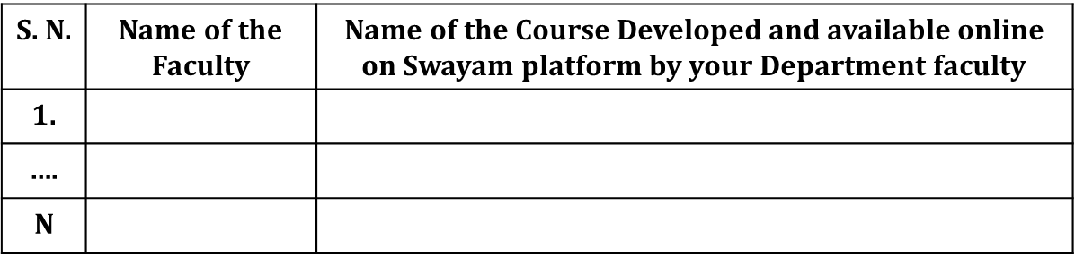
Criterion 6: Faculty Contribution (120)
6.1.3. Faculty Contribution in Development of SWAYAM MOOCs and other E-Content (05)
(Provide details of faculty members developed courses for various educational initiatives, including SWAYAM MOOCs/SWAYM PLUS/NPTEL, e-PG Pathshala and other e-contents during the assessment period.)
Table No. 6.1.3.1: List of faculty members developed MOOC course for the past 3 years.

Slide 152
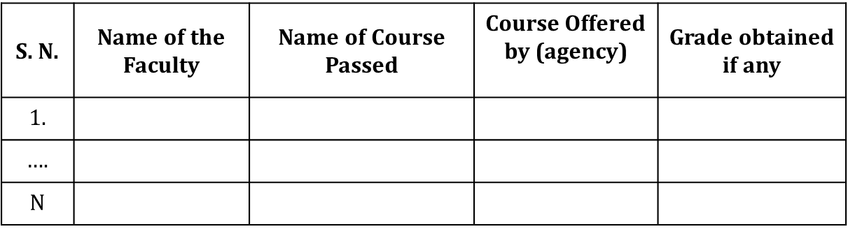
Criterion 6: Faculty Contribution (120)
6.1.4. Faculty Certification of MOOCs through SWAYAM, etc. (10)
(Provide details of faculty members, who have obtained MOOCs (Massive Open Online Courses) certification through platforms like SWAYAM/SWAYM PLUS/NPTEL and other approved programs during the assessment period.)
Table No. 6.1.4.1: List of faculty members obtained certification of MOOCs for the past 3 years.

Slide 153
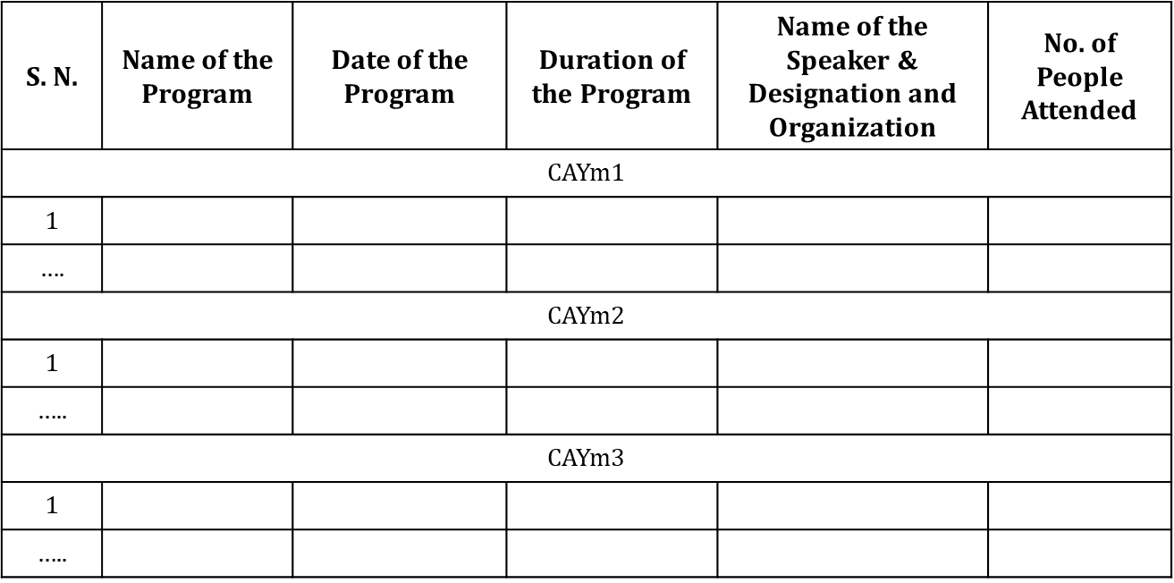
Criterion 6: Faculty Contribution (120)
6.1.5. FDP/STTP Organized by the Department (10)
(Provide details of the number of faculty development programs and short-term training programs organized by the department individually or in collaboration with other departments over the past 3 years.)
❖ The minimum duration of FDP/STTP is 5 days.
❖ 2 points per FDP/STTP, with a maximum of 4 marks per assessment year and a total maximum of 10 marks

Slide 154
Criterion 6: Faculty Contribution (120)
6.1.6. Faculty Support in Student Innovative Projects (10)
(Provide details of faculty supports as a mentor, facilitator, etc. in student innovation projects in various events like hackathons, codeathons, ideathons, open research, etc.)
Table No. 6.1.5.1: List of FDPs/STPs organized by Department for the past 3 years.
S. N. | Name of the Faculty | Name of the Event | Date of Event | Place of Event | Website link, if any
CAYm1
1
….
CAYm2
1
…..
CAYm3
1
…..

Slide 155
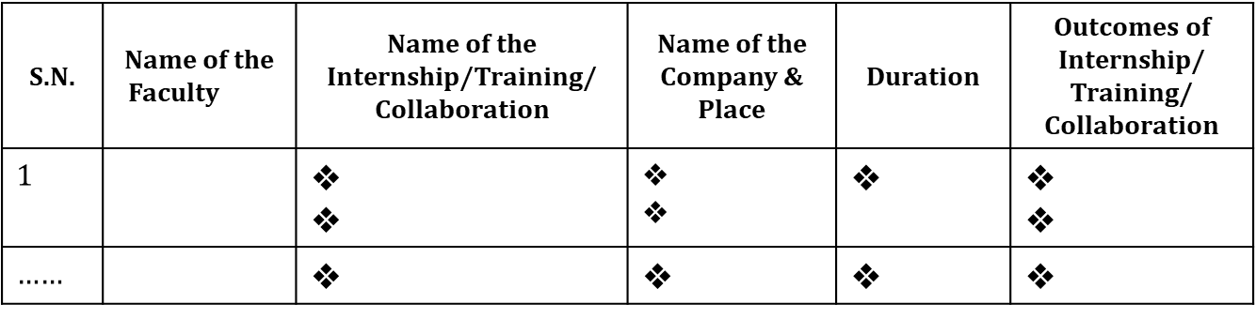
Criterion 6: Faculty Contribution (120)
6.1.7. Faculty Internship/Training/Collaboration with Industry (10)
(Provide details of faculty members who have undergone internships or training in industry and research organizations, or a list of faculty members who are actively collaborating with industry.
(The outcomes of internships, training, and collaborations including the number of programs organized for students and faculty members, the development of working models and prototypes, the publication of joint research papers, the number of funded projects received, etc. for the assessment period.)

Slide 156
Criterion 6: Faculty Contribution (120)
6.2. Research and Development Activities (60)
6.2.1. Academic Research (10)
(Provide details of compiled list including research papers, available online or in hard-copy, from reputable publishers and should be list of Scopus/WoS. Only papers with the faculty member's affiliation aligned with the current institution are considered. Each entry in the comprehensive list includes details such as DOI, publisher, and month/year of publication).
S.N. | Item | CAYm1 | CAYm2 | CAYm3
1 | No. of peer reviewed journal papers published
2 | No. of peer reviewed conference papers published
3 | No. of books/book chapters published
6.2.2. Ph.D. Student Details (05)
S.N. | Item | CAYm1 | CAYm2 | CAYm3
1 | No. of students enrolled for Ph.D. in the Department
2 | No. of Ph.D. students graduated in the Department

Slide 157
Criterion 6: Faculty Contribution (120)
6.2.3. Development Activities (10)
(Provide details of patents granted/published, working models, and prototypes developed by faculty members in the last 3 years.)
6.2.4. Sponsored Research Project (15)
(Provide details of funded research projects from the external sources including Corporate Social Responsibility (CSR). List includes Principal Investigator (PI), Co-PI name, name of the dept where project is sanctioned, project title, funding agency, sanctioned amount, duration and sanctioned year. Also, provide the cumulative funding amount received during CAYm1, CAYm2, and CAYm3. Please do not give duplicate data from the sections 6.2.5 and 6.2.6.)
❖ Amount >20 Lacs – 15 Marks
❖ Amount >16 Lacs and < 20 lacs– 12 Marks
❖ Amount >12 Lacs and < 16 lacs –9 Marks
❖ Amount > 8 Lacs and < 12 lacs –6 Marks
❖ Amount > 4 Lacs and < 8 lacs –3 Marks
❖ Amount > 1 Lacs and < 4 lacs –1 Mark
❖ Amount < 1 Lac – 0 Mark.

Slide 158
Criterion 6: Faculty Contribution (120)
6.2.5. Consultancy Work (15)
(Provide details of consultancy projects from the external sources. List includes Principal Investigator (PI), Co-PI name, name of the dept where project is sanctioned, project title, funding agency, sanctioned amount, duration and sanctioned year. Also, provide the cumulative funding amount received during CAYm1, CAYm2, and CAYm3. Please do not give duplicate data from the sections 6.2.4 and 6.2.6.)
Amount >20 Lacs – 15 Marks
Amount >16 Lacs and < 20 lacs–12 Marks
Amount >12 Lacs and < 16 lacs –9 Marks
Amount > 8 Lacs and < 12 lacs –6 Marks
Amount > 4 Lacs and <8 lacs –3 Marks
Amount > 1 Lacs and <4 lacs –1 Mark
Amount < 1 Lac – 0 Mark.

Slide 159
Criterion 6: Faculty Contribution (120)
6.2.6. Institution Seed Money or Internal Research Grant to its Faculty for Research Work (05)
(Provide details of faculty members received Institution seed money grants to its faculty for research work. Also, provide the cumulative funding amount received and utilized during CAYm1, CAYm2, and CAYm3. Please do not give duplicate data from the sections 6.2.4 and 6.2.5. The outcomes of the project are no. of publications, no. of working models/prototypes, no. of Ph.D. students graduated, no. of M.E students graduated, amount generated, etc.)
Amount received (3 marks)
❖ Amount > 6 Lacs – 3 Marks
❖ Amount > 4 Lacs and < 6 lacs– 2 Marks
❖ Amount > 2 Lacs and < 4 lacs – 1 Mark
❖ Amount < 1 Lac – 0 Mark.
Amount utilized (2 marks).

Slide 160
Criterion 7: Facilities and Technical Support (100)
7.1. Adequate and Well-Equipped Laboratories, and Technical Manpower (40)
(Provide details of various laboratories for the program and at the department level. Also, please provide a list of technical support staff appointed by the College for the Department and their qualifications. Please do not give duplicate data from the sections 7.2 and 7.5.)
S. N. | Name of the Laboratory | No. of students per setup (Batch Size) | Name of the major equipment | Weekly utilization status (all the courses for which the lab is utilized) | Technical Manpower support
 |  |  |  |  | Name of the technical staff | Name of the technical staff | Qualification
1.
….
N.

Slide 161
Criterion 7: Facilities and Technical Support (100)
7.2. Additional Facilities Created for Improving the Quality of Learning Experience in Laboratories (20)
(Provide details of various additional facilities provided by the department to enhance the quality of learning in laboratories. Please do not give duplicate data from the sections 7.1 and 7.5.)
Table No.7.2.1: List of additional facilities.
S. N. | Name of the Facility | Details | Purpose for creating facility | Utilization | Relevance to Pos/PSOs
1.
….
N.

Slide 162
Criterion 7: Facilities and Technical Support (100)
7.3. Maintenance of Laboratories and Overall Ambiance (10)
(Provide details of overall laboratories maintenance and overall ambiance in the Department.)
7.4. Safety Measures in Laboratories (10)
(Provide details of various safety measures deployed in each laboratory within the Department.)
7.5. Project Laboratory / Research Laboratory / Centre of Excellence (20)
(Provide details of laboratories for supporting projects, research, Centre of Excellence, innovation, and startups etc. Please do not give duplicate data from the sections 7.1 and 7.2.)

Slide 163
Criterion 8: Continuous Improvement (80)
8. 1. Actions Taken Based on the Results of Evaluation of the COs, POs, and PSOs (40)
8.1.1. Actions Taken Based on the Results of Evaluation of the COs Attainment (20)
(Identify the areas of weaknesses in the program based on the analysis of evaluation of COs attainment levels. Measures identified and implemented to improve COs attainment levels for the assessment year (CAYm1) including curriculum intervention, pedagogical initiatives, support system improvements, etc.)

Slide 164
Criterion 8: Continuous Improvement (80)
8.1.2. Actions Taken Based on the Results of Evaluation of the POs/PSOs Attainment (20)
(Identify the areas of weaknesses in the program based on the analysis of evaluation of POs/PSOs attainment levels. Measures identified and implemented during two years to improve POs attainment levels including curriculum intervention, pedagogical initiatives, support system improvements, etc.)
8.2. Academic Audit and Actions Taken thereof during the Period of Assessment (15)
(Academic audit system/process and its implementation in relation to continuous improvement.)

Slide 165
Criterion 8: Continuous Improvement (80)
8.3. Improvement in Faculty Qualification/Contribution (15)
(Assessment is based on improvement in qualification and publications with respect to the Department)
Table No.8.3.1: Improvement in qualification and publications
Item | CAYm1 | CAYm2 | CAYm3
No. of faculty members with Ph.D. degree
No. of publications in peer reviewed journals
No. of publications in conferences

Slide 166
Criterion 8: Continuous Improvement (80)
8.4. Improvement in Academic Performance (10)
(Provide details of improvement in academic performance of 1st year, 2nd year, 3rd year students during the assessment period.)
Table No.8.4.1: Improvement in academic performance
Item | CAYm1 | CAYm2 | CAYm3
Academic Performance Index (API) of the First-Year Students in the Program (Refer to section 4.3)
Academic Performance Index of the Second-Year Students in the Program (Refer to section 4.4)
Academic Performance Index of the Third Year Students in the Program (Refer to section 4.5)

Slide 167

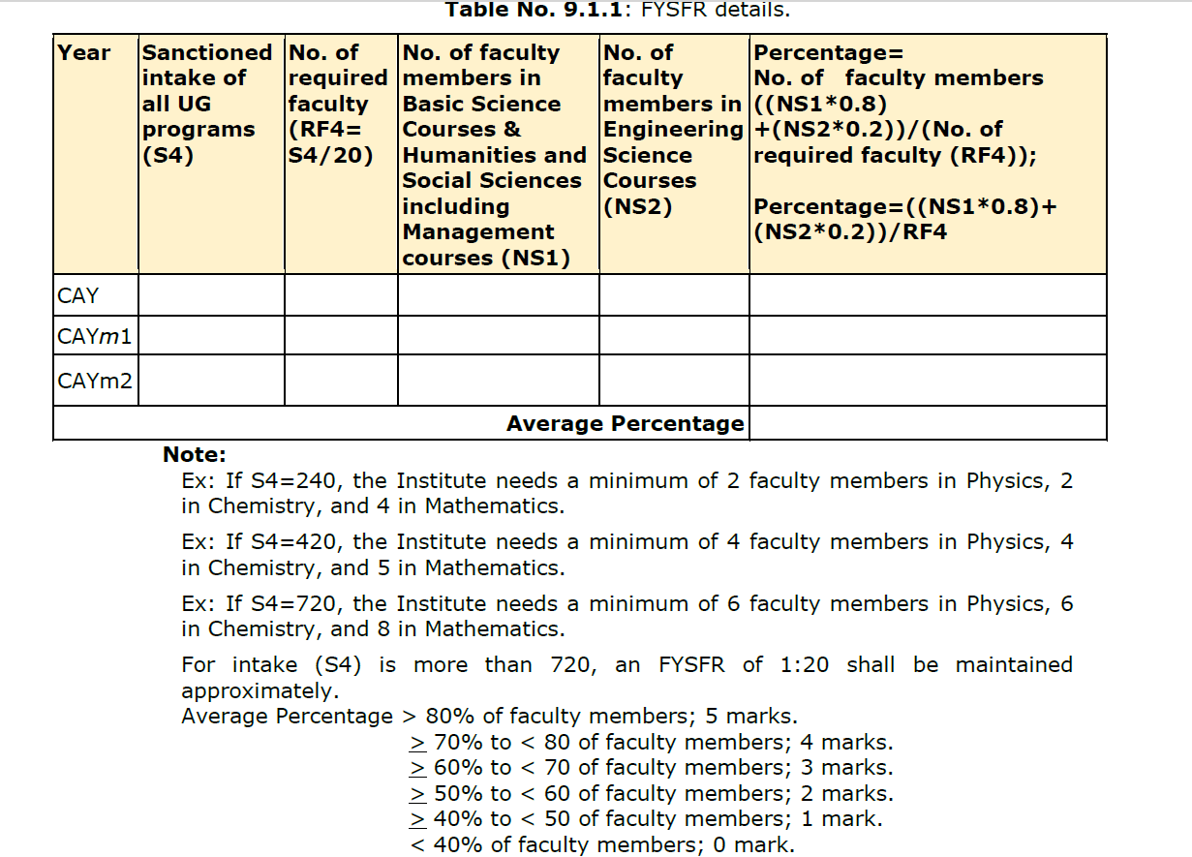
Criterion 9: Student Support System and Governance (120)
9.1. First Year Student-Faculty Ratio (FYSFR) (05)
(Data for first year courses to calculate the FYSFR)
.

Slide 168
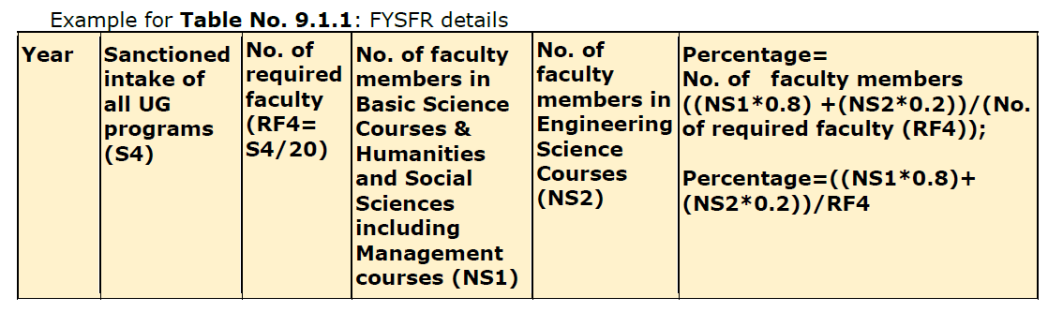

Criterion 9: Student Support System and Governance (120)

Slide 169
Criterion 9: Student Support System and Governance (120)
  9.2. Mentoring System (05)
  (Type of mentoring: Professional guidance/career advancement/course work specific/laboratory specific/all-round development. Number of faculty mentors: Number of students per mentor: Frequency of meeting:
  The institution should report the details of the mentoring system, its implementation and effectiveness through impact studies, services both online and physical, and the mentoring of seniors (final year students) to juniors (freshmen) if any, etc.).

Slide 170
Criterion 9: Student Support System and Governance (120)
9.3. Feedback Analysis (10)
  9.3.1. Feedback on Teaching and Learning Process and Corrective Measures Taken, if any (05)
  (Provide details of the feedback collection process on TLP, average percentage of students who participate; Specify the feedback analysis process; Basis of reward/ corrective measures during the assessment period. Specify the number of corrective measures taken. Exhibit the details of analysis done.)
  9.3.2. Feedback on Academic Facilities (05)
  (Provide details of the feedback collection process on facilities, its analysis and corrective actions taken during the assessment period.)

Slide 171
Criterion 9: Student Support System and Governance (120)
9.4. Training and Placement Support (10)
  (Provide details of the training and placement supports, calendar of scheduled trainings, career guidance and effectiveness of career guidance, industry interaction exclusively for pre-placement/internship/placement /counseling and support for higher study etc.)
  9.5. Start-up and Entrepreneurship Activities (05)
  (Describe the initiatives, facilities created/utilization and their effectiveness in encouraging students for innovation, entrepreneurship, incubation and start-up. Also provide the list of beneficiaries.)

Slide 172
Criterion 9: Student Support System and Governance (120)
9.6. Governance and Transparency (25)
9.6.1. Availability of the Institutional Strategic Plan and its Effective Implementation and Monitoring (10)
(Provide details of the Institute's strategic plan or Institutional Development Plan (IDP), its approval by the competent authority, and its implementation.)

Slide 173
Criterion 9: Student Support System and Governance (120)
9.6.2. Governing Body, Administrative Setup, Functions of Various Bodies, Service Rules, Recruitment procedures and Promotion Policies (10)
(Provide details of statutory and non-statutory administrative committees like the Governing body, Academic Council/ Senate, Grievance redressal Committee, IQAC, Anti-Raging committee, Disciplinary committee in place; Internal Complaints Committee (Women harassment mitigation committee) etc., provide the approval of these committees along with details of members, the meetings details (meeting notice, agenda, minutes, action taken etc. The service rules, policies and procedures; year of publication are to be listed.)

Slide 174
Criterion 9: Student Support System and Governance (120)
9.6.3. Transparency (05)
(Information on policies, rules, processes, delegation of financial powers, faculty, students, etc., and dissemination of this information to stakeholders should be made available on the Institute's website. Agendas and minutes of the Governing Body, Academic Council, and Senate are also required to be uploaded on the Institute's website. Additionally, state the extent of awareness among the stakeholders.)

Slide 175
Criterion 9: Student Support System and Governance (120)
9.7. Budget Allocation, Utilization, and Public Accounting at Institute Level (12)
(Provide a summary of the financial year's budget and actual expenditure incurred exclusively for the institution in the three financial years: CFYm1, CFYm2, and CFYm3. If the management oversees multiple Institutions, exclusive audited records for each Institute must be provided and made available on the Institute's website. The budget should be approved by the Institute BoG/GB/GC before the start of the financial year.)
CFY=Current Financial Year.
CFYm1=Current Financial Year Minus 1.
CFYm2=Current Financial Year Minus 2.
CFYm3=Current Financial Year Minus 3.

Slide 176
Criterion 9: Student Support System and Governance (120)
For CFYm1
Table No. 9.7.1: Summary of budget and actual expenditure incurred at Institute level for CFY m1.
Note:
Similar tables are to be prepared for CFYm2 & CFYm3.
Audited statements for CFYm2, and CFYm3 are to be uploaded on the website
Total Income in the CFYm1 |  |  |  | Actual expenditure in the CFYm1 | Total Students in the institute | Expenditure per student in CFYm1:
Fee | Govt. | Grants | Other Sources (specify)

Slide 177
Criterion 9: Student Support System and Governance (120)
Table No. 9.7.2: Budget and actual expenditure incurred at Institute level.
Items | Budgeted in CFY | Actual expenses in CFY (till …) | Budgeted in CFYm1 | Actual Expenses in CFYm1 | Budgeted in CFYm2 | Actual Expenses in CFYm2 | Budgeted in CFYm3 | Actual Expenses in CFYm3
Infrastructure Built-Up
Library
Laboratory equipment
Teaching and non-teaching staff salary
Outreach Programs
R&D

Slide 178
Criterion 9: Student Support System and Governance (120)
9.8. Program Specific Budget Allocation, Utilization (08)
(Total budget at program level: CFYm1, CFYm2 & CFYm3
CFY=Current Financial Year.
CFYm1=Current Financial Year Minus 1.
CFYm2=Current Financial Year Minus 2.
CFYm3=Current Financial Year Minus 3.)
For CFYm1 (Similar table to be prepared for CFYm2 and CFYm3)
Table No. 9.8.1: Summary of budget and actual expenditure incurred at program level.
Note: Justification and process of budgeting to be listed.
Total Budget in CFYm1: |  | Actual expenditure in CFYm1: |  | Total No. of students in CFYm1:
Demanded | Actual Allocated | Actual Expenditure | % Spent | Expenditure per student

Slide 179
Criterion 9: Student Support System and Governance (120)
9.9. Quality of Learning Resources (Hard/Soft) (05)
(Provide details of available learning resources, including e-resources (books and journals), as well as information on the accessibility of these resources to students. Additionally, describe the support provided to students for self-learning activities.)
9.10. E-Governance (05)
(E-governance initiatives, sustainable practices in academic and learning management, campus-wide computing resources, and their accessibility and availability to support academic and professional activities for students and faculty.)

Slide 180
Criterion 9: Student Support System and Governance (120)
9.11. Initiatives and Implementation of Sustainable Development Goals (SDGs) (10)
(Provide details of initiatives taken towards implementation of SDG specifically on green energy, waste management, preserving water, net zero, quality education, reuse, recycle, less use to renewables, etc. Provide evidences on implementation (projects assigned, R & D activities, entrepreneurial activities, outreach programs etc.)
9.12. Innovative Educational Initiatives and Implementation (05)
(Provide details of initiatives taken towards mobility of students, implementation of academic bank of credits, and support for holistic education including human values, multidisciplinary/interdisciplinary curriculum/programs, initiatives on Indian Knowledge System, Contribution towards and implementation of teaching in Indian language, etc. Policies on inclusivity and equity and their implementation, support for economically, socially and physically challenged students. Action plan and its implementation for slow learners.)

Slide 181
Criterion 9: Student Support System and Governance (120)
9.13. Faculty Performance Appraisal and Development System (FPADS) (10)
(Faculty members of Higher Educational Institutions today have to perform a variety of tasks pertaining to diverse roles. In addition to instruction, faculty members need to innovate and conduct research for their self-renewal, keep abreast of changes in technology, and develop expertise for the effective implementation of curricula. They are also expected to provide services to the industry and community to understand and contribute to solving real-life problems in industry. Another role involves shouldering administrative responsibilities and cooperating with other faculty, heads of departments, and the head of the institute. An effective performance appraisal system for faculty is vital for optimizing the contribution of individual faculty to institutional performance. The assessment is based on a well-defined system for faculty appraisal for all the assessment years and its implementation and effectiveness.)
9.14. Outreach Activities (05)
(Provide details of outreach activities such as community service, Unnat Bharat Abhiyan, social internship and society connect activities undertaken by the students and their achievements.)

Slide 182

SAR 24: SomeChanges to Note :
Alignment of Knowledge Profiles
Ascertain Complex Engineering Problems /activities as per definition of IEA..
Sustainability issues to be addressed while solving CEP
Develop measurement tools (Rubrics) for Labs, PBL, Projects, Seminars carefully targeting the corresponding POs.
Identify the courses/AATs which can be used to address SDGs apart from projects and keep a portfolio of evidences for those batch of students if possible..
Concept of allied department and faculty requirement for SFR, Cadre proportion and retention ratio computations.
Faculty contributions new criteria
There is no separate first year criteria
11 POs by NBA
9 criteria in SAR

Slide 183
THANK
YOU !

