Slide 1



Three-Day National Workshop on NAAC Accreditation & Outcome-Based Education (OBE) Through AI-Powered Digital Learn
Osmania University, Hyderabad ESTD. - 1917
NAAC , Bengaluru
ESTD - 1994
March 5, 2025

Slide 2



UGC- NEW DELHI

Slide 3

Guidelines for CO-PO: Assessment and Attainment
Resource Person
Dr. T. Ravinder Reddy
CEO, International Institute of Quality Accreditation (IIQA), Hyderabad
Website: iiqaccreditation.com
Email: iiqaccreditation@gmail.com
Mobile: 99590 26392

Slide 4

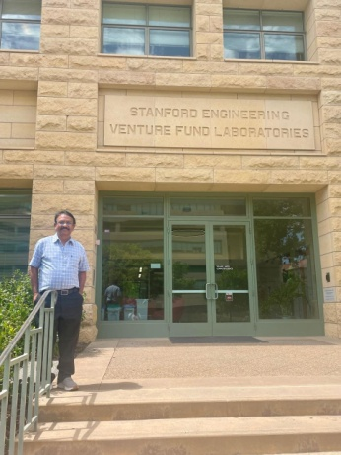
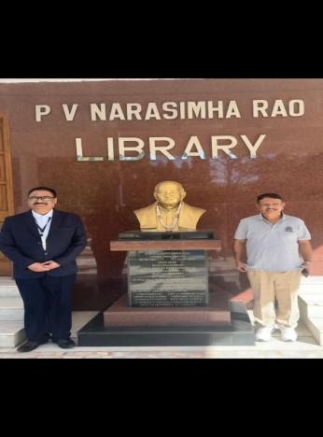
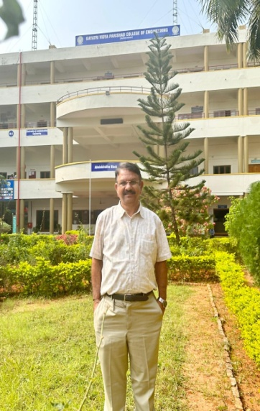
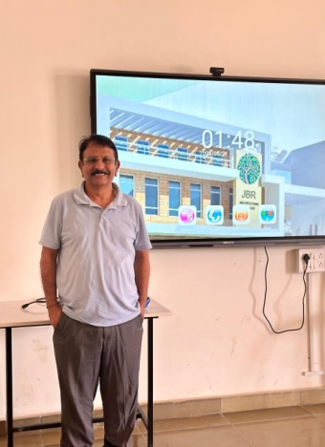




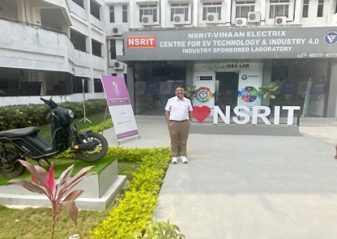


Stanford –USA
INTERNATIONAL INSTITUTE OF QUALITY ACCREDITATION (IIQA)
CEO VISITS 2024 - 25

Slide 5
Washington Accord
The membership of Washington Accord is an international recognition of the quality of undergraduate engineering education offered by the member country and is an avenue to bring it into the world class category. It encourages and facilitates the mobility of engineering graduates and professionals at international level.
India became Permanent Signatory status in June, 2014 and again in 2020 got the Permanent Signatory status of Washington Accord for a further period of six years. In the Washington Accord, India is represented by National Board of Accreditation(NBA).

Slide 6
India, OBE and Accreditation
Outcome Based Education as defined by Spady (1994, p. 12) means “clearly focusing and organizing everything in an educational system around what is essential for all students to be able to do successfully at the end of their learning experience.”
OBE has been propelled predominantly because it is used as a framework by international and local academic accreditation bodies
The National Board of Accreditation mandates establishing a culture of outcome based education (OBE) in institutions.
Outcome Based Education approach signifies a shift in the paradigm of the system of education from teaching to learning.

Slide 7
OBE Learning Process Steps
The OBE learning process can be stated into four steps:
Plan (Syllabus Writing/Review) — The Course Outcomes are aligned with the ELGA, PEO and Student Outcomes. The syllabi reflect strategies (learning plan) for achieving the outcomes, as well as for measuring the outcomes (assessment).
Implement (Course Delivery)- Carry out the learning plan and strategies planned for producing the outcomes.
Measure / Assess (Assessment) – Carry out the strategies planned for measuring the learning outcomes and objectives. Collect this data and analyze it to determine the results. (Assessment Phase).
Respond / Improve (Continuous Quality Improvement) – Determine what needs to be changed to make improvements. These changes are the basis Of new or revised outcomes and objectives for the next cycle of the process.

Slide 8
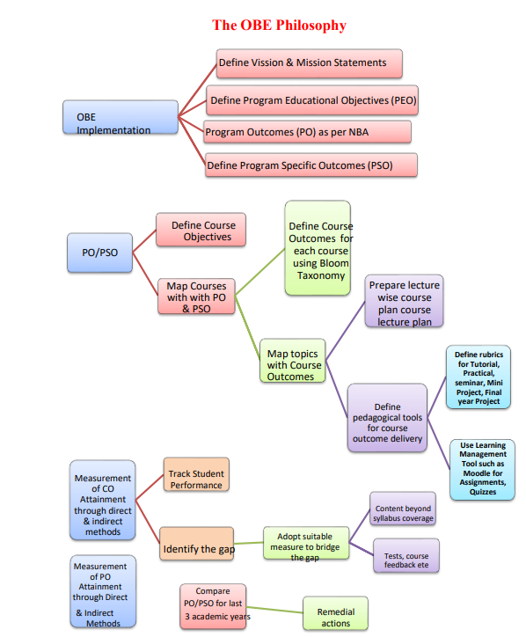

Slide 9
Outcome-Based Education
Outcome-Based Education (OBE) is a student-centric learning model that helps teachers to plan the course delivery and assessment.
It is implemented as per the following steps:
Define Vision statements, Mission statements for the Institute and department
Define Program Educational Objectives
PO & PSO Statements
Define Course Objectives
Map courses with Program outcomes at suitable levels of Bloom’s Taxonomy
Define Course Outcomes with Bloom’s Taxonomy for each course
Map topics with Course outcomes

Slide 10
Outcome-Based Education
Prepare lecture-wise Course Lesson Plan
Define pedagogical tools for course outcomes delivery
Define rubrics for Tutorial, Practical, seminar, Mini Project, Final year Project
Use Learning Management Tool such as Moodle for Assignments, Quizzes, Content beyond syllabus coverage, Tests, course feedback etc.
Measure the attainment of each CO through Direct/Indirect assessments
Track students performance
Identify Gaps in the Curriculum and adopt suitable measures to bridge the Gap
Compare PO/PSO for last 3 academic years and propose remedial actions
Assess the attainment of Program Educational Objectives

Slide 11
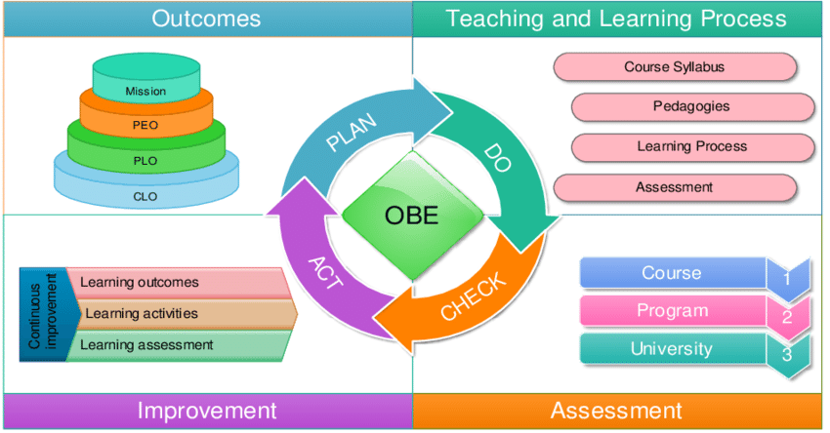
Outcome Based Education (OBE)

Slide 12
Benefits of OBE
Improved Learning Outcomes: By focusing on outcomes, OBE can lead to better learning outcomes and improved student performance.
Increased Relevance: OBE ensures that education is relevant to the needs of students and the demands of the job market.
Enhanced Employability: By focusing on practical skills and competencies, OBE can improve the employability of graduates.
Student Empowerment: OBE empowers students to take ownership of their learning and develop their potential.

Slide 13
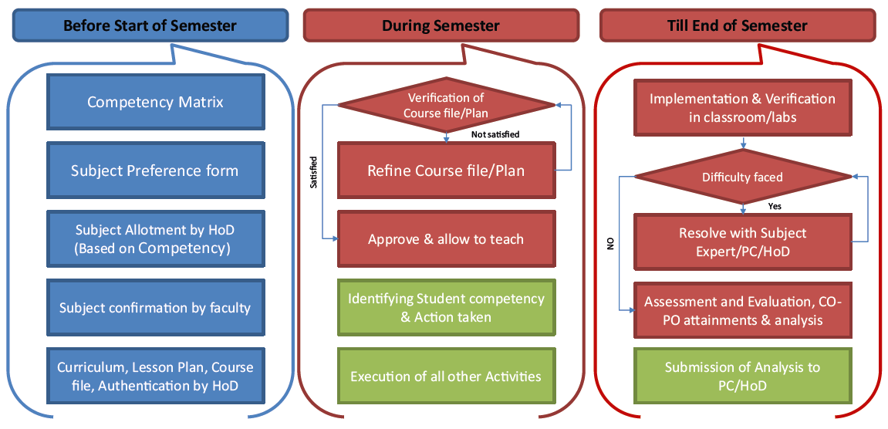
Outcome Based Education (OBE)

Slide 14
Vision and Mission Inline with OBE
Vision
A vision statement states the current and future objectives of a Department.
Vision statement is intended as a guide to help the department make decisions that align with its philosophy and declared set of goals.
The statement gives a vivid picture of an ambitious desirable future state of an organization.
Its purpose is to inspire to act as a guide for decision making & planning.

Slide 15
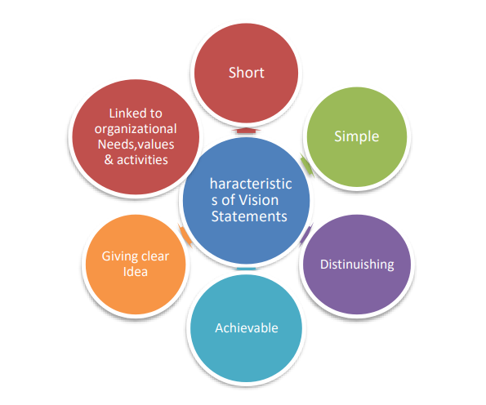
Characteristics of Vision statement

Slide 16
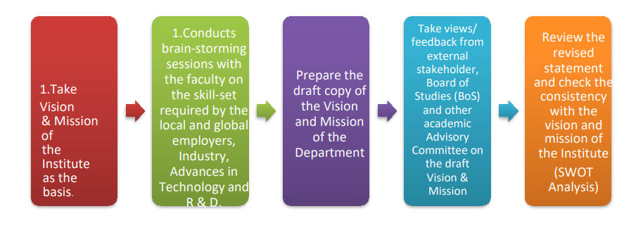
Mission
The following steps are followed to establish the Mission of the Department:

Slide 17

Sample - Vision & Mission

Slide 18
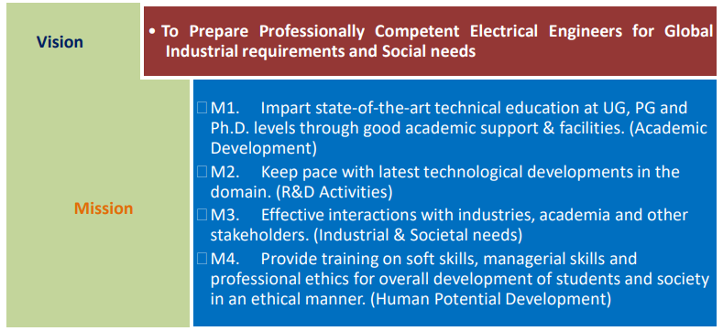
Sample - Department Vision & Mission

Slide 19
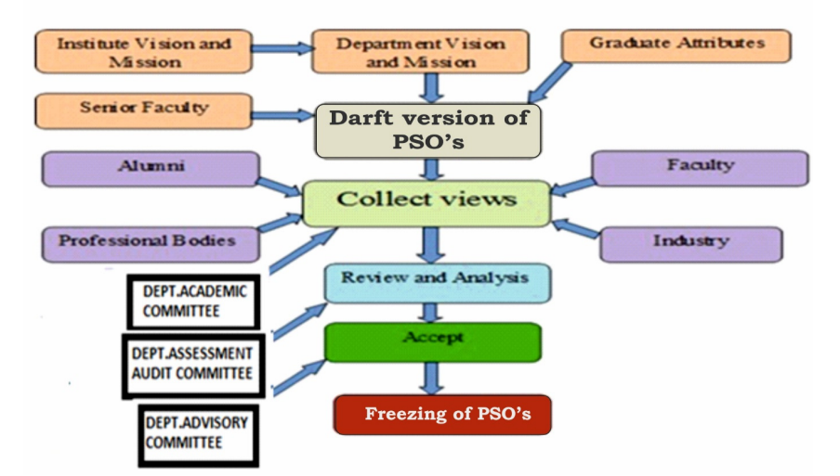
Process to Define the PSOs of the Department

Slide 20
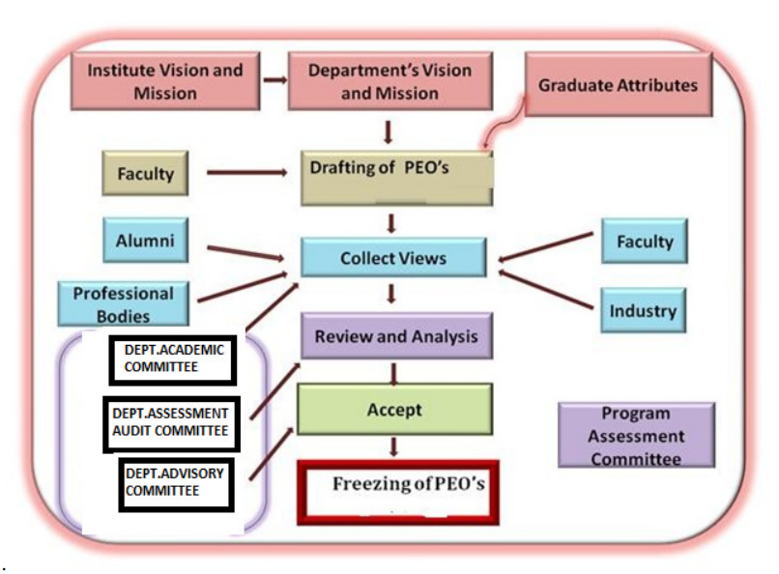
Process to Define the PEOs of the Department

Slide 21
Program Educational Objectives (PEOs)
PEOs are broad statements that describe the career and professional accomplishments that the program is preparing graduates to achieve.
Knowledge, Skill and Attitude are the three behavioral elements based on which PEOs are constructed.
PEOs are broad marketing statements.
PEOs describe the career and professional accomplishments that the program is preparing graduates to accomplish after 3 to 5 years of graduation.
PEOs are promises made by the institute to the stakeholder (Employers, students etc)
PEOs should be measurable, appropriate, realistic, and achievable

Slide 22
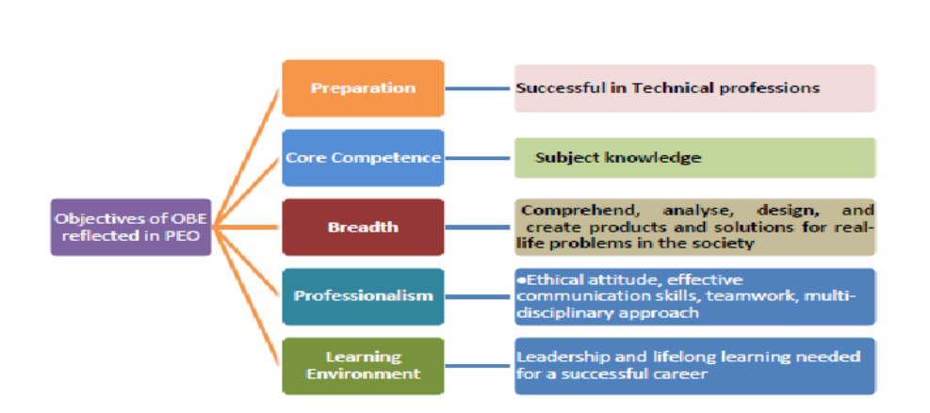
Objectives of OBE Reflected in PEO

Slide 23
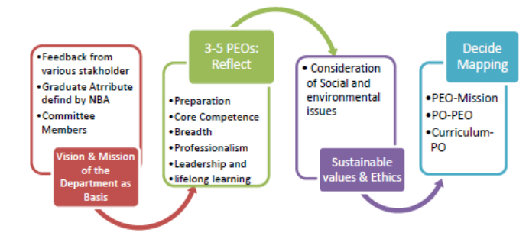
Process of Defining PEOs of Dept

Slide 24
Sample PEOs
PEO1: Graduates will have successful careers in core and allied fields of Electrical Engineering
PEO2: Graduates will have technical and analytical abilities and skills suitable to cater to industrial and societal needs
PEO3: Graduates will follow professional ethics and display an attitude of continuous learning

Slide 25
Mapping Mission statements with Program Educational Objectives
The Program Educational Objectives (PEOs) should fall in line with the Mission statements.
The BOS of the department is to establish consistency of the PEOs with the Mission of the department.
The correlation is established between PEOs and such distinct elements of mission statements, the correlation is quantized the correlation levels need to be entered as 1 or 2 or 3.
“1” means that the correlation is low or slight, “2” means that the correlation is moderate or medium and “3” means that the correlation is substantial or is very high.
To ensure the proper mapping of Mission and PEO, the following Table is required to be prepared by taking inputs from the various stakeholders.
To ensure the proper mapping of Mission and PEO, the following Table is required to be prepared by taking inputs from the various stakeholders.

Slide 26
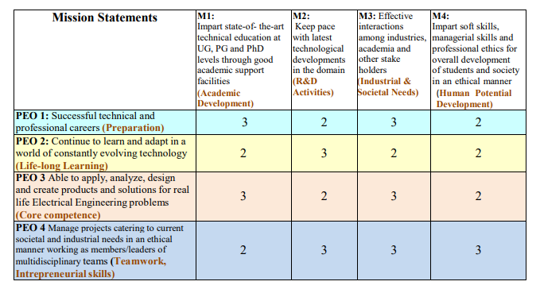
Sample - Mission Statements

Slide 27
PO & PSO Statements
Program Outcomes (POs)
Program outcomes are statements that describe what students are expected to know and be able to do upon graduating from the program.
These relate to the skills, knowledge, analytical ability, attitude, and behavior that students acquire through the program at the end of 4 years.
The POs essentially indicate what the students can do from the knowledge acquired by them during the program.
NBA has defined the following 12 POs for an engineering graduate and are applicable to all engineering programs:

Slide 28

Program Outcomes (POs) Defined by NBA
PO1. Engineering Knowledge
PO2. Problem Analysis
PO3. Design/Development of Solutions
PO4. Conduct Investigations of Complex Problems
PO5. Modern Tool Usage
PO6. The Engineer and Society
PO7. Environment and Sustainability
PO8. Ethics
PO9. Individual and Team Work
PO10. Communication
PO11. Project Management and Finance
PO12. Life-Long Learning

Slide 29
Program Specific Outcomes (PSOs)
Program Specific Outcomes are statements that describe what the graduates of a specific engineering program should be able to do.
PSOs characterize the specificity of the core courses of a program.
The POs are important as a guideline when developing or revising the course outcomes.
PSOs are defined based on the Centre of Excellence of the Department.
Generally, 2 to 4 Program Specific Outcomes (PSOs) that the graduates of the program will attain should be defined for each department.

Slide 30
Course Outcomes (COs)
It is a detailed description of what a student must be able to do at the end of a course.
COs are the statements of Knowledge/ Skills/ Attitude that students are expected to know, understand and perform, as a result of learning experiences.
Course Outcome remains the base of the hierarchy of outcomes and is the tools that can be used to measure student performance in each course.
The course outcomes need to be concise descriptions of what learning is expected to take place by course completion.
It should be narrower and measurable statements
Well-written COs facilitate the faculty in measuring the achievement of the CO at the end of the semester. It also helps the faculty in designing suitable delivery and assessment methods to achieve the designed CO’s.
New COs are developed when a new course is offered.

Slide 31
Writing/ Framing COs
Well-written CO facilitates the faculty in measuring the achievement of the CO at the end of the semester.
The CO statements are defined by considering the course content covered in each module of a course.
Focus on the learning that results from the course rather than describing activities or lessons that are in the course. Create statements that have a student focus rather than an instructor centric approach.
For every course there may be 5 or 6 Course Outcomes.
The keywords used to define CO are based on Bloom’s Taxonomy.
It also helps the faculty in designing suitable delivery and assessment methods to achieve the designed Course Outcomes.

Slide 32
Introduction to CO and PO Mapping
As per NBA (National Board of Accreditation) guidelines, 6 Course Outcomes (COs) must be defined for theory and laboratory courses.
For courses with both theory and laboratory components, at least 8 COs are required, and no CO should be framed at the "Remember" level.
Keep these essential points in mind while framing COs for a course.
Mapping COs with POs (Program Outcomes)
All COs should be mapped with PO1 to PO4 based on the respective CO level.
The first four Program Outcomes (PO1 to PO4) are linked to cognitive domains and are focused on solving complex engineering problems. These POs are mapped to different levels of cognitive skills:
PO1: K3 Level (Application)
PO2: K4 Level (Analysis)
PO3: K5 Level (Synthesis)
PO4: K6 Level (Evaluation)

Slide 33
Assessment Process for CO Attainment (Theory Courses)
Course Outcome is evaluated based on the performance of students in internal assessments, end semester examination of a course, course end seminar, one minute paper writing and feedback on course outcome.
Course end seminar, one minute paper writing and feedback on course outcome are the indirect measurement tools and internal assessments, end semester examination of a course are the direct method for CO assessment.
In direct assessment method, internal assessment (mid-term examinations, weekly quizzes and assignments are used for theory courses, rubrics based evaluation is used for seminar and projects courses) contributes 40% to the total CO attainment. End term assessment contributes 60% to the total attainment of a CO as shown in the flowchart below.

Slide 34
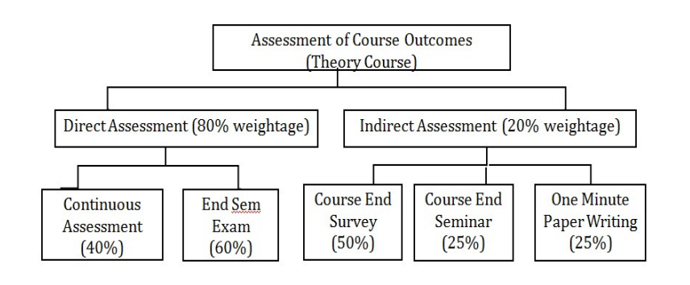
Assessment Process for CO Attainment (Theory Courses)

Slide 35
Assessment Process for CO Attainment : Direct method
Every mid-exam question, every quiz question and every assignment is mapped to a specific CO.
For practical courses, seminars and projects, rubrics should be mapped with every CO of that course.
Thereafter, a CO wise cut-off value is taken based on the average marks scored by the students for that CO or a threshold mark such as 60% of the maximum marks allocated that CO.
The number of students with their marks in a CO under consideration, above the cutoff value is considered for the CO attainment.
The documentation of the CO attainment level of the respective semester courses is presented in BOS meeting.

Slide 36
Example of CO Mapping
If a CO is framed at K2 level, it can be mapped to PO1 and PO2 with correlation values of 2 and 1, respectively.
For a CO at K3 level, map it to PO1, PO2, and PO3 with correlation values of 3, 2, and 1.
Similarly, for a K4 level CO, the mapping could be 3, 2, 1.
Use this template to align your COs with PO1 to PO4.
Assessment Tools for PO1 to PO4
Common assessment tools for PO1 to PO4 include:
Class tests, centralized internal tests (sometimes called common internal tests), model exams, semester examinations, assignments, quizzes, and mini-projects.
These tools are typically used to assess PO1 to PO4
For PO5 to PO12, other assessment tools are utilized. These assessments focus more on practical skills and outcomes and are not limited to traditional tests and exams.

Slide 37
Mapping COs with PO5
(Modern Tool Usage)
PO5 focuses on the use of modern tools in engineering.
High correlation (3): If students are able to demonstrate a concept using modern tools.
Medium correlation (2): If students are able to explain a concept using the tools.
Low correlation (1): If students can only list tools or syntax used to implement the concept.
Assessment for PO5
You can assign assignments or tutorials where students use modern tools to implement concepts. The extent to which students complete the tasks (e.g., meeting the specifications) will determine their attainment levels (3, 2, 1, or 0).
These tools are typically used to assess PO1 to PO4
For PO5 to PO12, other assessment tools are utilized. These assessments focus more on practical skills and outcomes and are not limited to traditional tests and exams.

Slide 38
Mapping COs with PO7
(Environment and Sustainability)
PO7 deals with environmental sustainability and the impact of engineering solutions.
Courses like Environmental Science (EVS) and projects dealing with sustainable development can be mapped with high correlation.
All COs of EVS courses will be highly correlated with PO7.
Mini-projects and projects that address environmental and sustainability issues should also be mapped with PO7.
Mapping COs with PO8 (Ethics)
PO8 focuses on ethics and responsibilities in engineering practice.
For courses, map at least two COs with correlation levels of 2/1
Use assignments, seminars, or group assignments to assess ethical principles.
Lab courses, mini-projects, and EEC courses can also be mapped with PO8.
Assessment for PO8
Focus on plagiarism during assessments and assign corresponding attainment levels based on submission timeliness and ethical behavior.

Slide 39
Mapping COs with PO9
(Individual and Teamwork)
PO9 focuses on individual and teamwork skills.
For each course, map at least two COs with correlation levels of 2/1 using seminars, case studies, or group assignments.
Lab courses, mini-projects, and projects should also be mapped with PO9.
Assessment for PO9:
Evaluate teamwork and individual contributions through rubrics that assess practical skills, leadership, and collaboration.
Mapping COs with PO10 (Communication Skills)
PO10 emphasizes effective communication.
Map at least two COs to PO10 with assignments, seminars, and group assignments.
Lab courses, mini-projects, projects, and technical communication courses (like English and Professional Communication) should be mapped with PO10.

Slide 40
Assessment for PO10
Assess communication skills through viva-voce marks, splitting them into technical and communication skills.
Use rubrics for report writing and documentation to assess this PO.
Mapping COs with PO11 (Project Management)
PO11 can be mapped to mini-projects and projects
For project-based courses, use project-specific rubrics to evaluate the project management skills and map them with PO11.
Mapping COs with PO12 (Lifelong Learning)
PO12 promotes lifelong learning.
You can assign a high correlation (3) if students are involved in service learning courses or tackling complex problems like GATE or IES.
Assign medium (2) or low (1) correlation for activities like paper presentations or other activities promoting continuous learning.

Slide 41
Procedure for Computation of CO Attainment
Course outcomes will be attained through direct and indirect methods.
Direct Attainment
The following criteria are considered in the direct attainment
Conduction of Two Mid Semester Examination based on COs
Class performance activities
Assignments
Tutorials
Skill based Mini Projects
Quizzes
Case studies related to COs
End Term Examinations
The proportional weight ages of the above criteria are as per the institute academic regulations.

Slide 42
Procedure for Computation of CO Attainment
Indirect Attainment
Feedback from student on the framed questionnaires
Course End Seminar
One-minute paper writing
Direct Assessment tools
The various internal assessment tools should be in alignment with the COs for different subjects. All the assessment are mapped to action verbs so that they help to measure the performance of students.
Question paper should be so set to assess all CO. The marks obtained in assessments against items for each CO will indicate the CO attainment.
Faculty can set targets for each CO of his/her course Attainment gaps can therefore be identified
Faculty can plan to reduce the attainment gaps or enhance attainment targets.

Slide 43
Procedure for Computation of CO Attainment
A common format of programmed excel sheet, prepared in the Institute, is initially being used for finding the attainment of COs.
Each course faculty computes the attainment as per the appropriate assessment tools considered.
Once the marks of each student in internal assessment tests and assignments and other internal evaluation metrics are entered, the CO attainment can be measured for each class.

Slide 44
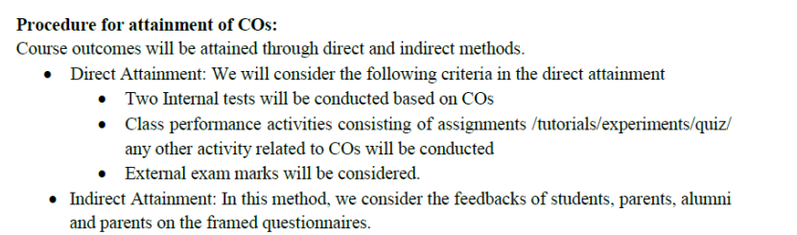
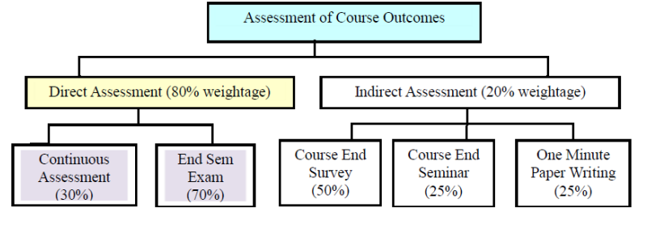
Procedure for Attainment for CO’s

Slide 45
Procedure for Attainment for COs
Mapping Questions with Course Outcomes at appropriate levels of Bloom’s Taxonomy and maps it with assessments
Questions are framed using Bloom’s Taxonomy verbs (both during the class test and written assignments) from the remember, understand, apply, analyze, evaluate, and create levels of the taxonomy pyramid.
Rubrics for activities such as Seminars, projects, internships, Lab assignments etc.
Although it is appropriate enough to measure the learning of the students based on the level of Bloom’s Taxonomy, Rubrics are used to cater to the different levels of learners, should measure their capabilities, and should be mapped with the course outcomes.

Slide 46
Action Verbs for Assessment
Level | Skill Demonstrated | Question cues / Verbs for tests
1 Remember | • Ability to recall of information like facts, conventions, definitions, jargon, technical terms, classifications, categories, and criteria • ability to recall methodology and procedures, abstractions, principles, and theories in the field • knowledge of dates, events, places • mastery of subject matter | list, define, tell, describe, recite, recall, identify, show, label, tabulate, quote, name, who, when, where
2 Understand | • understanding information • grasp meaning • translate knowledge into new context • interpret facts, compare, contrast • order, group, infer causes • predict consequences | describe, explain, paraphrase, restate, associate, contrast, summarize, differentiate interpret, discuss
3 Apply | • use information • use methods, concepts, laws, theories in new situations • solve problems using required skills or knowledge • Demonstrating correct usage of a method or procedure | calculate, predict, apply, solve, illustrate, use, demonstrate, determine, model, experiment, show, examine, modify

Slide 47
Action Verbs for Assessment
Level | Skill Demonstrated | Question cues / Verbs for tests
4 Analyse | • break down a complex problem into parts • Identify the relationships and interaction between the different parts of a complex problem • identify the missing information, sometimes the redundant information and the contradictory information, if any | classify, outline, break down, categorize, analyse, diagram, illustrate, infer, select
5 Evaluate | • compare and discriminate between ideas • assess value of theories, presentations • make choices based on reasoned argument • verify value of evidence • recognize subjectivity • use of definite criteria for judgments | assess, decide, choose, rank, grade, test, measure, defend, recommend, convince, select, judge, support, conclude, argue, justify, compare, summarize, evaluate
6 Create | • use old ideas to create new ones • Combine parts to make (new) whole, • generalize from given facts • relate knowledge from several areas • predict, draw conclusions | design, formulate, build, invent, create, compose, generate, derive, modify, develop, integrate

Slide 48
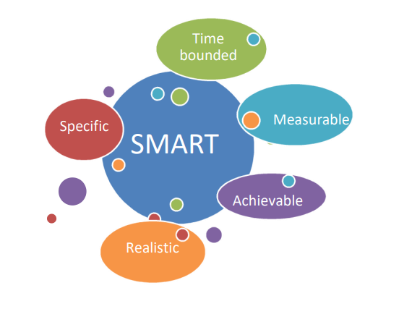
Rules to Develop COs
The rules to develop COs are SMART.

Slide 49
The Rules to Develop COs are SMART
Specific: Students can state what they should be able to achieve from reading the outcomes.
Measurable: Students can be able to recognize when they have achieved the outcomes.
Achievable: It is genuinely possible to complete the outcomes in the time and with the resources available.
Realistic: Outcomes are appropriate for the student.
Time bounded: Outcomes have a time limit for completion

Slide 50
Action Verbs for Course Outcomes: Blooms Revised Taxonomy
There are SIX levels of cognitive learning according to the revised version of Bloom’s Taxonomy.
Each level is conceptually different. The six levels are remembering, understanding, applying, analyzing, evaluating, and creating. Bloom’s Taxonomy is frequently used in writing the course outcomes as it provides a readymade structure and list of action verbs.
All levels of Bloom’s taxonomy of thinking skills can be incorporated into expected learning outcome statements. Recently, Anderson and Krathwohl (2001) adapted Bloom’s model to include language that is oriented towards the language used in expected learning outcome statements.
A summary of Anderson and Krathwohl’s revised version of Bloom’s taxonomy of critical thinking is provided in Figure below:

Slide 51
Bloom's Taxonomy in practice
Cognitive Domain
Remember
  Sample learning outcome: Remember the names and relationships of a cast of characters in a play.
  Sample assessment/activity: A multiple-choice test designed to test the memory of learners.
  Rationale: A multiple-choice test will allow educators to see whether students have effectively memorized the given material.

Slide 52
Bloom's Taxonomy in Practice
Understand
  Sample learning outcome: Understand and explain the main ideas of a play or piece of literature.
  Sample assessment/activity: Write a short (1 page) paper summarizing the plot and most important events in the play.
  Rationale: Writing a summary encourages learners to think about what the most important parts of a piece of literature are, and to decide which aspects of the plot to disregard in favor of a concise summary. It allows educators to evaluate whether or not they have understood the main idea of the play.

Slide 53
Bloom's Taxonomy in Practice
3. Apply
  Sample learning outcome: Apply the main ideas/themes in the play to another context.
  Sample assessment/activity: Write an advice column responding to one of the characters.
  Rationale: In doing this assignment, learners will consider the implications of a character’s actions outside of the consequences shown in the play.

Slide 54
Bloom's Taxonomy in Practice
Analyze
  Sample learning outcome: Be able to analyze the relative roles of each character in the play and their relationships to each other.
  Sample assessment/activity: Write an analytical paper comparing the antagonists and protagonists of the play.
  Rationale: Through this assignment, as learners consider what makes each character an antagonist or a protagonist, they need to use both their knowledge of the play and critical thinking skills.

Slide 55
Bloom's Taxonomy in Practice
5. Evaluate
  Sample learning outcome: Evaluate the decisions of characters in the play, and support your evaluation with textual evidence.
  Sample assessment/activity: Write a response to one of the events in the play, either supporting or rejecting their actions on the basis of evidence from the play as well as personal opinion and projected/actual consequences of action.
  Rationale: Through this assignment, learners will consider the rationale and consequences for actions in the play, leading them to understand and make judgments about the validity of a character’s decision making.

Slide 56
Bloom's Taxonomy in Practice
6. Create
  Sample learning outcome: Create a new and unique piece of writing using similar plot devices.
  Sample assessment/activity: Create a short story using similar plot devices in a new time or setting.
  Rationale: Through this activity, learners must integrate the plot devices and writing techniques into a new setting, allowing them to practice their creative writing skills and showing their full understanding of the writer's techniques.

Slide 57
Bloom's Taxonomy in Practice
Effective Domain
Receiving
  Sample learning outcome: Listen to other students with respect.
  Sample assessment/activity: Be an audience member to another student’s presentation, and then write a summary.
  Rationale: Through this assignment, learners will learn how to listen effectively to others as well as remember key details about their presentation (used in writing the summary).

Slide 58
Bloom's Taxonomy in Practice
2. Responding
  Sample learning outcome: Speak effectively in front of an audience and actively respond to others.
  Sample assessment/activity: Present on a subject in front of the class, and answer questions from peers about their presentation.
  Rationale: Through this, learners will become more comfortable with public speaking as well as more comfortable with contributing to a discussion in the form of answering questions.

Slide 59
Bloom's Taxonomy in Practice
3. Valuing
  Sample learning outcome: Demonstrate and explain own values regarding various topics.
  Sample assessment/activity: Write an opinion piece on any issue, explaining one’s own stance and reasons supporting that stance.
  Rationale: Through this, learners will explore not only their own values but why they support their values, giving them a chance to understand more fully their own value system.

Slide 60
Bloom's Taxonomy in Practice
4. Organization
  Sample learning outcome: Compare value systems and understand evidence behind values.
  Sample assessment/activity: Organize and compare different cultural value systems, evaluating the differences between them and why these differences may have arisen.
  Rationale: In doing this activity, learners will consider how value systems are put into place and organized, as well as the evidence that supports different value systems across the world.

Slide 61
Bloom's Taxonomy in Practice
5. Characterization
  Sample learning outcome: Work well in a team of peers.
  Sample assessment/activity: A group project, including group work on any assignment.
  Rationale: By working in a group, learners must balance their own values with the values of the team, as well as prioritize tasks and practice teamwork.

Slide 62
Bloom's Taxonomy in Practice
Psychomotor Domain
Reflex
  Sample learning outcome: Instinctively respond to a physical stimulus.
  Sample assessment/activity: A game of dodge ball.
  Rationale: Learners must react (dodge) the balls that are being thrown at them, allowing them to develop their reflexive skills.

Slide 63
Bloom's Taxonomy in Practice
2. Basic fundamental movements
  Sample learning outcome: Perform a simple action (including running and throwing).
  Sample assessment/activity: A game of dodge ball.
  Rationale: Learners must run and throw to actively engage the opposing team, allowing them to develop these skills.

Slide 64
Bloom's Taxonomy in Practice
3. Perceptual abilities
  Sample learning outcome: Use more than one ability to integrate different sensory perceptions.
  Sample assessment/activity: A game of catch or soccer (or other game involving movement and passing).
  Rationale: Learners must integrate running, visual information about the position of the ball, and predictive information about the future position of the ball.

Slide 65
Bloom's Taxonomy in Practice
4. Physical abilities
  Sample learning outcome: Sustain an activity for a set period of time.
  Sample assessment/activity: Run for 25 minutes steadily.
  Rationale: This activity is a measure of the learner’s stamina and physical fitness.

Slide 66
Bloom's Taxonomy in practice
5. Skilled movements
  Sample learning outcome: Adapt one’s behaviour and movement to better achieve goals.
  Sample assessment/activity: A soccer or other strategic game (football, hockey).
  Rationale: This activity allows teams to change their strategy and individuals to change their physical behaviour depending on the response of the other team.

Slide 67
Bloom's Taxonomy in Practice
6. Non-discursive communication
  Sample learning outcome: Express oneself through purposeful movement and activity.
  Sample assessment/activity: A soccer or other strategic game (football, hockey)
  Rationale: These games all involve teamwork, strategy, and integrative and purposeful movement. Successful teams must integrate all of their senses, communicate through movement, and use a variety of adaptive strategies.

Slide 68
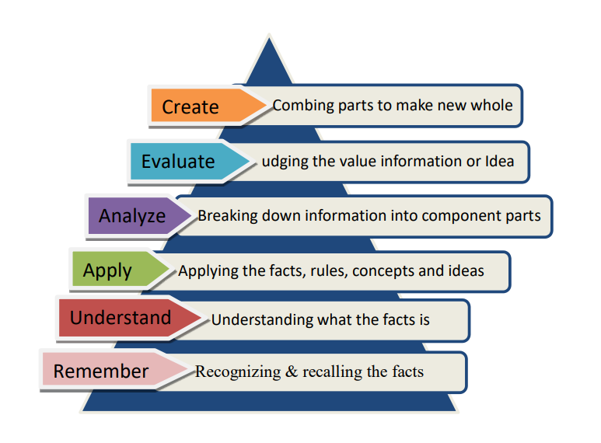
Action Verbs for Course Outcomes: Blooms Revised Taxonomy

Slide 69
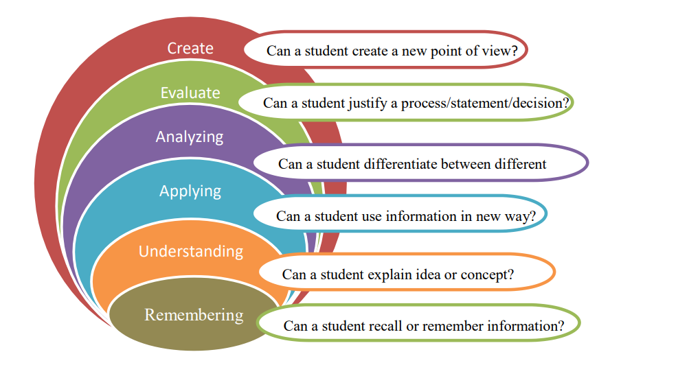
Action Verbs for Course Outcomes: Blooms Revised Taxonomy

Slide 70
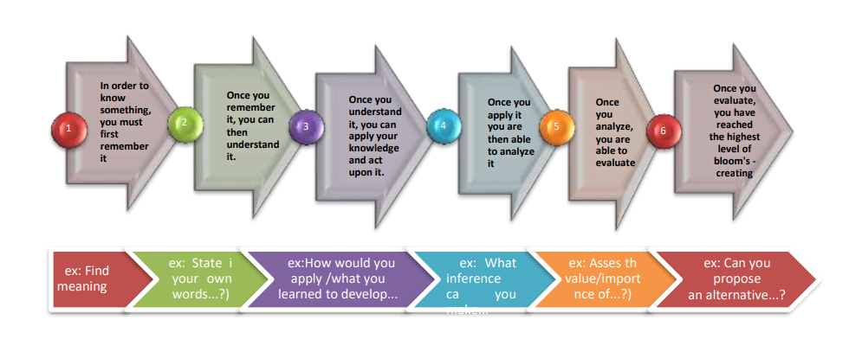
Action Verbs for Course Outcomes: Blooms Revised Taxonomy

Slide 71
Action Verbs for Course Outcomes: Blooms Revised Taxonomy
Problem 1: Water falls from a height of 100 m. Find the rise in temperature of the water when it reaches the bottom, assuming all its energy is converted to heat at the bottom of the waterfall. (g=10ms−2,sw=4200Jkg−1K−1)
Solution:
Given:
Specific Heat of water, sw=4.2J/Calorie
g=10ms−2, the acceleration of gravity
Height, H=100m
swΔT=g×H
So, rise in temperature, ΔT=swgH=4200/(10×100)=4.2K
According to Energy conservation law, energy is neither created nor destroyed

Slide 72
Action Verbs for Course Outcomes: Blooms Revised Taxonomy
BTL Level 1: Remember = When water is at 100m height it possess Potential energy
PE=mgh
BTL Level 2: Understand = when water is falling from height, the Potential energy is converted to Kinetic energy
KE=1/2 mv2
BTL level 3: Apply = ΔT=swgH=4200/(10×100)=4.2K

Slide 73
Continuation of concept -
Sample 4, 5 and 6 BTL levels
BTL level 4: Analyse = Find the rise in temperature at the bottom with different heights of water fall, prepare and analyse the data
BTL level 5: Evaluate = Evaluate the principles of energy conversions with the above analysed data with the conversion of Kinetic energy into Mechanical energy
BTL level 6: Create = Create and design the electrical Power Turbine which generates the electrical energy from Mechanical energy. Temperature differences, specifically through the Seebeck effect or by driving heat engines, play a crucial role in converting mechanical energy into electrical energy, with larger temperature differences leading to greater power generation.

Slide 74

BTL Levels using Newton’s 2nd Law of Motion
Problem 2: Why Falling on sand results in less injury than falling on a hard surface using Newton's second law of motion.
BTL Level 1: Remember – F=ma
BTL Level 2: Understand – The rate of change of momentum = force applied
BTL Level 3: Apply - F ∝ m(v-u)/t
(v-u)/t = a
F ∝ ma
F = kma
If m=1kg, a=1m/s2 then, f=ma
Sir Issac Newton

Slide 75
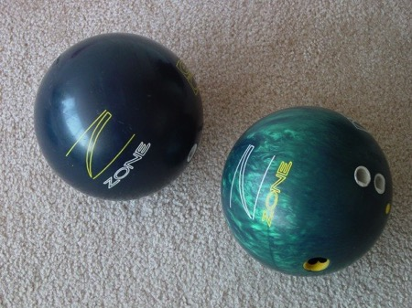
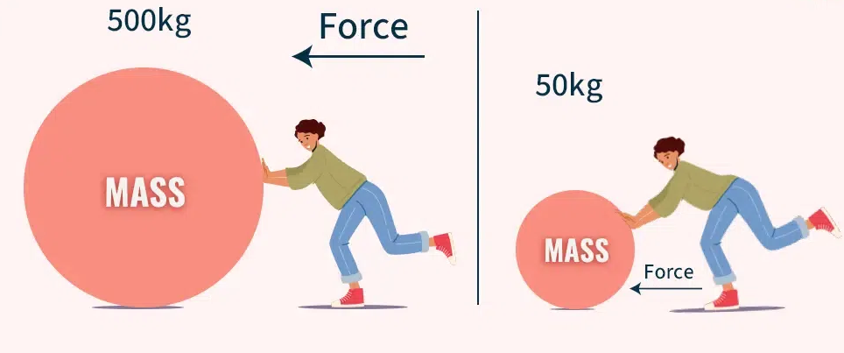
BTL levels using Newton’s 2nd Law of Motion
BTL Level 4: Analyze - When a person falls, they possess momentum, which is mass in motion. Upon landing, this momentum reduces to zero. The impulse, or change in momentum, remains consistent whether the person lands on sand or a hard surface.
BTL Level 5: Evaluate - By understanding the mass of a machine and the forces acting upon it, engineers can accurately predict its acceleration and velocity, ensuring the machine meets performance standards. By applying Newton's Second Law, engineers can optimize machine design by adjusting variables such as mass and force to achieve desired performance characteristics.
This law is crucial for ensuring the safety of machines and their operators, as it helps engineers understand how forces impact motion during crashes or impacts, leading to the design of safer vehicles and equipment.

Slide 76


BTL levels using Newton’s 2nd Law of Motion
BTL level 6: Create - Engineers use the law to design machines that move efficiently and safely. For example, in car design, understanding how forces affect acceleration and braking is crucial for safety features like airbags and seatbelts.

Slide 77
Thinking Skills
Lower Order Thinking Skills
Based on Bloom’s taxonomy of critical thinking, Lower Order Thinking Skills have three levels.
They are Remembering, Understanding and Applying.
Higher-order thinking skills
The higher-order thinking skills include Analyzing, Evaluating, and Creating. It consist Complex thinking that achieves more than the basic recall of facts.
Higher-order thinking skills enable students to retain information learned, and apply problem-solving solutions to real world problems.

Slide 78
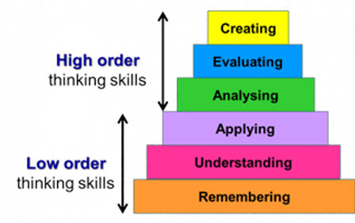
Thinking Skills

Slide 79
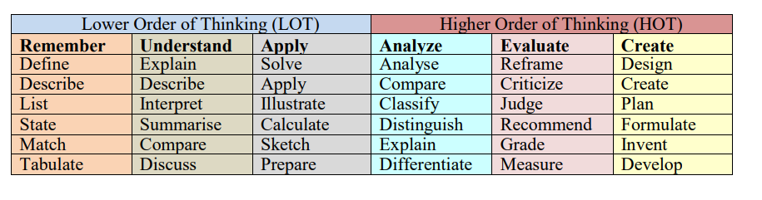
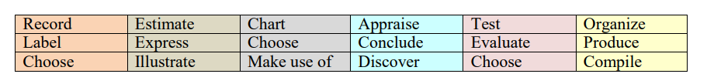
List of Action Words

Slide 80
Process to Maintain Quality of the Course Outcomes
After the course (subject) allotment from the department, identify the expected learning outcomes from the course i.e. what knowledge or skills from this course will students will acquire to perform well in the future. Make a list of learning outcomes first.
Look over the list and check the most important learning outcomes.
Identify 4 to 6 most important learning outcomes from the course using the action verbs of learning levels.
It should be related to the skills, knowledge, and behaviour that students will acquire through the course.
Check how clear and how important are the statements of outcomes for the students?
Check each of the most important outcomes identified against the list of program outcomes stated the by NBA.
How many are on the list of key competencies of program outcomes?
Existing COs are revised upon feedback from stakeholders or during the cycle of Curriculum Review.

Slide 81
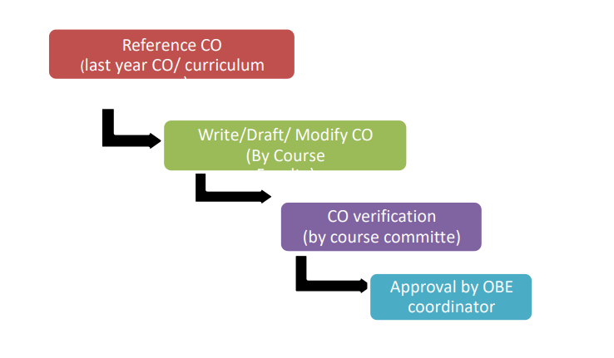
Process to Maintain Quality of the Course Outcomes

Slide 82
Observations
For the theory courses, while writing the COs, restrict between Blooms Level 1 to Level 4.
For the laboratory courses, while composing COs, restrict between Blooms Level 1 to Level 5.
For mini-project and major projects, extend up to Blooms Level 6 while composing COs

Slide 83
Relation Between POs and COs:
CO-PO Mapping
Before developing the relationship between the CO and PO, it is necessary to understand the action verbs used in the PO statements. The table shows the PO with action verbs and corresponding Bloom levels.
The Course Outcomes should be mapped with at least one of the PO i.e. all POs can be adequately addressed through the selection of core courses and their COs
When designing the COs, faculty handling the course should map their COs to the appropriate PO in order to ensure that all POs are delivered throughout the period of study.
Write the COs for a course and see to what extent each of those CO’s correlate with the POs.

Slide 84
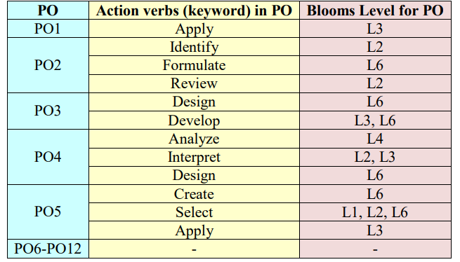
Relation Between POs and COs:
CO-PO Mapping

Slide 85
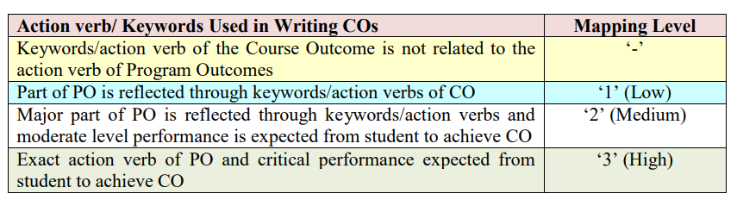
CO-PO Mapping Guidelines
The correlation level to CO-PO matrix can be assigned as given in Table below:

Slide 86
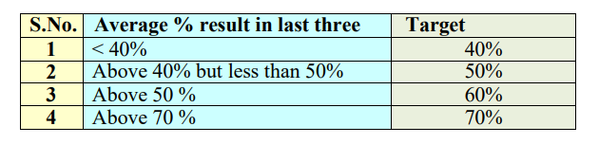
Targets
Same target for all the COs of a course
For Example, the target for all the course outcomes can be >= 60% of the
maximum marks allocated to CO.

Slide 87
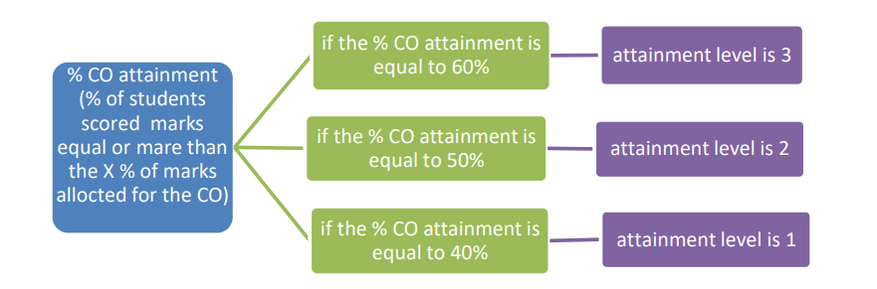
Levels of Attainment
Here 3 levels of attainment are taken as 1-Low; 2-medium; 3- High. These 3 levels of attainment can be defined as:

Slide 88
Rubrics for Project
Consistency and Objectivity: Rubrics help ensure that all students are evaluated using the same criteria and standards, leading to more consistent and objective grading.
Student Learning: By clearly outlining expectations, rubrics help students understand what is expected of them and how they will be assessed, promoting better learning outcomes.
Effective Feedback: Rubrics provide students with detailed and constructive feedback, allowing them to identify areas for improvement and growth.
Facilitates Assessment: Rubrics streamline the assessment process, making it easier for instructors to evaluate student work and provide feedback.
Problem Definition and Scope: Clearly defines the problem, identifies objectives, and sets the scope of the project.
Design and Methodology: Explains the design process, methodology, and rationale behind the chosen approach.

Slide 89
Rubrics for Project
Implementation and Testing: Demonstrates the ability to implement the design, conduct experiments, and analyze results.
Documentation and Communication: Presents the project findings in a clear, concise, and professional manner through reports and presentations.
Teamwork and Collaboration: Demonstrates effective teamwork, communication, and collaboration skills.
Resource Conservation and Sustainability: Considers and implements resource conservation and sustainability strategies.
Cost Analysis and Profitability: Conducts a cost analysis and profitability analysis.
Ethical Considerations: Demonstrates an understanding of ethical considerations in engineering.

Slide 90
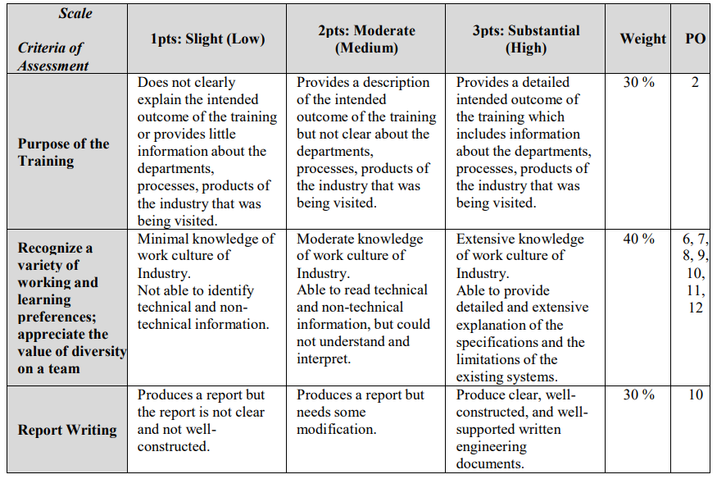
Rubrics for Industrial Visit

Slide 91
Attainment of PO and PSO Outcomes
Direct Assessment
Process for Direct Assessment
1. CO-PO matrix is developed for each course.
2. The PO attainment for given CO attainment in a course is computed as follows:
a. The CO attainment data is multiplied by the mapping strength (1, 2 or 3).
b. Above step is repeated for all COs of the course for given PO.
c. The weighted COs attainment so obtained are added.
d. Weighted sum is then divided by the total mapping strength of that PO with all COs of
the course.
3. Step a-d are repeated for each PO mapping with the course.
4. Step i-iii is repeated for all courses.
5. The average of PO attainment in individual Courses is the final direct PO/PSO attainment
in the level of 1,2 &3

Slide 92
Attainment of PO and PSO Outcomes
Indirect Assessment Tools
1. Feedback and survey questionnaire with score/level for each question is prepared for all the stake holders.
2. Graduate Exit Feedback is taken by the students.
3. Alumni, particularly who has graduated within the 3-4 years of current academic year, feedback is taken on POs & PSOs.
4. Industrial Feedback is taken from industry persons.
Overall PO/PSO attainment
Data thus obtained is consolidated and average value is computed. The average value obtained is the final indirect PO attainment. The Overall PO/PSO attainment is calculated using the rubric.

Slide 93
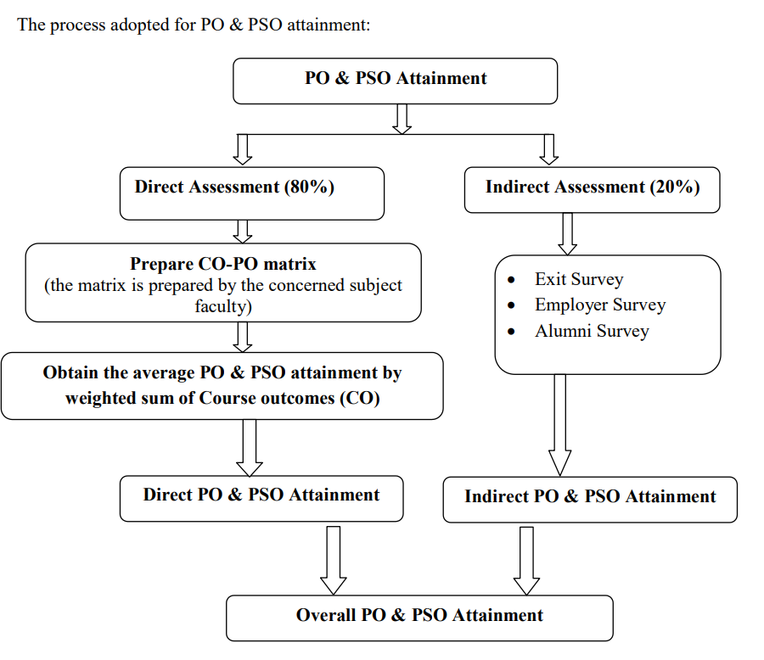
Process Adopted for PO and PSO Attainment

Slide 94
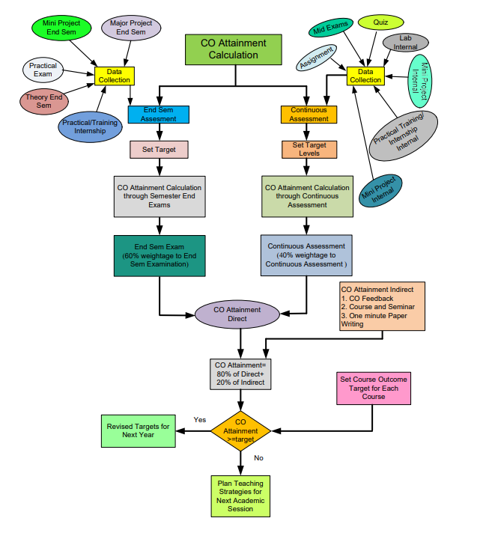

Slide 95
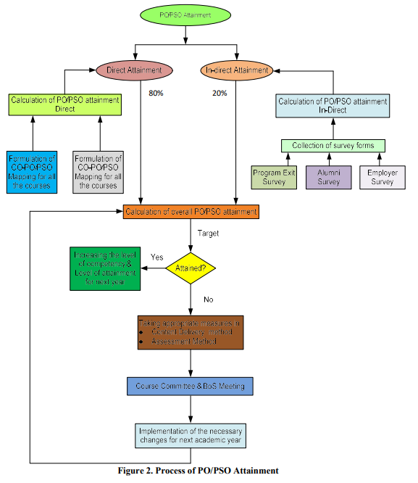

Slide 96
Write Course Outcomes (COs) for Each Course of the Program
Write about 5-6 COs for each course using the action verbs of learning levels, It should be narrower and measurable statements.
CO statements should describe what the students are expected to know and able to do at the end of each course, which are related to the skills, knowledge and behavior that students will acquire through the course.
Departmental Course Committees to finalize COs (Not individual faculty members).

Slide 97
Mapping of CO’s with PO’s
After CO statements are developed by the course in-charge, CO’s should map with any possible PO’s based on the relationship exist between them.
All PO’s are not necessarily mapped with any one CO and it may be left blank.
All the courses together must cover all the POs (and PSOs). For a course we map the COs to POs through the CO-PO matrix and to PSOs through the CO-PSO matrix.
The CO-PO mapping has been done with correlation levels of 3, 2, 1 and ‘-’. The notation of 3, 2 and 1 denotes substantially (high), moderately (medium) and slightly (low). The meaning of ‘-’ is no correlation between CO and PO.
The Process for mapping the values for CO-PO Matrix is given in the Table below.

Slide 98
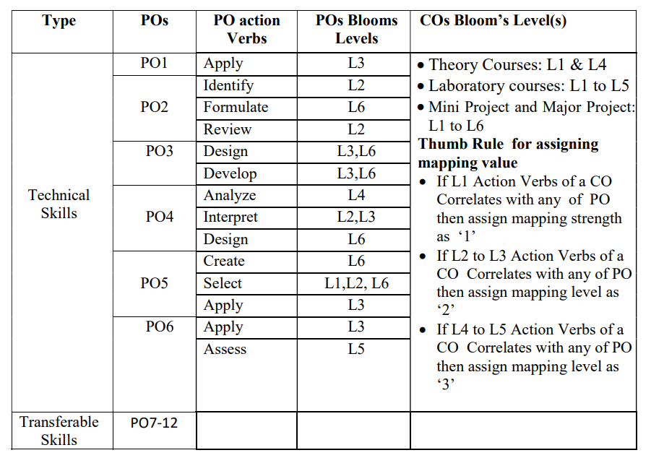
Process for mapping the values for CO-PO Matrix

Slide 99
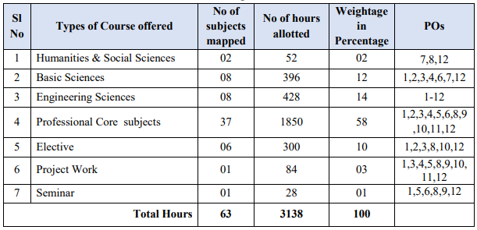
CO – PO MATRICES OF COURCES

Slide 100
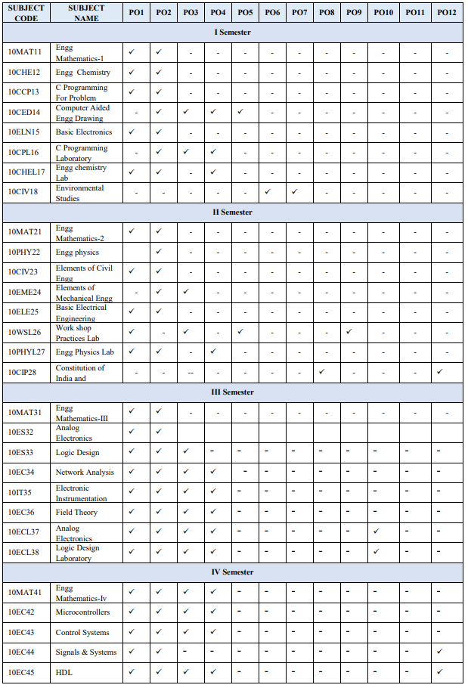
CO – PO MATRICES OF COURCES

Slide 101
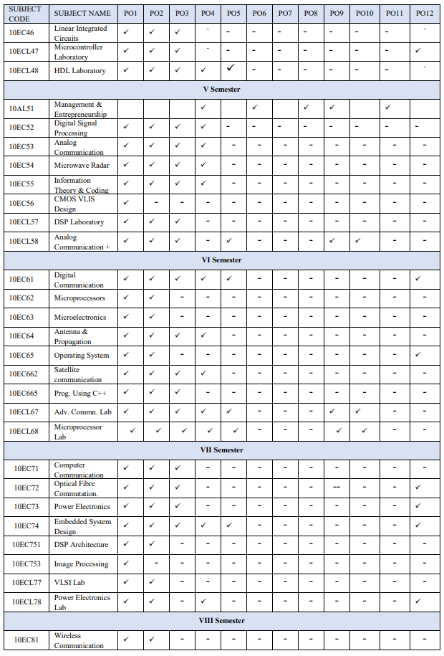

Slide 102
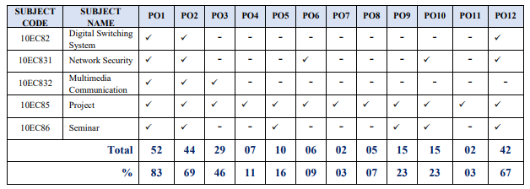
CO – PO MATRICES OF COURCES

Slide 103
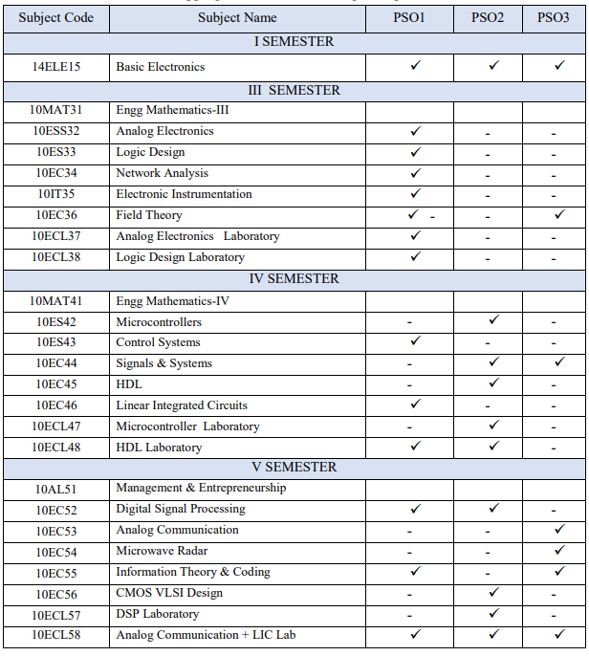

Slide 104
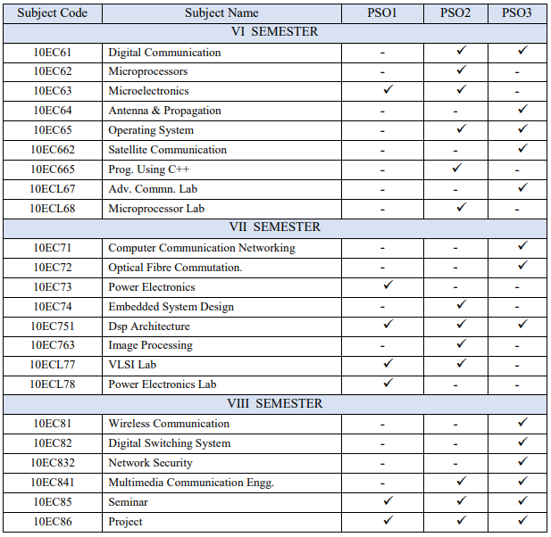

Slide 105
Process Used to Identify the Curricular Gaps to the Attainment of COs/POs
The course handle faculty, after CO-PO mapping, would submit CO attainment to Course coordinator.
The course coordinator would submit the CO-PO attainment along with curriculum gap identified in the course and recommendations to conduct co-curricular activities & identify content beyond the syllabus to Year wise coordinator.
The year wise coordinators who are the members of the PAC would consolidate the CO attainment of the respective year along with curricular gaps and recommendations to conduct co-curricular activities reported by course coordinators.
The PAC would consolidate the CO and PO attainment of the programme with all the identified gaps and submit report to DAB.

Slide 106
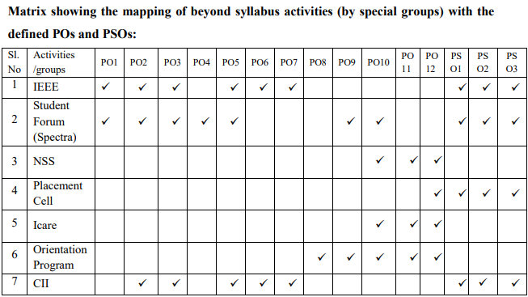

Slide 107
Attainment of Course Outcomes
Describe the assessment processes used to gather the data upon which the evaluation of Course Outcome is based
(Examples of data collection processes may include, but are not limited to, specific exam/tutorial questions, assignments, laboratory tests, project evaluation, student portfolios
(A portfolio is a collection of artifacts that demonstrate skills, personal characteristics and accomplishments created by the student during study period),
internally developed assessment exams, project presentations, oral exams etc.)

Slide 108
Attainment of Course Outcomes
Program shall have set Course Outcome attainment levels for all courses.
(The attainment levels shall be set considering average performance levels in the university examination or any higher value set as target for the assessment years.)
Measuring Course Outcomes attained through University Examinations
Target may be stated in terms of percentage of students getting more than the university average marks or more as selected by the Program in the final examination.
For cases where the university does not provide useful indicators like average or median marks etc., the program may choose an attainment level on its own with justification.

Slide 109
Measuring CO Attainment Through Internal Assessments
The examples indicated are for reference only. Program may appropriately define levels
Target may be stated in terms of percentage of students getting more than class average marks or set by the program in each of the associated COs in the assessment instruments (midterm tests, assignments, mini projects, reports and presentations etc. as mapped with the COs)
Example
Mid-term test 1 addresses C202.1 and C202.2.
Out of the maximum 20 marks for this test 12 marks are associated with C202.1 and 8 marks are associated with C202.2.

Slide 110
Example related to attainment levels Vs. targets: (The examples indicated are for reference only. Program may appropriately define levels)
Examples related to attainment levels Vs. targets
If targets are achieved then the C202.1 and C202.2 are attained for that year. Program is expected to set higher targets for the following years as a part of continuous improvement.
If targets are not achieved the program should put in place an action plan to attain the target in subsequent years. Similar targets and achievement are to be stated for the other midterm tests/internal assessment instruments
Attainment Level 1: 60% students scoring more than 60% marks out of the relevant maximum marks. 14
Attainment Level 2: 70% students scoring more than 60% marks out of the relevant maximum marks.
Attainment Level 3: 80% students scoring more than 60% marks out of the relevant maximum marks.
Attainment is measured in terms of actual percentage of students getting set percentage of marks.

Slide 111
Course Outcome Attainment
For Example
Attainment through University Examination: Substantial i.e. 3
Attainment through Internal Assessment: Moderate i.e. 2
Assuming 80% weight age to University examination and 20% weight age to Internal assessment, the attainment calculations will be (80% of University level) + (20% of Internal level) i.e. 80% of 3 + 20% of 2 = 2.4 + 0.4 = 2.8
Note: Weightage of 80% to University exams is only an example. Programs may decide weightages appropriately for University exams and internal assessment with due justification.

Slide 112
Attainment of Program Outcomes and Program Specific Outcomes
Program shall set Program Outcome attainment levels for all POs & PSOs.
The attainment levels by direct (student performance) and indirect (surveys) are to be presented through Program level Course – PO & PSO matrix as indicated.

Slide 113
Example: PO Attainment
Direct Assessment
C201 –High (3)
C302 – Medium (2)
C303 – Low (1)
C401 – High (3)
Attainment level will be summation of levels divided by no. of courses 3+2+1+3/4= 9/4=2.25
Indirect Assessment
Surveys, Analysis, customized to an average value as per levels 1, 2 & 3.
Assumed level – 2
PO Attainment level will be 80% of direct assessment + 20% of indirect assessment
i.e. 1.8 + 0.4 = 2.2

Slide 114
CO-PO Assessment & Attainment

Slide 115
S. No. |  | Mid Sem - 1 |  |  |  |  | Mid Sem - 2 |  |  |  |  | Quiz |  |  |  |  | Assignment |  |  |  |  | End Sem Exam
Count of Students | 25 | CO-1 | CO-2 | CO-3 | CO-4 | CO-5 | CO-1 | CO-2 | CO-3 | CO-4 | CO-5 | CO-1 | CO-2 | CO-3 | CO-4 | CO-5 | CO-1 | CO-2 | CO-3 | CO-4 | CO-5 | CO-1 | CO-2 | CO-3 | CO-4 | CO-5
Max marks allotted |  | 5 | 10 | 0 | 10 | 0 | 5 | 0 | 10 | 0 | 10 | 2 | 2 | 2 | 2 | 2 | 2 | 4 | 4 | 4 | 4 | 8 | 5.5 | 7.5 | 9 | 10.5
Target Value | 0.6 | 3 | 6 | 0 | 6 | 0 | 3 | 0 | 6 | 0 | 6 | 1.2 | 1.2 | 1.2 | 1.2 | 1.2 | 1.2 | 2.4 | 2.4 | 2.4 | 2.4 | 4.8 | 3.3 | 4.5 | 5.4 | 6.3
1 |  | 0 | 9 | 0 | 7 | 0 | 4 | 0 | 8 | 0 | 5 | 2 | 1 | 2 | 2 | 2 | 2 | 4 | 4 | 3 | 2 | 5.5 | 4 | 7.5 | 7 | 8.5
2 |  | 0 | 7 | 0 | 8 | 0 | 5 | 0 | 9 | 0 | 5 | 2 | 1 | 2 | 1 | 1 | 1 | 3 | 3 | 3 | 4 | 5.5 | 3.5 | 3 | 7 | 6.5
3 |  | 0 | 5 | 0 | 6 | 0 | 5 | 0 | 9 | 0 | 5 | 1 | 2 | 1 | 2 | 2 | 2 | 3 | 2 | 3 | 4 | 7.5 | 4.5 | 7.5 | 8.5 | 9.5
4 |  | 0 | 6 | 0 | 10 | 0 | 5 | 0 | 9 | 0 | 4 | 1 | 2 | 1 | 2 | 1 | 2 | 3 | 3 | 4 | 3 | 4.5 | 5.5 | 6.5 | 8.5 | 8.5
5 |  | 0 | 8 | 0 | 8 | 0 | 5 | 0 | 7 | 0 | 4 | 2 | 1 | 2 | 1 | 1 | 1 | 3 | 4 | 4 | 3 | 5.5 | 3 | 7.5 | 6 | 8.5
6 |  | 0 | 7 | 0 | 9 | 0 | 4 | 0 | 9 | 0 | 5 | 0 | 2 | 2 | 2 | 2 | 1 | 2 | 3 | 4 | 4 | 4.5 | 5.5 | 7.5 | 8.5 | 7.5
7 |  | 0 | 7 | 0 | 10 | 0 | 4 | 0 | 7 | 0 | 5 | 2 | 2 | 2 | 2 | 2 | 2 | 3 | 3 | 3 | 3 | 5.5 | 5.5 | 5 | 6 | 9.5
8 |  | 0 | 7 | 0 | 5 | 0 | 4 | 0 | 10 | 0 | 5 | 2 | 2 | 2 | 1 | 1 | 1 | 2 | 2 | 3 | 3 | 5 | 5.5 | 6 | 5.5 | 6
9 |  | 0 | 9 | 0 | 10 | 0 | 4 | 0 | 9 | 0 | 5 | 0 | 2 | 1 | 2 | 2 | 1 | 2 | 2 | 3 | 4 | 7.5 | 4.5 | 7.5 | 8.5 | 10.5
10 |  | 0 | 7 | 0 | 7 | 0 | 5 | 0 | 6 | 0 | 5 | 2 | 2 | 2 | 1 | 2 | 2 | 4 | 3 | 3 | 3 | 5.5 | 5.5 | 5.5 | 7.5 | 8.5
11 |  | 0 | 10 | 0 | 8 | 0 | 4 | 0 | 8 | 0 | 4 | 1 | 2 | 1 | 2 | 2 | 2 | 3 | 3 | 3 | 3 | 7.5 | 3.5 | 5.5 | 8.5 | 9.5
12 |  | 0 | 9 | 0 | 8 | 0 | 5 | 0 | 5 | 0 | 5 | 2 | 1 | 1 | 2 | 2 | 1 | 2 | 2 | 2 | 2 | 6.5 | 5.5 | 4.5 | 8.5 | 10.5
13 |  | 0 | 7 | 0 | 10 | 0 | 2 | 0 | 8 | 0 | 4 | 1 | 1 | 1 | 1 | 2 | 1 | 2 | 3 | 3 | 3 | 7.5 | 3 | 6.5 | 7 | 8.5
14 |  | 0 | 3 | 0 | 10 | 0 | 3 | 0 | 6 | 0 | 5 | 2 | 2 | 0 | 1 | 2 | 2 | 3 | 3 | 4 | 3 | 6.5 | 2 | 4.5 | 7 | 10.5
15 |  | 0 | 7 | 0 | 8 | 0 | 4 | 0 | 9 | 0 | 3 | 1 | 1 | 0 | 2 | 2 | 2 | 3 | 3 | 3 | 3 | 7.5 | 5.5 | 3 | 7 | 9.5
16 |  | 0 | 7 | 0 | 8 | 0 | 5 | 0 | 8 | 0 | 2 | 1 | 1 | 1 | 2 | 0 | 2 | 3 | 2 | 2 | 2 | 5.5 | 3 | 6.5 | 6 | 10.5
17 |  | 0 | 4 | 0 | 7 | 0 | 5 | 0 | 10 | 0 | 5 | 0 | 1 | 1 | 1 | 1 | 1 | 3 | 4 | 3 | 2 | 4.5 | 4.5 | 5 | 7 | 7.5
18 |  | 0 | 5 | 0 | 9 | 0 | 3 | 0 | 9 | 0 | 5 | 1 | 2 | 1 | 1 | 2 | 2 | 4 | 4 | 3 | 3 | 5.5 | 4.5 | 6.5 | 8.5 | 8.5
19 |  | 0 | 6 | 0 | 10 | 0 | 5 | 0 | 8 | 0 | 5 | 1 | 1 | 2 | 0 | 2 | 1 | 2 | 3 | 3 | 2 | 5.5 | 4 | 6.5 | 7 | 8.5
20 |  | 0 | 8 | 0 | 8 | 0 | 5 | 0 | 9 | 0 | 5 | 2 | 2 | 2 | 2 | 2 | 1 | 2 | 2 | 2 | 2 | 7.5 | 5.5 | 7.5 | 8.5 | 6.5
21 |  | 0 | 9 | 0 | 6 | 0 | 5 | 0 | 10 | 0 | 4 | 2 | 2 | 2 | 1 | 2 | 2 | 3 | 3 | 4 | 4 | 6.5 | 3 | 6.5 | 7 | 9.5
22 |  | 0 | 9 | 0 | 9 | 0 | 4 | 0 | 10 | 0 | 5 | 2 | 2 | 2 | 2 | 2 | 2 | 4 | 4 | 4 | 4 | 5.5 | 2 | 5.5 | 6 | 8.5
23 |  | 0 | 9 | 0 | 8 | 0 | 4 | 0 | 7 | 0 | 5 | 2 | 2 | 2 | 2 | 1 | 2 | 4 | 3 | 3 | 4 | 6.5 | 5.5 | 6 | 7 | 10.5
24 |  | 0 | 7 | 0 | 9 | 0 | 4 | 0 | 10 | 0 | 5 | 1 | 1 | 1 | 2 | 2 | 2 | 3 | 3 | 4 | 4 | 5.5 | 3 | 6.5 | 7 | 7.5
25 |  | 0 | 9 | 0 | 8 | 0 | 5 | 0 | 8 | 0 | 5 | 2 | 1 | 1 | 2 | 2 | 2 | 3 | 2 | 2 | 3 | 3.5 | 3.5 | 4.5 | 7.5 | 7.5
No. of Students Scored More Than Target Value |  | 0 | 21 | 0 | 24 | 0 | 24 | 0 | 24 | 0 | 0 | 13 | 14 | 12 | 15 | 18 | 15 | 18 | 18 | 21 | 19 | 21 | 18 | 23 | 25 | 24
CO - Attainment |  | 0 | 0.84 | 0 | 0.96 | 0 | 0.96 | 0 | 0.96 | 0 | 0 | 0.52 | 0.56 | 0.48 | 0.6 | 0.72 | 0.6 | 0.72 | 0.72 | 0.84 | 0.76 | 0.84 | 0.72 | 0.92 | 1 | 0.96
% Attainment |  | 0% | 84% | 0% | 96% | 0% | 96% | 0% | 96% | 0% | 0% | 52% | 56% | 48% | 60% | 72% | 60% | 72% | 72% | 84% | 76% | 84% | 72% | 92% | 100% | 96%
Level of Attainment |  | 0 | 3 | 0 | 3 | 0 | 3 | 0 | 3 | 0 | 0 | 1 | 1 | 1 | 2 | 3 | 2 | 3 | 3 | 3 | 3 | 3 | 3 | 3 | 3 | 3

Slide 116
Direct attainment % |  |  |  |  | Indirect attainment % |  |  | Total attainment % |  |  |  |  | Course Attainment % Analysis
CO No. | CIE | SEE | Total |  | CO No. | Course End Survey |  | CO No. | Direct | Indirect | Total |  | CO No. | CO Average | CO Target | Attained | Target Achieved
C126.1 | 93.88 | 55.91 | 71.10 |  | C126.1 | 86.33 |  | C126.1 | 71.10 | 86.33 | 74.15 |  | C126.1 | 100.00 | 70.00 | 74.15 | YES
C126.2 | 91.83 | 89.71 | 90.56 |  | C126.2 | 91.00 |  | C126.2 | 90.56 | 91.00 | 90.64 |  | C126.2 | 100.00 | 70.00 | 90.64 | YES
C126.3 | 68.69 | 88.89 | 80.81 |  | C126.3 | 90.33 |  | C126.3 | 80.81 | 90.33 | 82.72 |  | C126.3 | 100.00 | 70.00 | 82.72 | YES
C126.4 | 94.48 | 97.44 | 96.26 |  | C126.4 | 89.00 |  | C126.4 | 96.26 | 89.00 | 94.80 |  | C126.4 | 100.00 | 70.00 | 94.80 | YES
C126.5 | 88.09 | 100.00 | 95.23 |  | C126.5 | 89.00 |  | C126.5 | 95.23 | 89.00 | 93.99 |  | C126.5 | 100.00 | 70.00 | 93.99 | YES
C126.6 | 64.97 | 79.31 | 73.58 |  | C126.6 | 91.67 |  | C126.6 | 73.58 | 91.67 | 77.19 |  | C126.6 | 100.00 | 70.00 | 77.19 | YES
Average of CO | 83.66 | 85.21 | 84.59 |  | Average of CO | 89.56 |  | Average of CO | 84.59 | 89.56 | 85.58 |  | Average of CO | 100.00 | 70.00 | 85.58 | YES
Direct attainment level |  |  |  |  | Indirect attainment level |  |  | Total attainment level |  |  |  |  | Course Attainment Levels Analysis
CO No. | CIE | SEE | Total |  | CO No. | Course End Survey |  | CO No. | Direct | Indirect | Total |  | CO No. | CO Average | CO Target | Attained | Target Achieved
C126.1 | 3.0 | 1.0 | 1.80 |  | C126.1 | 2.59 |  | C126.1 | 1.80 | 2.59 | 1.96 |  | C126.1 | 3.00 | 2.10 | 1.96 | NO
C126.2 | 3.0 | 3.0 | 3.00 |  | C126.2 | 2.73 |  | C126.2 | 3.00 | 2.73 | 2.95 |  | C126.2 | 3.00 | 2.10 | 2.95 | YES
C126.3 | 1.0 | 3.0 | 2.20 |  | C126.3 | 2.71 |  | C126.3 | 2.20 | 2.71 | 2.30 |  | C126.3 | 3.00 | 2.10 | 2.30 | YES
C126.4 | 3.0 | 3.0 | 3.00 |  | C126.4 | 2.67 |  | C126.4 | 3.00 | 2.67 | 2.93 |  | C126.4 | 2.40 | 1.68 | 2.93 | YES
C126.5 | 3.0 | 3.0 | 3.00 |  | C126.5 | 2.67 |  | C126.5 | 3.00 | 2.67 | 2.93 |  | C126.5 | 2.20 | 1.54 | 2.93 | YES
C126.6 | 1.0 | 3.0 | 2.20 |  | C126.6 | 2.75 |  | C126.6 | 2.20 | 2.75 | 2.31 |  | C126.6 | 2.67 | 1.87 | 2.31 | YES
Average of CO | 2.33 | 2.67 | 2.53 |  | Average of CO | 2.69 |  | Average of CO | 2.53 | 2.69 | 2.56 |  | Average of CO | 2.71 | 1.90 | 2.56 | YES

Slide 117
S.No. | Course Name | PO1 | PO2 | PO3 | PO4 | PO5 | PO6 | PO7 | PO8 | PO9 | PO10 | PO11 | PO12 | PSO 1 | PSO 2
1 | Data Structures - 2160221 | 1.64 | 1.73 | 1.73 | 1.67 | 1.64 |  | 1.4 |  |  | 1.8 |  | 1.8 | 1.58 | 1.76
2 | Data Structures LAB -2160221 | 3 | 3 | 3 | 3 | 3 |  | 3 |  |  | 3 |  | 3 | 3 | 3
3 | Python Programming -2160222 | 2.98 | 2.98 | 2.98 | 2.99 | 2.98 |  | 3 |  |  | 2.95 |  | 2.95 | 2.98 | 2.98
4 | Python Programming LAB -2160222 | 3 | 3 | 3 | 3 | 3 |  | 3 |  |  | 3 |  | 3 | 3 | 3
5 | Data Base Management -2160223 | 3 | 2.83 | 3 | 2.92 | 3 | 3 | 3 | 3 | 3 | 3 | 3 | 2.92 | 2.9
6 | Data Base Management Lab -2160223 | 3 | 2.83 | 3 | 2.92 | 3 | 3 | 3 | 3 | 3 | 3 | 3 | 2.92 | 2.9
7 | Computer System Organization -2160224 | 2.76 | 2.87 | 2.77 | 2.89 | 2.71 | 2.8 | 2.8 | 2.8 |  |  |  |  | 2.89 | 2.77
8 | Computer Graphics and Multimedia -160411 | 3 | 3 | 3 | 3 | 3 | 3 | 3 | 3 | 3 | 3 | 3 | 3 | 3 | 3
9 | Computer Graphics and Multimedia LAB -160411 | 3 | 3 | 3 | 3 | 3 | 3 | 3 | 3 | 3 | 3 | 3 | 3 | 3 | 3
10 | Computer Networks -160413 | 2.77 | 2.73 | 2.73 | 2.73 | 2.73 | 2.82 | 2.82 | 2.82 | 2.82 | 2.73 | 2.73 | 2.73 | 2.67
11 | Compiler Design -160611 | 1.64 | 1.67 | 1.67 | 1.6 | 1.72 |  | 2.2 |  |  | 2.2 |  | 1.8 | 1.71 | 1.69
12 | Compiler Design LAB -160611 | 3 | 3 | 3 | 3 | 3 |  | 3 |  |  | 3 |  | 3 | 3 | 3
13 | Data Mining -160612 | 2.74 | 2.83 | 2.72 | 2.85 | 2.74 |  | 3 |  |  | 2.6 |  | 2.6 | 2.8 | 2.81
14 | Data Mining LAB -160612 | 3 | 3 | 3 | 3 | 3 |  | 3 |  |  | 3 |  | 3 | 3 | 3
15 | Artificial Intelligence and Machine Learning (160613) | 3 | 2.95 | 2.95 | 2.97 | 2.96 | 2.95 |  |  | 2.9 | 3 | 2.95 | 2.95 | 2.97 | 2.96
16 | Artificial Intelligence and Machine Learning LAB (160613) | 3 | 3 | 3 | 3 | 3 | 3 | 3 | 3 | 3 | 3 | 3 | 3 | 3 | 3
Direct PO attainment |  | 2.78 | 2.78 | 2.78 | 2.78 | 2.78 | 2.95 | 2.81 | 2.95 | 2.96 | 2.82 | 2.95 | 2.78 | 2.78 | 2.77

Slide 118
CO-PO Assessment & Attainment
Indirect PO Attainment |  | PO1 | PO2 | PO3 | PO4 | PO5 | PO6 | PO7 | PO8 | PO9 | PO10 | PO11 | PO12 | PSO 1 | PSO 2
Survey 1 | (Exit Survey) | 2.06 | 2.26 | 2.19 | 2.23 | 2.26 | 2.23 | 2.32 | 2.19 | 2.39 | 2.26 | 2.23 | 2.35 | 2.19 | 2.23
Survey 2 | (Alumni Survey) | 2.1 | 2.1 | 2.06 | 2.14 | 2.01 | 2.08 | 2.06 | 2.12 | 2.14 | 2.19 | 2.26 | 2.23 | 2.15 | 2.1
Survey 3 | (Employer Survey) | 1.84 | 1.93 | 1.9 | 1.74 | 1.61 | 1.66 | 1.87 | 1.89 | 1.82 | 1.9 | 1.68 | 1.31 | 1.66 | 1.58
Indirect PO Attainment |  | 2 | 2.1 | 2.05 | 2.04 | 1.96 | 1.99 | 2.08 | 2.07 | 2.12 | 2.12 | 2.06 | 1.96 | 2 | 1.97
PO ATTAINMENT | PO1 | PO2 | PO3 | PO4 | PO5 | PO6 | PO7 | PO8 | PO9 | PO10 | PO11 | PO12 | PSO 1 | PSO 2
Direct PO Attainment | 2.78 | 2.78 | 2.78 | 2.78 | 2.78 | 2.95 | 2.81 | 2.95 | 2.96 | 2.82 | 2.95 | 2.78 | 2.78 | 2.77
Indirect PO Attainment | 2 | 2.1 | 2.05 | 2.04 | 1.96 | 1.99 | 2.08 | 2.07 | 2.12 | 2.12 | 2.06 | 1.96 | 2 | 1.97
Overall PO Attainment | 2.62 | 2.64 | 2.63 | 2.63 | 2.62 | 2.76 | 2.66 | 2.77 | 2.79 | 2.68 | 2.77 | 2.62 | 2.62 | 2.61
Target value | 2.10 | 2.10 | 2.10 | 2.10 | 2.10 | 2.10 | 2.10 | 2.10 | 2.10 | 2.10 | 2.10 | 2.10 | 2.10 | 2.10
PO Attainment | Y | Y | Y | Y | Y | Y | Y | Y | Y | Y | Y | Y | Y | Y

Slide 119
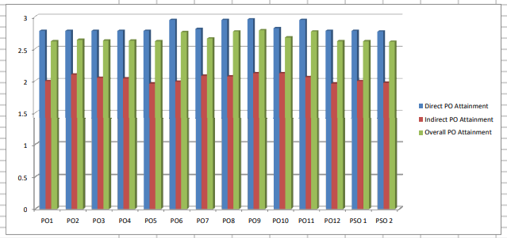

Slide 120
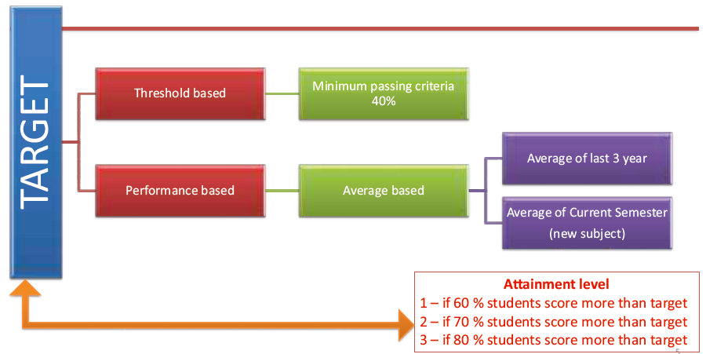
Targets/ Attainment Levels

Slide 121


